Slide 1
Preinjector Status
D. Raparia
Time Meeting
August 19, 2025

Slide 2
Tandem
MP7- RHIC support
Running well after terminal foil change
Change to MP6 on Tuesday night
Terminal foils change on Wednesday
Back on Saturday afternoon to fill RHIC
- MP6 –External User
Provided ( Tue-Sat) a RHIC fill during foil change in MP7
next week internal users

Slide 3
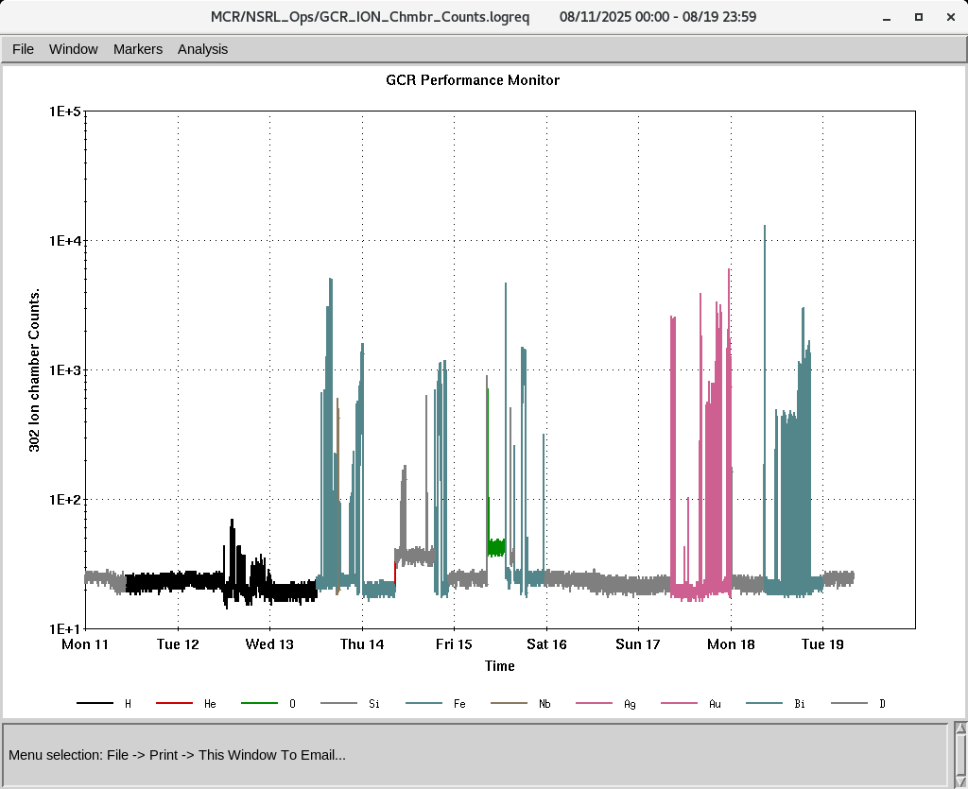
EBIS
Electronics testing continues
P, H₂⁺ and D to NSRL first time
IONS to NSRL
P, H₂⁺,D, O⁺⁵ Si⁺¹¹ Fe⁺²⁰ ,Nb⁺²³ Ag⁺²⁹, Au^{+31,47 ,}Bi⁺⁴⁷

