Slide 1
sPHENIX Status
Kin Yip
sPHENIX Director of Operations
Time Meeting
Aug. 19, 2025

Slide 2
sPHENIX Status & Performance (cont.)
With no more major change to be made, sPHENIX continues data taking with rapid response to any occasional malfunctions/fixes:
PLC problem (Aug. 13) in the Gas-Mixing-House stopped the flow of TPC gases for several hours and we had to allow the gases to flow through TPC several times to get to the right composition before we could operate TPC again Friday (Aug. 15) morning.
An IHCAL sector tripped which required a 30-minute access to fix (Aug. 17).
A thermo-sensor of a cooling unit of the INTT detector went bad and caused false alarms. It was replaced on Monday (Aug. 18).
The shift change meetings are getting shorter (on average), indicative of steady operation.

Slide 3
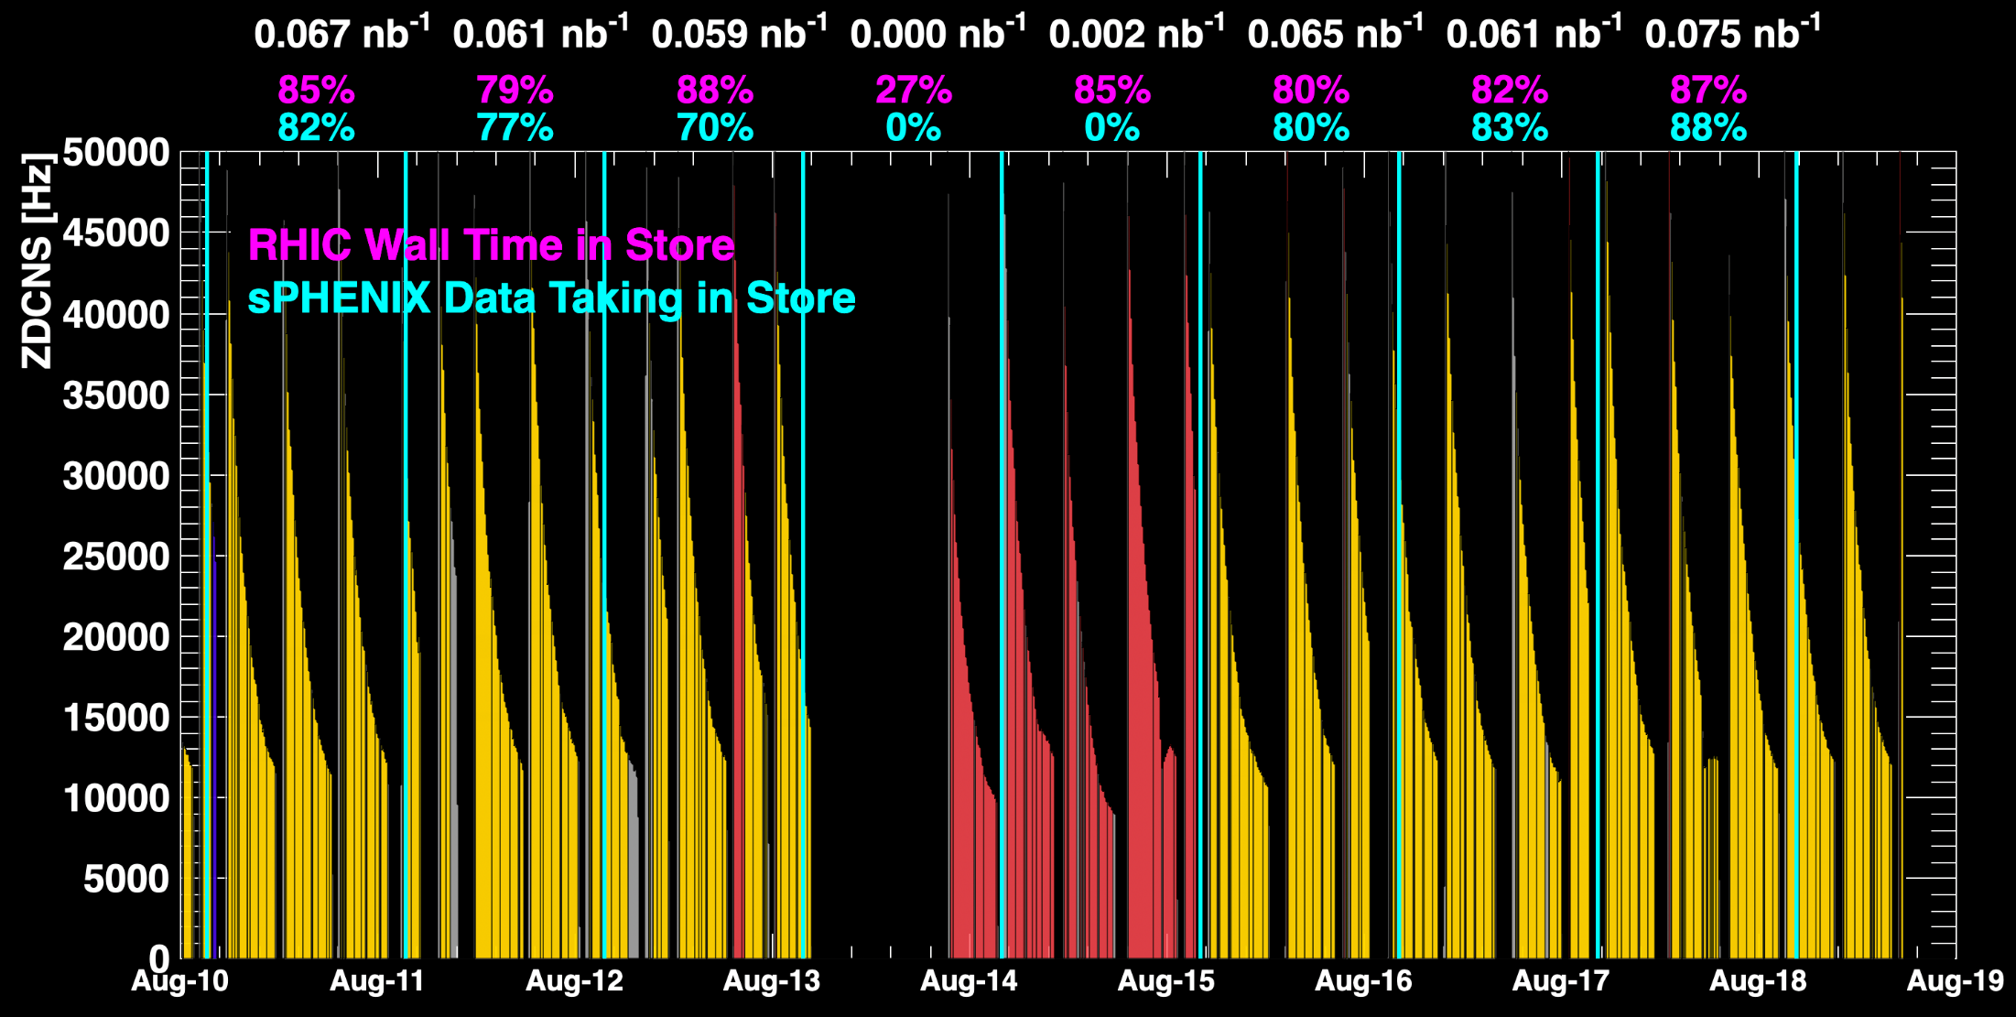
sPHENIX Status & Performance
July 26 was one of the best days yet !
Maintenance Day Not operating TPC
When all sPHENIX detectors were being operated.

Slide 4
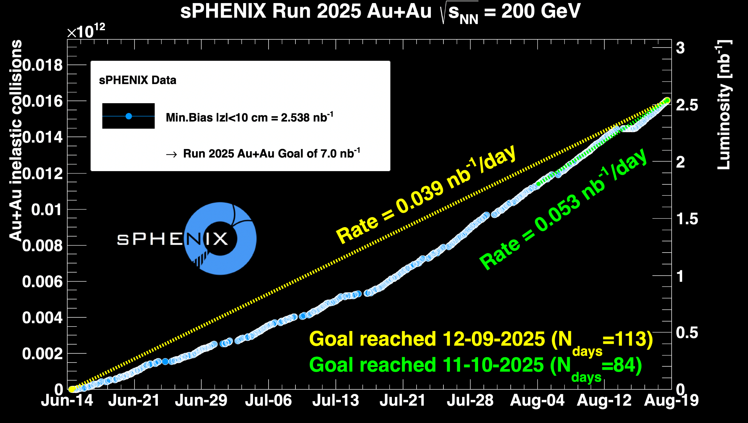
sPHENIX Status & Performance (cont.)

