Slide 1
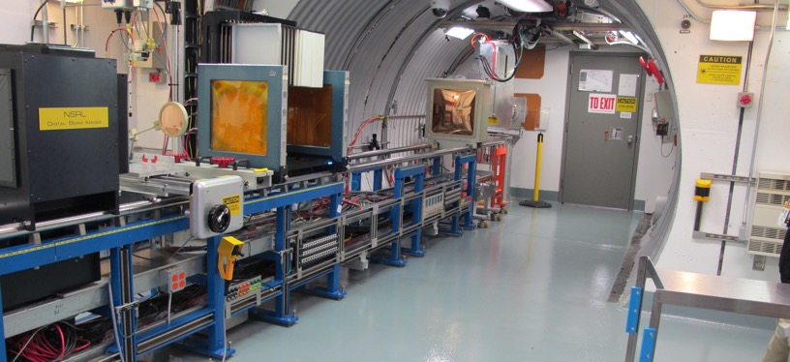
NSRL Time Meeting Report
19 August 2025
Michael Sivertz

Slide 2
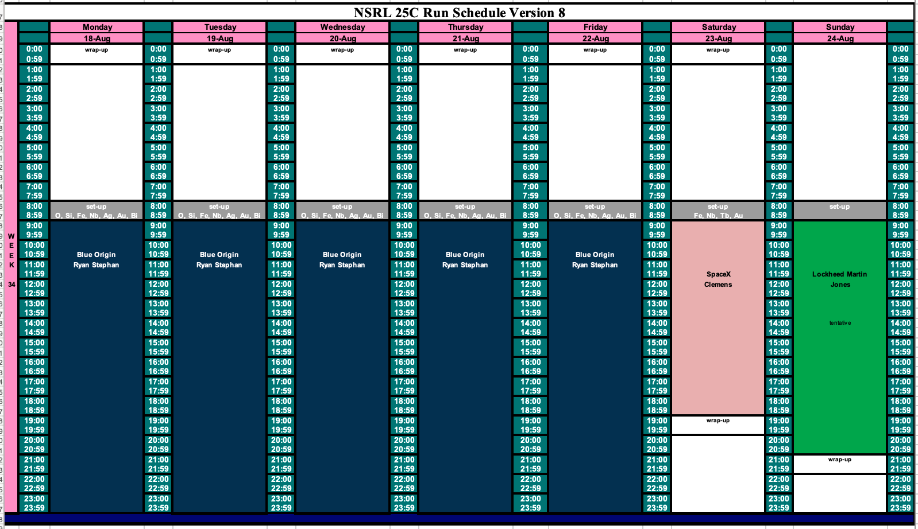
Schedule for this week

Slide 3
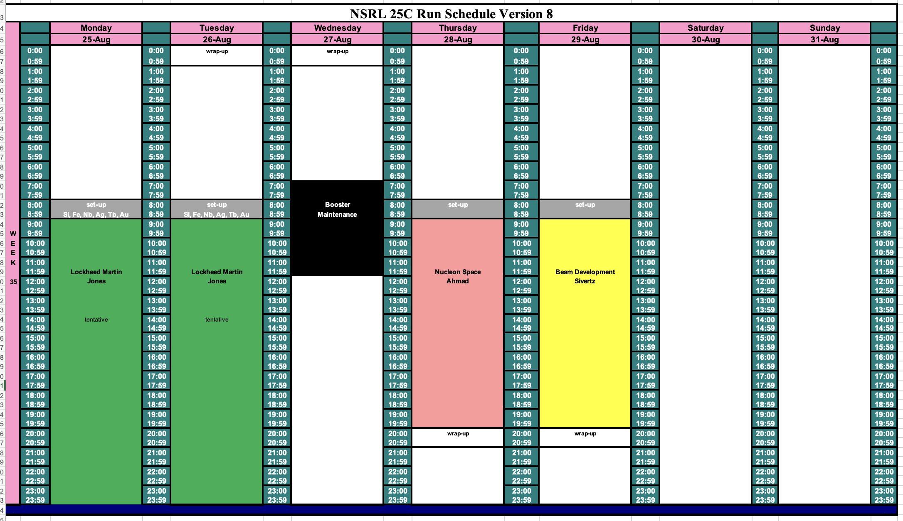
Schedule for next week

Slide 4
Future Schedule
Sunday 17 August begins a week-long run of 16-hour days for Blue Origin using O, Si, Fe, Nb, Ag, Au and Bi.
We run through the following weekend with SpaceX and Lockheed Martin running through the beginning of next week.
Wednesday has no NSRL activity and Friday is a beam development day.
TRMC is back on the schedule with two weeks of 16-hour days beginning
8 September through 20 September. We have no ion species yet.

