Slide 1
Data courtesy C. Naylor

Slide 2
Data courtesy C. Naylor

Slide 3
Data courtesy C. Naylor

Slide 5
Data courtesy C. Naylor

Slide 6
Data courtesy C. Naylor

Slide 7
Data courtesy C. Naylor

Slide 8
Data courtesy C. Naylor

Slide 9
Data courtesy C. Naylor

Slide 10
Data courtesy C. Naylor

Slide 11
Data courtesy C. Naylor

Slide 12
Data courtesy C. Naylor

Slide 13
Operations for BLIP
No BLIP
this past week
BLIP remains in shutdown.
Linac off since 8 July.
Notes:
BLIP plot from LogView /MCR/PerformanceStats/timeMeetingBLIP.lvdisp
Avail calc on nsrl time Excel sheet

Slide 14
NSRL activity past week: 8/12-19/2025 (as of 0800)
NSRL running continues.
Various user time and beam development continuing.
10 species (H, H₂, d, O, Si, Fe, Nb, Ag, Au, Bi) logged to NSRL.
Run 25-C began 30 June; 25-C schedule posted, updates forthcoming through 1 November.
Availability: 97.1%
Notes:
Graph and avail calc from nsrl time.xlsx

Slide 15
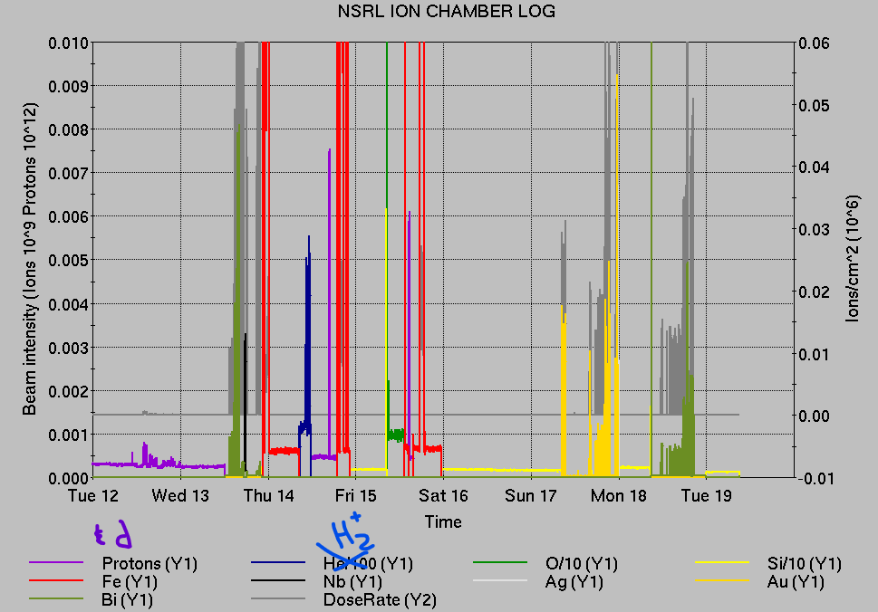
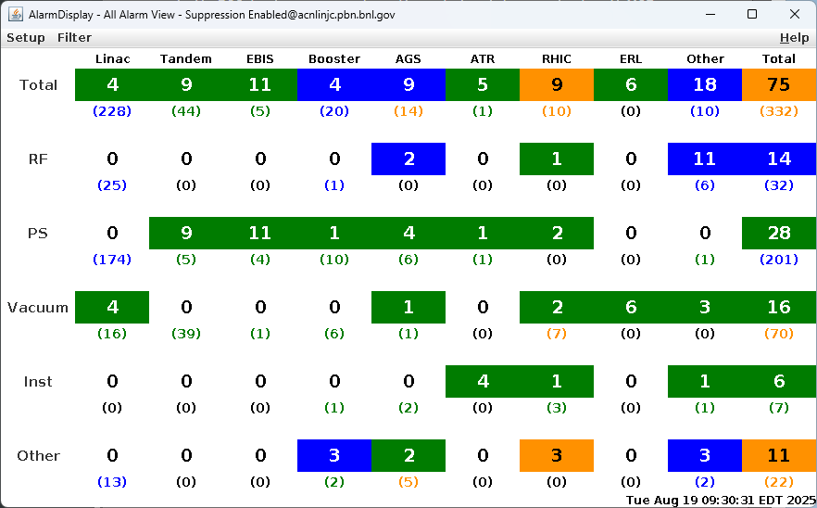
Notes from Operations
Notable failures (>1 hr)
BLM abort, 56MHz FPC connector failure, access to
repair
Tandem MP6 spark, HV recovery (2x)
Beam abort, Cryo lead flow interlock; input card
replaced (2x)
Other notes
1002A ODH trips (3x) with Fire/Rescue response;
system expert local manual reset only
AGS RF sta B still down, awaiting access
EBIS Collector PS (3x), RFQ (2x) other PS trips
STAR Trim West PS trips
NQBPS beam abort, slight power fluctuations
Y-line vacuum valve faults, permit configuration error
Various network/FEC issues, resets
Booster access for RCD survey of EBIS beams, delays
RHIC refill
Vacuum tmp failure, poor housekeeping 1010A
Other various trips, resets, tuning, foil changes
Over 85 hours CeC beam work; additional injector beam for
Au setup, Operator training
(when injector systems are available)
Notes:
NSRL plot from LogView /MCR/PerformanceStats/timeMeetingNSRL.lvdisp, select Dose Rate and ion species in use
Screenshot of AlarmSummary

Slide 16
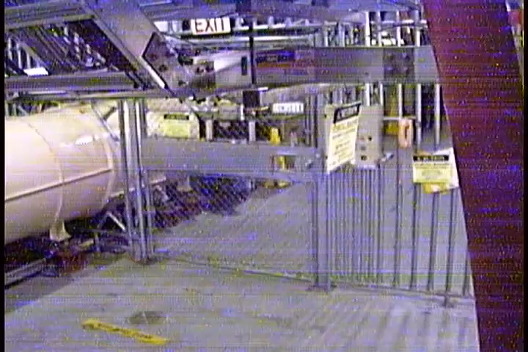
Reminder from Operations
MCR beam operations continue
  RHIC physics running continues
    Tandem (MP7) remains sole provider of Au31 for RHIC
  NSRL shifts continue for users and MD, 7 days/2 shifts this week, 6 days next.
    H₂, d, H established from EBIS; proton intensities low
    Au31 from Tandem for higher intensity; no TVDG protons established (including mode switching)
    Linac proton beams off until November
    Other ion beams from EBIS.
  AGS tuning, other studies to continue behind
  stores as time allows.
  MCR on duty 24/7.
Don’t forget: call MCR gate watch x7400
before you touch the gate.
  Not sure of the process? Ask us.
  Something not working? Tell us.

Slide 17
Keytree notes
Remote keytree systems require a database lookup to validate and authorize distribution of keytokens. The Keytrak system’s database is available for lookup functionality, but can no longer be modified in any way to add or edit qualified personnel.
Personnel affected:
New employees, experimenters arriving after 12/1/2024 could not be enrolled in database
Existing employees & experimenters, not already enrolled, cannot be added or modified in database
Remote keytrees affected:
Iris scan @NSRL
BNLID scan @AGS South gate, North Conjunction Gate
Iris scan @RHIC STAR, sPHENIX, IP12, IP4
Keytrees NOT affected:
BNLID scan @Linac, Booster
BNLID scan @RHIC IP2
MCR keytrees

Slide 18
Keytree notes, continued
Mitigation:
Choose entrants that are currently enrolled to perform the work in the enclosure under Controlled Access (CA).
Obtain CA keys from MCR for remote gate watch
Arrange for local gate watch using other tokens for entrants.
Arrange for Restricted Access, and allow for delays incurred to sweep areas.
CAUTION
Follow procedures. Gate Watch staff will remain vigilant.
  No “piggy-backing” – one key/token per entrant.
  Access keys are not candy! Authenticated entrant retains possession.
Radiological Controls and the Access Controls System are not to be circumvented. This is (has been) enforced with disciplinary action (dismissal).

Slide 20
Notes:
Reliability comparisons to previous runs

Slide 21
Notes:
Reliability comparisons to previous runs

Slide 22
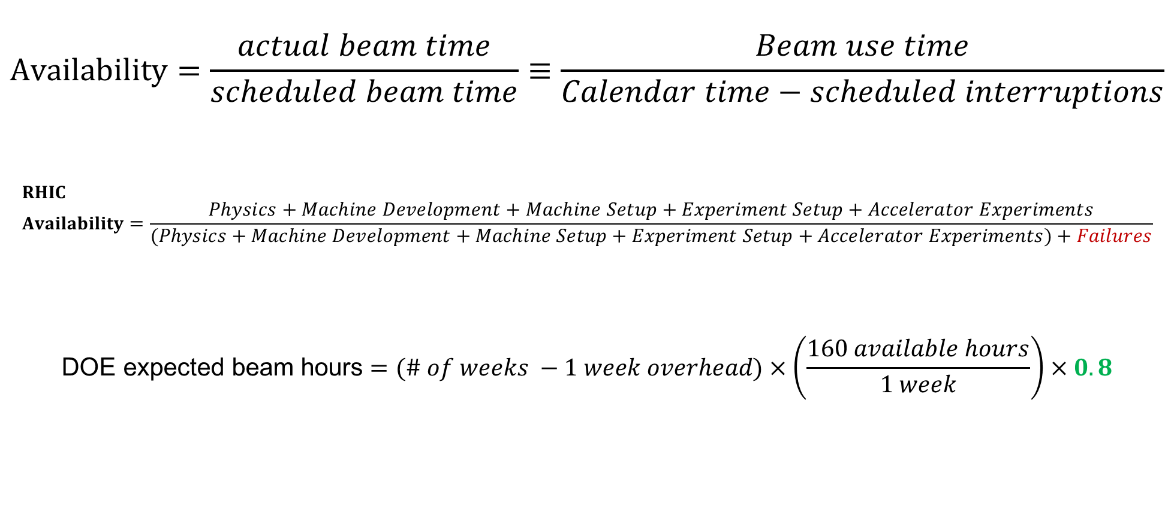
Availability, expected beam hours
$$Availability=\frac{actual beam time}{scheduled beam time}≡\frac{Beam use time}{Calendar time−scheduled interruptions}$$
$$RHIC \\ Availability=\frac{Physics+Machine Development+Machine Setup+Experiment Setup+Accelerator Experiments}{(Physics+Machine Development+Machine Setup+Experiment Setup+Accelerator Experiments)+Failures}$$
$$\text{DOE} \text{expected} \text{beam} \text{hours}=(\# of weeks −1 week overhead)×\left(\frac{160 available hours}{1 week}\right)×0.8$$
Notes:
Normally hidden. Explains how the 85% from DOE comes in to play, & general availability metrics

