Slide 1
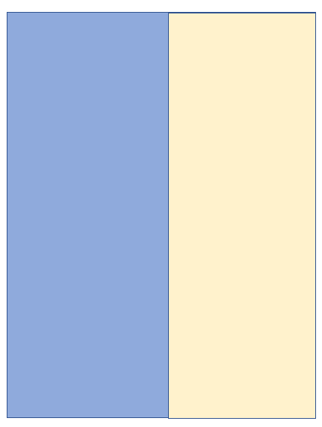
APEX Plan for August 20, Wednesday
( 8:00am - 24:00 pm )
8am
25-01:
Maximize flat beam collision beam-beam parameter
Yun, Bredan, Kevin, Travis, Derong, Christoph, Will, MCR
Store
15pm
Store
25-08
Exploring Sextupole Settings to Reduce Vertical Emittance Growth in Flat Beam Collision
Derong, Yun, Yi-kai, MCR
23pm
Back to Physics
24pm
Physics

