Slide 1


Learning & Organizational Development at BNL
Erica Collins
Sr. Leadership & Organizational Development Specialist
August 2025

Slide 2
L&OD
Leadership Learning Journeys
Institutional Mentorship Program Career Development
Workforce Planning
On Demand Resources
Visit: BNL | Learning & Organizational Development | Home 2

Slide 3
Leadership Learning Journeys
 | Employee Level and Core Capabilities | Learning Experiences
Leading & Managing Organizations | Executive: Strategic Visionary | Complete a 360 Assessment with L&OD Develop IDP based on 360 Feedback Be a mentor as part of Institutional Mentoring Program Engage an executive coach Participate in Battelle and cross-Lab committees, and Communities of Practice Participate in Board involvement Participate in proposal and transition activities
Leading & Managing Programs | Manager: Creativity & Innovation Enterprising Transparent | Complete a 360 Assessment with L&OD Develop IDP based on 360 Feedback Have a mentor/be a mentor as part of Institutional Mentoring Program Participate in Battelle and cross-Lab committees, and Communities of Practice Participate in proposal and transition activities
Leading & Managing People | Supervisor: Accountability Conflict Management Performance Management Collaborative Empathetic | Complete NSO within first year as new Supervisor Complete a 360 Assessment with L&OD Develop IDP based on 360 Feedback Have a mentor/be a mentor as part of Institutional Mentoring Program Enroll in supervisor development program (LEADER) Participate on committees or working groups and Communities of Practice Engage in self-directed learning; Learning Lending Library, LinkedIn Learning
Managing Projects | Project Manager & Team Leader: Decisiveness Influencing/Negotiating Team Building Technical Credibility | Complete a 360 Assessment with L&OD Develop IDP based on 360 Feedback Have a mentor/be a mentor as part of Institutional Mentoring Program Complete SBU Project Management training Participate in L&D learning and networking opportunities and Communities of Practice Engage in self-directed learning; Learning Lending Library, LinkedIn Learning
Managing Yourself (Individual Contributor) | All Employees: Flexibility Integrity/Honesty Interpersonal Skills Communication Problem Solving Respect | Develop IDP with supervisor Have a mentor/be a mentor as part of Institutional Mentoring Program Engage in cross-training Volunteer for special projects Join and become active in outside professional organizations Participate in L&OD learning and networking opportunities and Communities of Practice Engage in self-directed learning; Learning Lending Library, LinkedIn Learning
3

Slide 4
 | Leadership Learning Journeys
 | Courses & Professional Development Programs
Leading & Managing Organizations | Leading Matters Governing for Assurance (in development) Battelle Sr. Manager Onboarding (in development)
Leading & Managing Programs | Laboratory Operations Leadership Academy (LOLA) Leadership Exchange Advancement Program (LEAP) Building Executive Leaders for Tomorrow (BELT) Oppenheimer Science & Engineering Leadership Program (OSELP) Project Leadership Institute (PLI)
Leading & Managing People | New Supervisor Orientation (NSO) Lead Engage Act Develop Empathy Role Model (LEADER) Business Leadership Program (BLP) Human Resources Leadership Development Program (HRELD) LOSA as Lead Role Player BNL LOSA Change Agent Courses: Salary Review Workshop for Supervisors; Feedback Conversations for Supervisors; Critical Conversations, Building Trust, Putting the Law to Work
Managing Projects | SBU Project Manager training Laboratory Operations Supervisor Academy (LOSA) as Participant BNL LOSA Change Agent Courses: Understanding & Managing Social Styles; Emotional Intelligence; Personal Agility
Managing Yourself (Individual Contributor) | Align Skills Practices Inspire Reaching Excellence (ASPIRE) Science & Engineering Development Program (SEDP) Courses: Feedback Loop for Employees; Effective Interviewing; Skillful Collaboration; Communicating Powerfully, Navigating Difficult Conversations, 7 Habits of Highly Effective People, Thriving Amidst Change Visit: BNL | Learning & Organizational Development | Leadership Development Programs
4

Slide 5
Career Development Resources
Career Coaching & Mapping
Individual Development Plan (IDP)
Assessments
Internal Job Preparation
Tuition Assistance
Employees can meet with a certified career coach to discuss career trajectory and assist with career decisions
A developmental "action" plan to help an individual grow from where they are to where they want to go
CCL 360
assessments
  Skill Scope for Individual Contributors
  Benchmark for Managers
Hogan
Employees can gain help and support in resume reviews and practice interviewing techniques
Includes reimbursement for allowable courses and degree programs offered by accredited institutions and job-relevant vocational courses
Visit: BNL | Learning & Organizational Development | Career Development
5

Slide 6

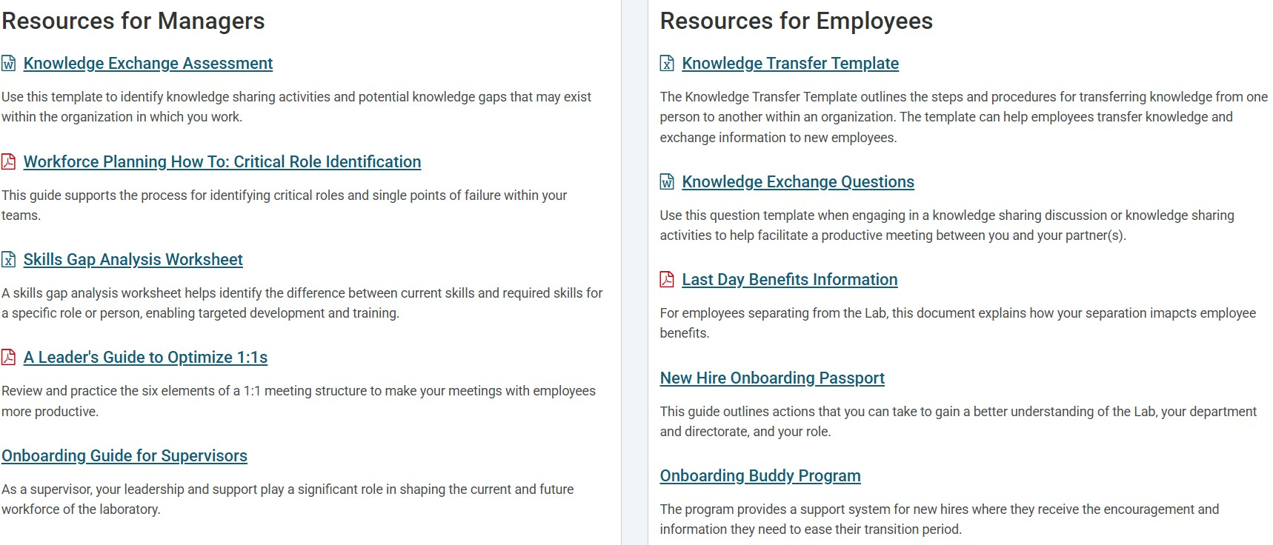
Workforce Planning
How L&OD works with you, lab leadership and your HR Managers:
Performance management
  “Goal Setting Guide”, workshops/classes
Team development
  “Guide for Building High Performing Teams”
Succession planning
  “Succession Planning Manager Guide”
Communities of Practice (CoPs)
  “Building an Effective CoP”
Knowledge Transfer
Visit: BNL | Learning & Organizational Development | Workforce Planning
6

Slide 7












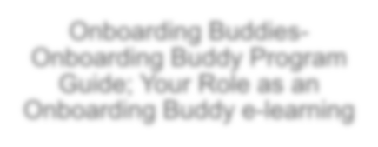



Additional On Demand Learning Resources
LinkedIn Learning
L&OD Lending Library
Onboarding
Visit: BNL | Onboarding Resources | Home
New Hires- BNL Onboarding Passport
Available upon request by submitting the Sign Up Form
Interested in reading one of our physical books? Complete the Request Form
Supervisors- Onboarding Guide for Supervisors
Onboarding Buddies- Onboarding Buddy Program Guide; Your Role as an Onboarding Buddy e-learning
FY26: More to come!
7

Slide 8
Questions?
Contact Learning@bnl.gov
8

