Slide 1
Preinjector Status
J. Ritter/D. Raparia
Time Meeting
August 19, 2025

Slide 2
Tandem
MP7- RHIC support
Running well
some spark
- MP6 –External User
This week internal users

Slide 3
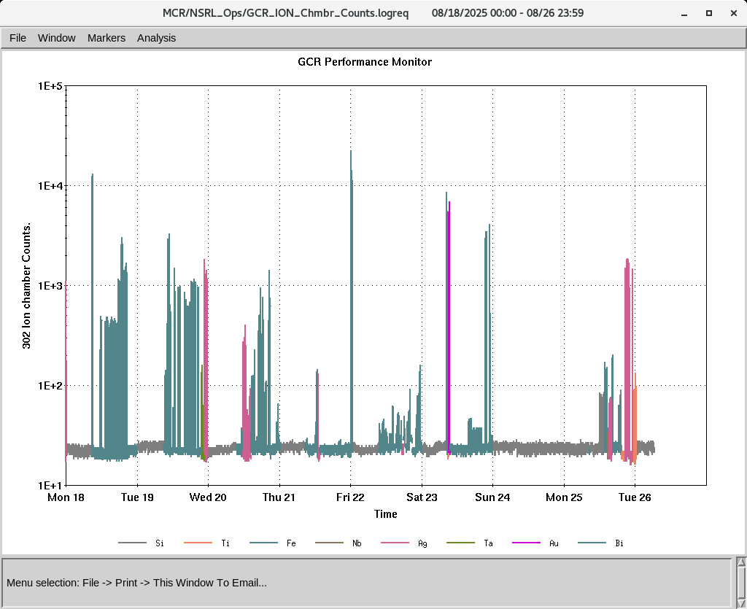
EBIS
Electronics testing continues
worked on D intensity on Sunday
Water leak in the ETB quad eba-q3/q4
Collector trips
IONS to NSRL
Si⁺¹¹ Ti^{+17,} Fe⁺²⁰ ,Nb⁺²³ Ag⁺²⁹, Au^{+31, ,} Ta^{+38 ,}Bi⁺⁴⁷

