Slide 1
sPHENIX Status
Kin Yip
sPHENIX Director of Operations
Time Meeting
Aug. 26, 2025

Slide 2
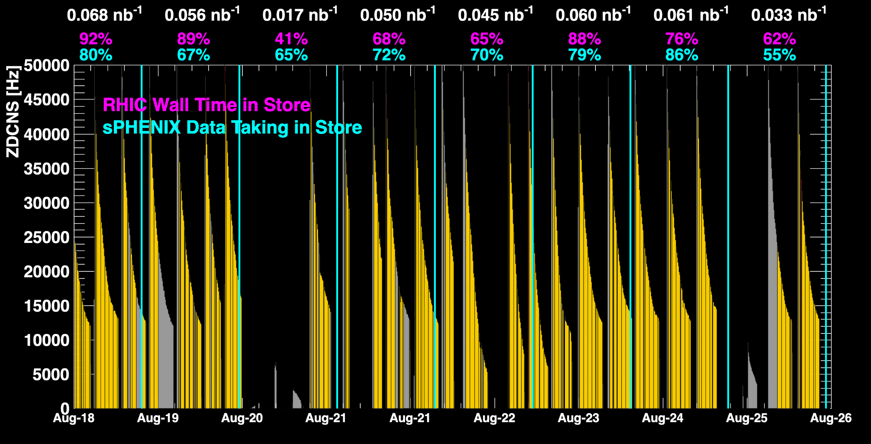
sPHENIX Status & Performance
July 26 was one of the best days yet !
APEX 1008B substation power outage
When all sPHENIX detectors were being operated.

Slide 3
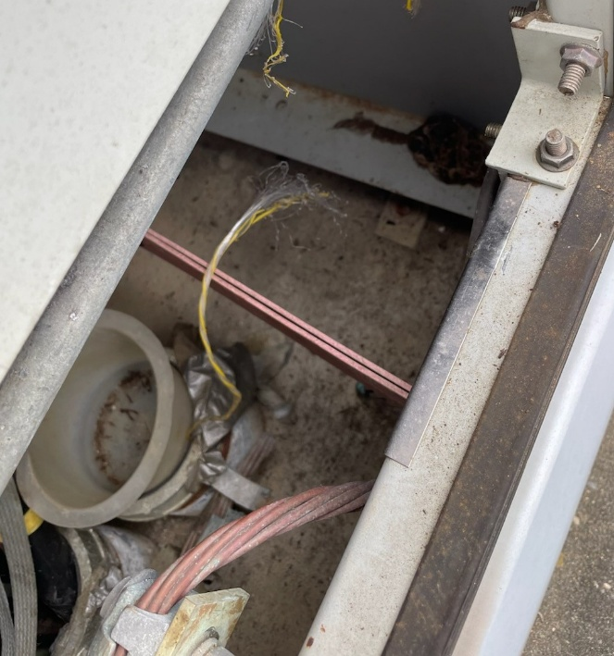
sPHENIX Status & Performance (cont.)
sPHENIX is making every effort to take data as efficiently as possible.
  We fixed a mistake in logic that “TPC Gas Rack” alarms/warnings would close the (KGT) valve for isobutane (Aug. 21).
  Squirrel in 13.8 kV cage caused power outage
  in 8B substation ⇒ brought down cooling water
  (1008C) and magnet (1008B) from 4:33 am to
  ~noon (Aug. 25).
  Today, we are opening or have opened the
  magnet pole-tip door to investigate the glycol
  leak from EMCAL which has apparently
  affected HCAL operation. Though inefficiency is around 0.065% now, we try to avoid further damage.

Slide 4
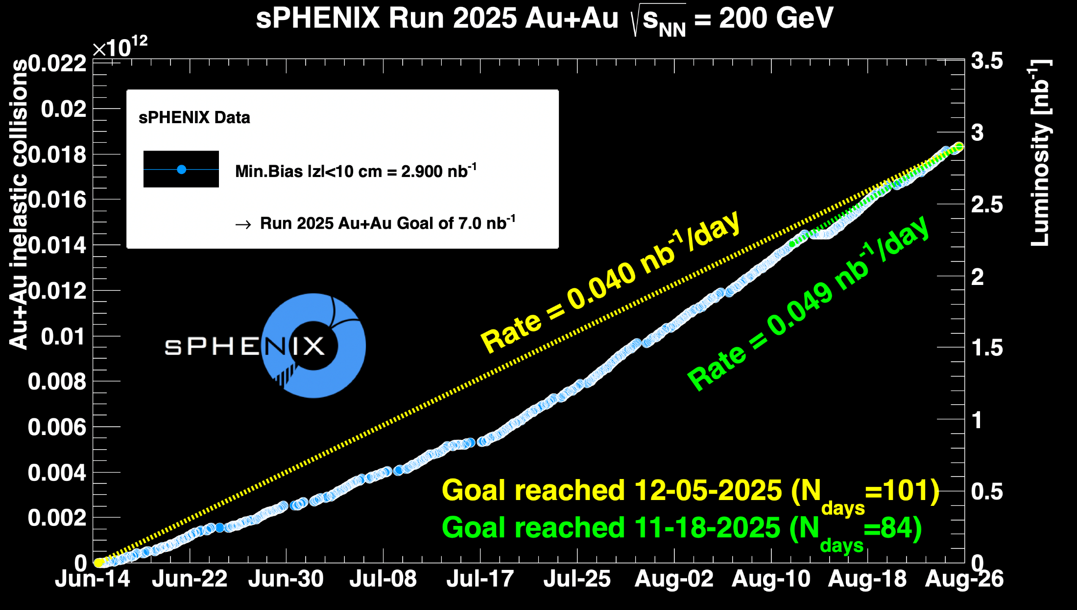
sPHENIX Status & Performance (cont.)

