Slide 1
APEX Report
August 26, 2025

Slide 2
August 20 APEX Session
Planned 7 hours. Use beam time 13.5 hours totally.
Lose first fill when 2 .5 hours into store due to Yellow QLI. Recovering from QLI took about 1.5 hours. Lose second fill at beginning of store due to unstable power line. Useful bema time since 14pm.
In the following had two fills for beam experiments. Struggled with Yellow emittance ratio in both fills.
For the last fill, we collided 11:1 blue beam with 4:1 yellow beam. Later on, we cooled both beams with collision. We made to 12:1 blue beam colliding with 8.5:1 yellow beam. Un-cogged and re-cogged beams to check set tunes. Yellow beam decay about 30-40% with beam-beam parameters (0.002, 0.007)/IP. Blue beam-beam parameters were smaller than yellow beam.
A much larger tune split needed for Yellow to generate a flat beam than usual. Separation bumps may alter coupling condition.

Slide 3
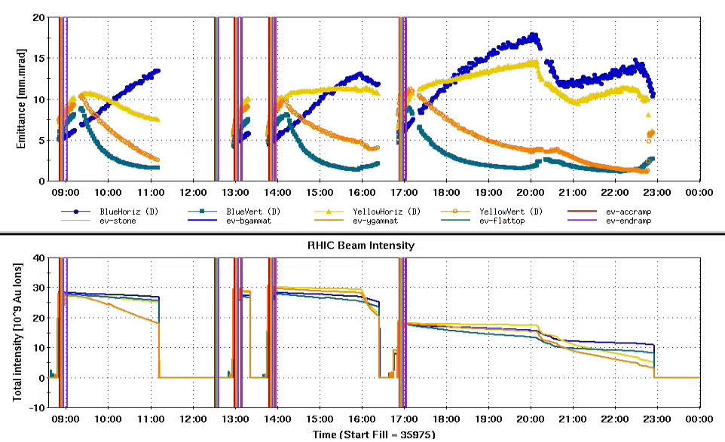
Intensities and Emittances
PS unstable
12*12, 1.5e9
28*28, 1e9
28*28, 1e9
QLI

Slide 4
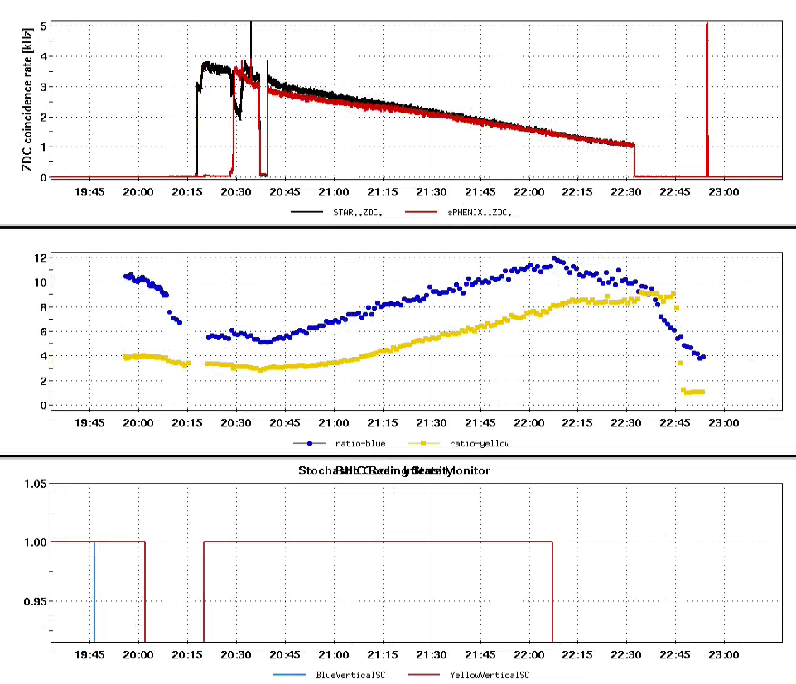
Emittance ratio, Vertical cooling, Collision
1) Emittance ratio mostly affected by cooling.
2) Emittance ratio did not change much w/o collision.

Slide 5
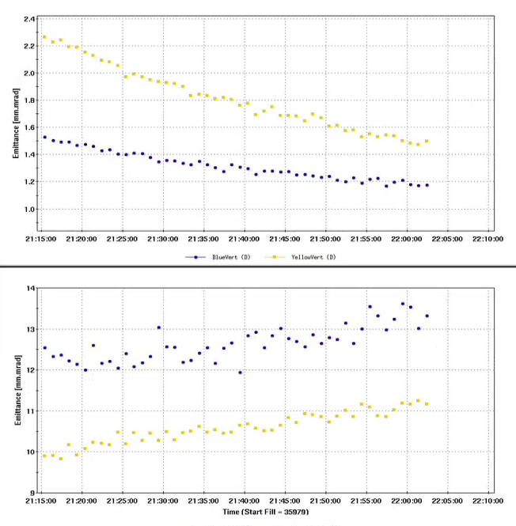
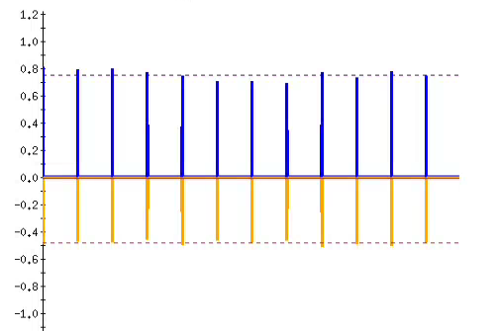
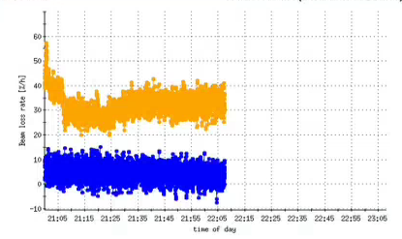
Beam-beam Parameters
BB parameters for Yellow:
(0.0021,0.0071)/IP, 2 IPs in collision. Blue emittance ratio 11.2:1 , 0.8e9/bunch
BB parameters for Blue:
(0.0015,0.0041)/IP, 2 IPs in collision. Yellow emittance ratio 7.5:1, 0.5e9/bunch
BB parameters for EIC/HSR:
(0.012, 0.012)/IP, ONLY 1 IP
Vertical Emittance
Beam decay
Horizontal Emittance
How much from luminous loss?
At ~ 22:00pm

Slide 6
APEX Schedules for Following Sessions
6/25 Au 100 24-03(15h) Accelerating flat gold ion beams from 31GeV to 100GeV: ramp development
7/9 Au 100 24-03(15h) Accelerating flat gold ion beams from 31GeV to 100GeV: cooling setup
7/23 Au 100 24-03(15h) Accelerating flat gold ion beams from 31GeV to 100GeV: acceleration of flat beam
8/6 Au 100 23-10(8h) Transition Jump with Less Jump Quads
Au 100 25-01(7h) Maximize b-b parameter with flat beam collision at RHIC
8/20 Au 100 25-01(15h) Maximize b-b parameter with flat beam collision at RHIC
9/3 Au 10 25-04((4h) RF transient beam loading study
Au 100 23-10(4h) Measure longitudinal impedance in RHIC (both rings)
Au. 100 25-01(7h) Maximize b-b parameter with flat beam collision at RHIC
9/17 Au 100 25-09(8h) Transition Jump with Less Jump Quads.
Au 100 23-02(2h) IR8 tuning with crossing angle and short vertex
Au 100 25-08(5h) Sextupole settings to reduce vertical emittance growth with flat ion beam collisions
10/1 Au 100 23-05(7h) Radial shift in RHIC using a dipole field offset
Au 100 23-02(4h) IR8 tuning with crossing angle and short vertex
Au 19.57 25-02(4h) CeC Experiment ramp preparation
10/15 Au 100 25-08(6h) Sextupole settings to reduce vertical emittance growth with flat ion beam collisions
Au 31 25-07(9h) Effects of Various Ramp Rates on Transition Crossing.
10/29(?) p 100 25-03(12h) Light from C target (proton beam from tandem). 3 hours left
11/12
11/26
12/10
Some backup APEX:
Au 3.85 22-05(28h) Studies of electron-ion heating effect (take longer time to recover to normal ramp)

Slide 7
