Slide 1
Preinjector Status
J. Ritter/D. Raparia
Time Meeting
September 02, 2025

Slide 2
Tandem
MP7- RHIC support
Running well
Au to AGS and NSRL over the weekend
GVM stability issues
- MP6 –External User
This week external users

Slide 3
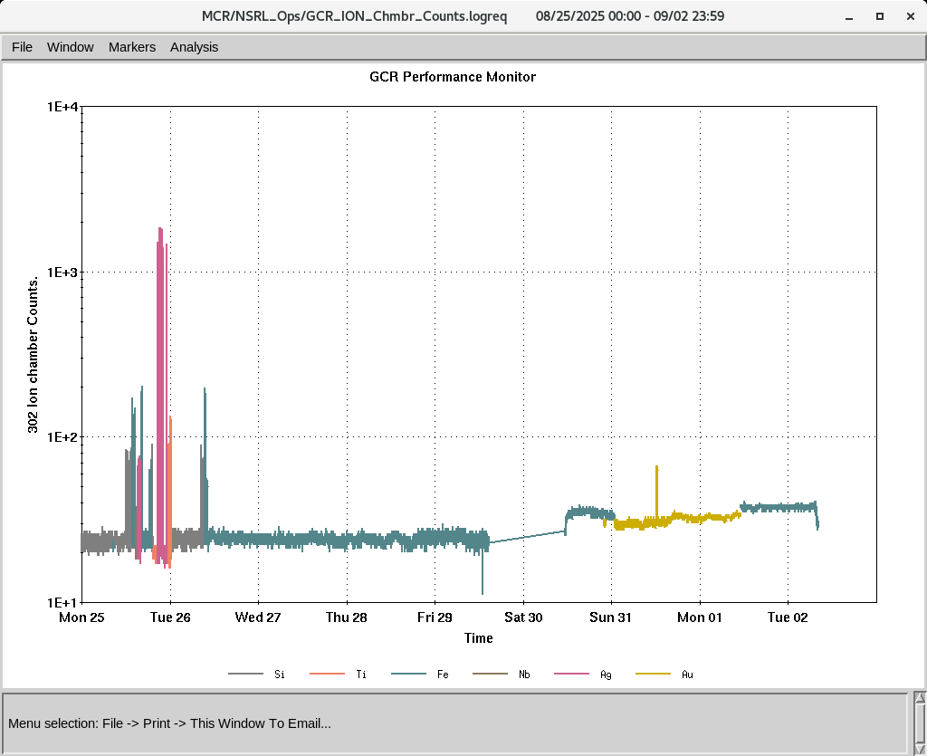
EBIS
Worked on H intensity during last week
after power repair , most of the system were restore on Saturday
Few issues were resolved this morning
Beam is available now
IONS to NSRL
Si⁺¹¹ Ti^{+17,} Fe⁺²⁰ ,Nb⁺²³ Ag⁺²⁹, Au⁺³¹

