Slide 1
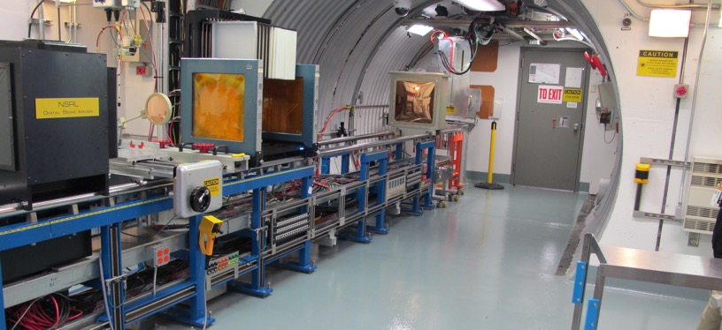
NSRL Time Meeting Report
2 September 2025
Michael Sivertz

Slide 2
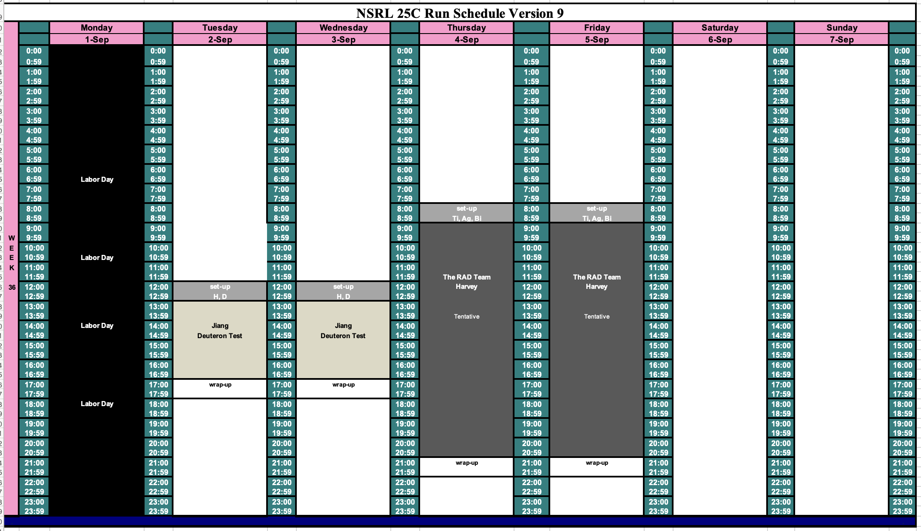
Schedule for this week

Slide 3
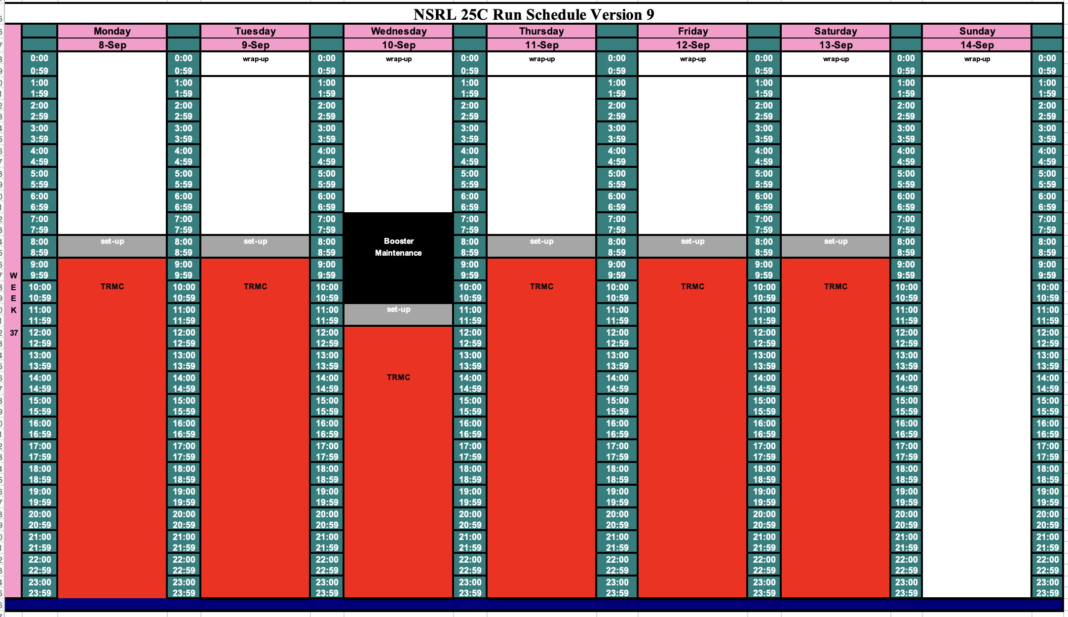
Schedule for next week

Slide 4
Future Schedule
After Labor Day, NSRL will conduct 2 days of beam development working on protons from EBIS. We will use atomic H, molecular H2, and Deuterons.
The week ends with two days of Ti, Ag, and Bi for the RAD Team.
Next week the TRMC starts two weeks of 16-hour days beginning
8 September through 20 September. All will use heavy ions from EBIS.

