Slide 1
Preinjector Status
J. Ritter/D. Raparia
Time Meeting
September 09, 2025

Slide 2
Tandem
MP7- RHIC support
Running well
24/7 shift started over the weekend
- MP6 –External User
Last week external users

Slide 3
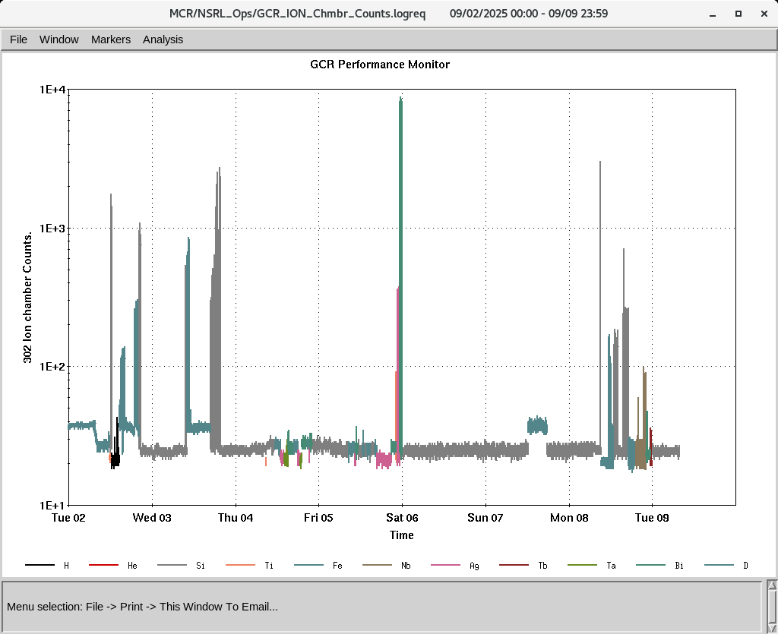
EBIS
Worked on H²+ intensity during last Sunday
Five-fold improvement in the H₂+ intensity about 1.43.10¹⁰
Ion to NSRL
Few RFQ Trips
IONS to NSRL
P, H₂⁺ D^{+ ,}Si⁺¹¹ Ti^{+17,} Fe⁺²⁰ ,Nb⁺²³ Ag⁺²⁹, Tb⁺³⁵, Ta⁺³⁸,Bi⁺⁴³

