Slide 1
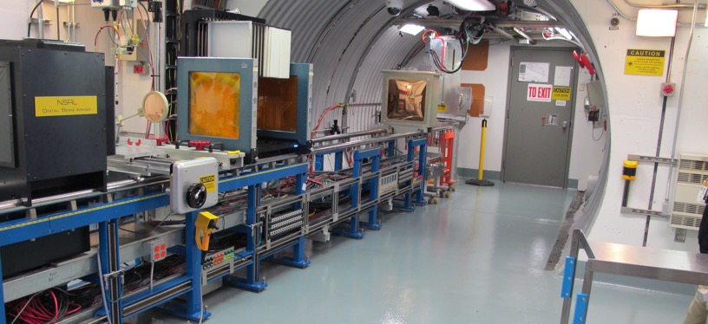
NSRL Time Meeting Report
9 September 2025
Michael Sivertz

Slide 2
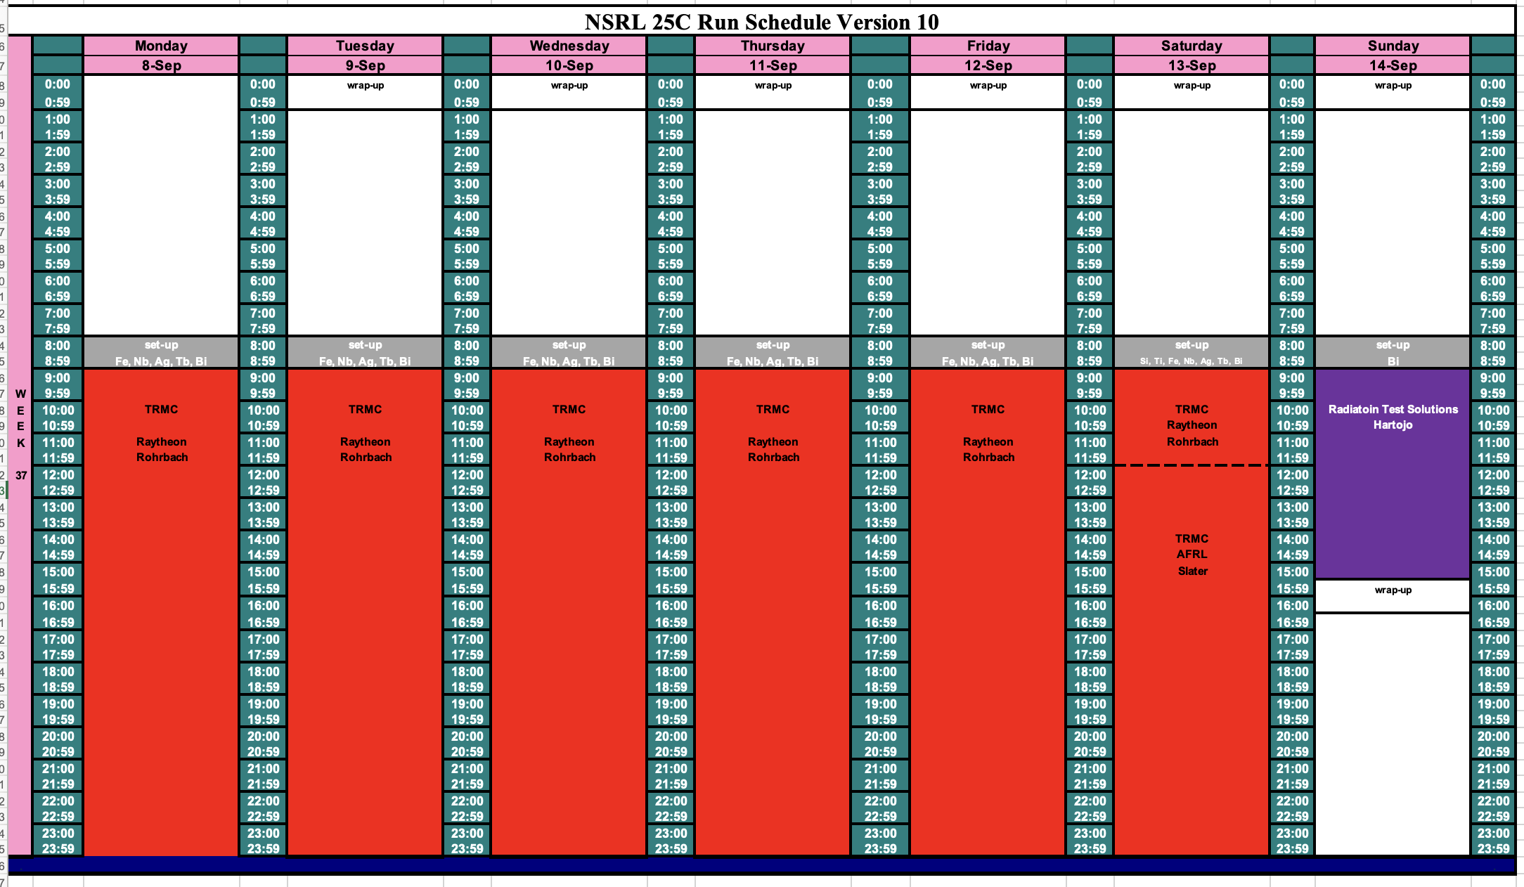
Schedule for this week

Slide 3
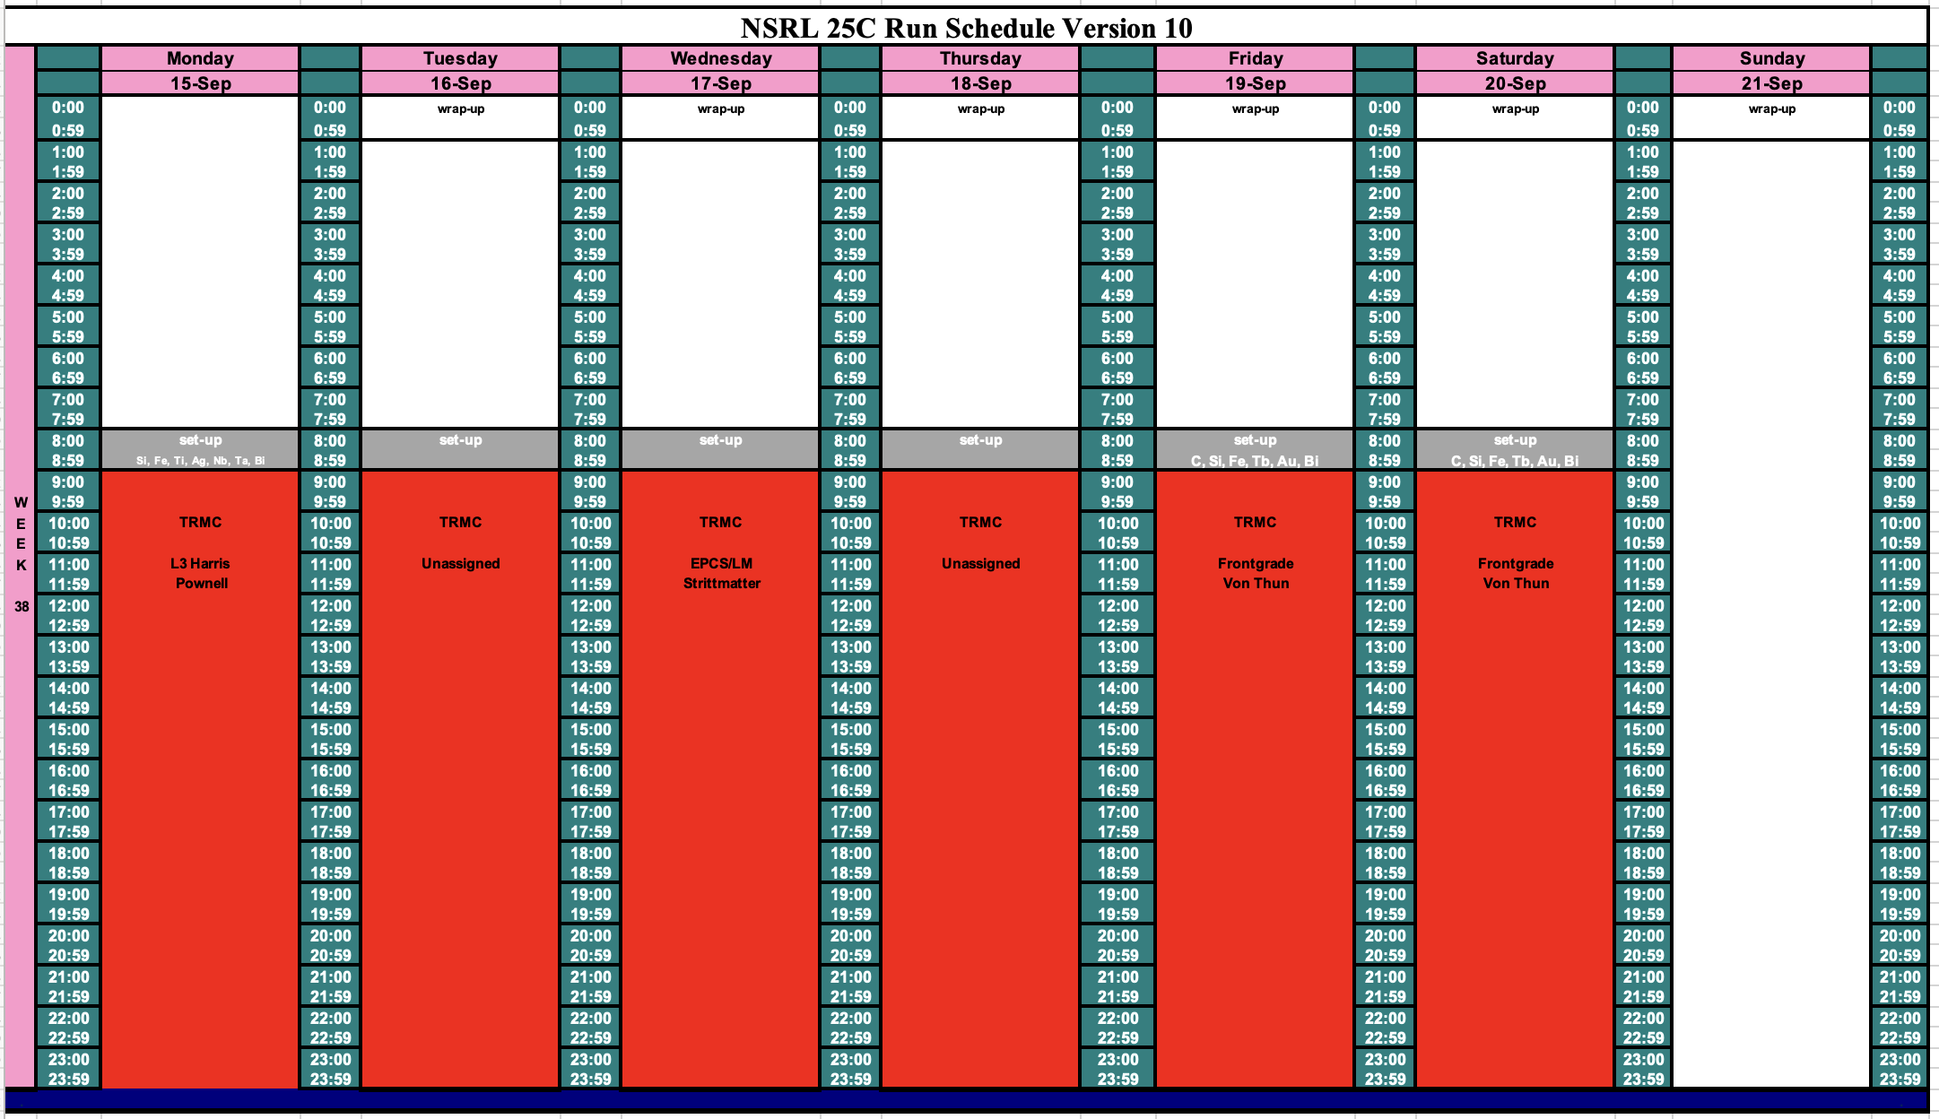
Schedule for next week

Slide 4
Future Schedule
TRMC starts two weeks of 16-hour days beginning 8 through 20 September. All will use heavy ions from EBIS. We don’t yet have the ion species for 16 – 18 September next week.
Still sorting out the proton source for NASA biology run in October.
Starting to assign NSRL beamtime for November 2025 – March 2026.

