Slide 1
TAKE FIVE for Safety-
Injury Prevention and Regulatory Requirements
Frank Craner
September 9, 2025

Slide 2
Two Related Needs Associated with Safety
Safety and Health of Workers
  Preventing Injuries/Accidents/Events
  Understanding and Managing Risk
  Graded Approach
  Organizational Learning and Improvement
Compliance with Regulations and Standards
  DOE Orders and Regulations
  OSHA Regulations
  Consensus Standards (i.e., NFPA, ANSI)

Slide 3
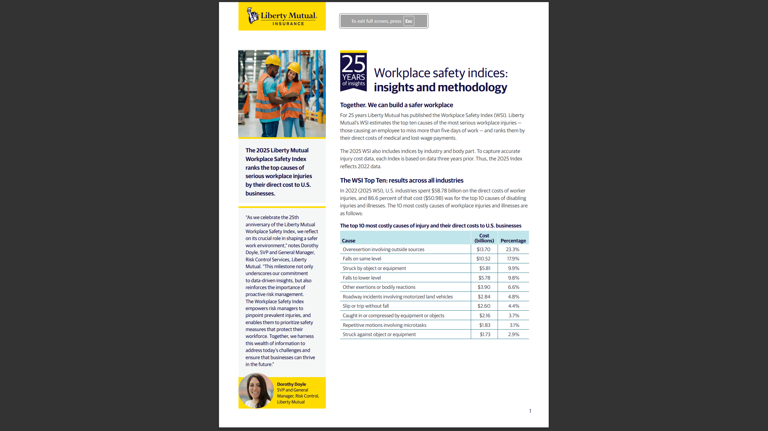
Liberty Mutual Insurance Workplace Safety Index

Slide 4
Cost of Workplace Injuries
Liberty Mutual’s Workplace Safety Indices estimates the top ten causes of the most serious workplace injuries — those causing an employee to miss more than five days of work — and ranks them by their direct costs of medical and lost-wage payments.
According to the 2025 Index, U.S. businesses spend more than $1 billion per week on workplace injuries, for a total of more than $58 billion per year.
The top 10 causes cost U.S. businesses $50.87 billion per year or 86.55% of total.

Slide 5
The top 10 most costly causes of injury and their direct costs to U.S. businesses
Cause Cost (billions) Percentage
1. Overexertion involving outside sources $13.70 23.3%
2. Falls on same level $10.52 17.9%
3. Struck by object or equipment $5.81 9.9%
4. Falls to lower level $5.78 9.8%
5. Other exertions or bodily reactions $3.90 6.6%
6. Roadway incidents involving motorized land vehicles $2.84 4.8%
7. Slip or trip without fall $2.60 4.4%
8. Caught in or compressed by equipment or objects $2.16 3.7%
9. Repetitive motions involving microtasks $1.83 3.1%
10.Struck against object or equipment $1.73 2.9%

Slide 6
The top 10 Most Frequently Cited Standards by OSHA in Fiscal Year 2024
Fall Protection, general requirements (29 CFR 1926.501)
Hazard Communication, general industry (29 CFR 1910.1200)
Ladders, construction (29 CFR 1926.1053)
Respiratory Protection, general industry (29 CFR 1910.134)
Control of Hazardous Energy (lockout/tagout), general industry (29 CFR 1910.147)
Powered Industrial Trucks, general industry (29 CFR 1910.178)
Fall Protection Training, construction (29 CFR 1926.503)
Scaffolding, construction (29 CFR 1926.451)
Eye and Face Protection, construction (29 CFR 1926.102)
Machine Guarding, general industry (29 CFR 1910.212)

Slide 7
How do these lists correlate?
Most Costly Injury types (Liberty Mutual)
1 Overexertion involving outside sources
2. Falls on same level
3. Struck by object or equipment
4. Falls to lower level
5. Other exertions or bodily reactions
6. Roadway incidents involving motorized land vehicles
7. Slip or trip without fall
8. Caught in or compressed by equipment or objects
9. Repetitive motions involving microtasks
10.Struck against object or equipment
Most Common Regulatory Violations (OSHA)
1 Fall Protection, general requirements
2. Hazard Communication, general industry
3. Ladders, construction
4. Respiratory Protection, general industry
5. Control of Hazardous Energy (lockout/tagout), general industry
6. Powered Industrial Trucks, general industry )
7. Fall Protection Training, construction
8. Scaffolding, construction
9. Eye and Face Protection, construction
10. Machine Guarding, general industry

Slide 8
Summary- Hazard Identification Includes Requirements and Risk
Work Planning and Control
  Hazard Identification
SCoR Principles
  Hazards are identified and evaluated for every task, every time.
  A healthy respect is maintained for what can go wrong.

