Slide 1
Preinjector Status
D. Raparia
Time Meeting
September 16, 2025

Slide 2
Tandem
MP7- RHIC support
Running well
Some instability due to LE charging system, cable was changed
- MP6 –External User
Last week external users

Slide 3
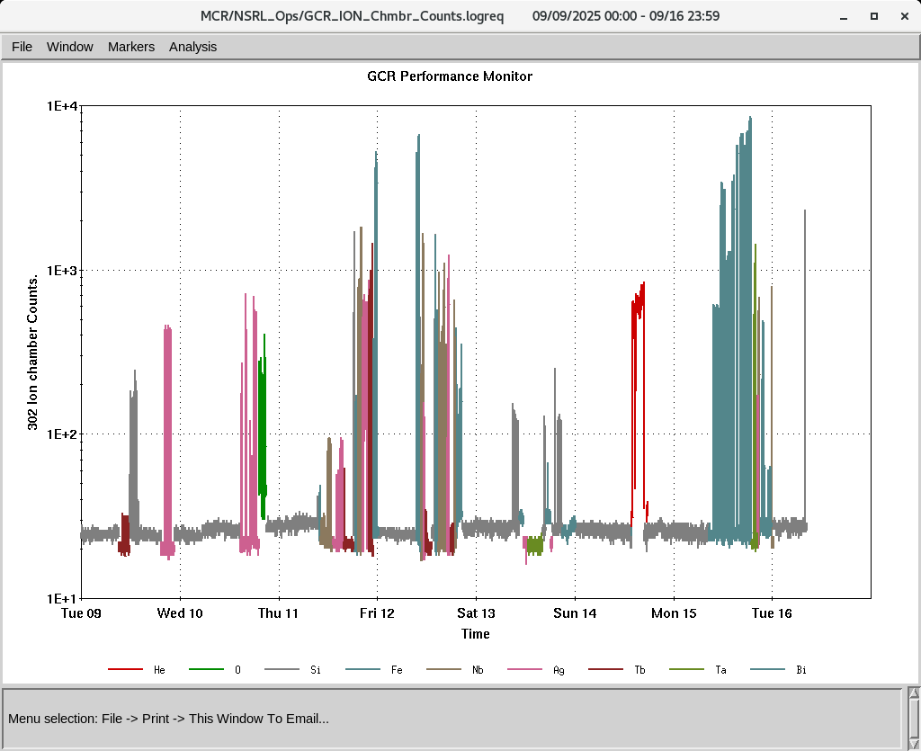
EBIS
Worked on H₃⁺ intensity during last Sunday ~5. 10⁹ ( 1.5 10¹⁰ P) @ EtB
H₂⁺ delivered to NSRL 7. 10⁹ (1.4 10¹⁰ P⁾
Smooth operation for NSRL
RFQ Trips
IONS to NSRL
H₂^{+ ,}O⁺⁵ Si^{+11 ,} Fe⁺²⁰ ,Nb⁺²³ Ag⁺²⁹, Tb⁺³⁵, Ta⁺³⁸,Bi⁺⁴³

