Slide 1
sPHENIX Status
Kin Yip
sPHENIX Director of Operations
Time Meeting
Sept. 16, 2025

Slide 2
sPHENIX Matters
We’ve quickly reestablished physics data taking as RHIC resumed physics operation early morning on Sept 10.
sPHENIX Magnet was unaffected even after the “soft start” of STAR Magnet was removed (Wed. night).
One of the compressors of the Chiller #4 is being replaced this week. (We’re relying on Chiller #3 now with rental chiller as the backup.)
Old “PhnxAlarm” appeared last week that has caused some confusion. The associated ADO was disabled and the alarms have been erased.
We’ll ramp down the sPHENIX Magnet at 4:30 am (Wed.) for the 6x6 store (for tracking system alignment) before APEX, and ramp up the Magnet at 8 am.

Slide 3
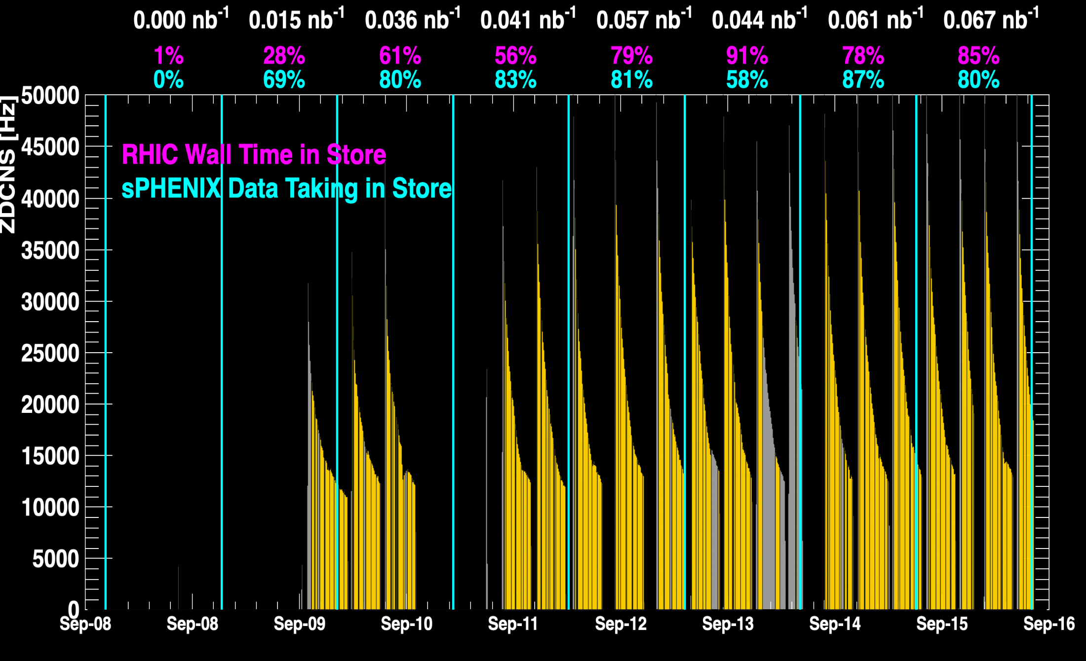
sPHENIX Status

Slide 4
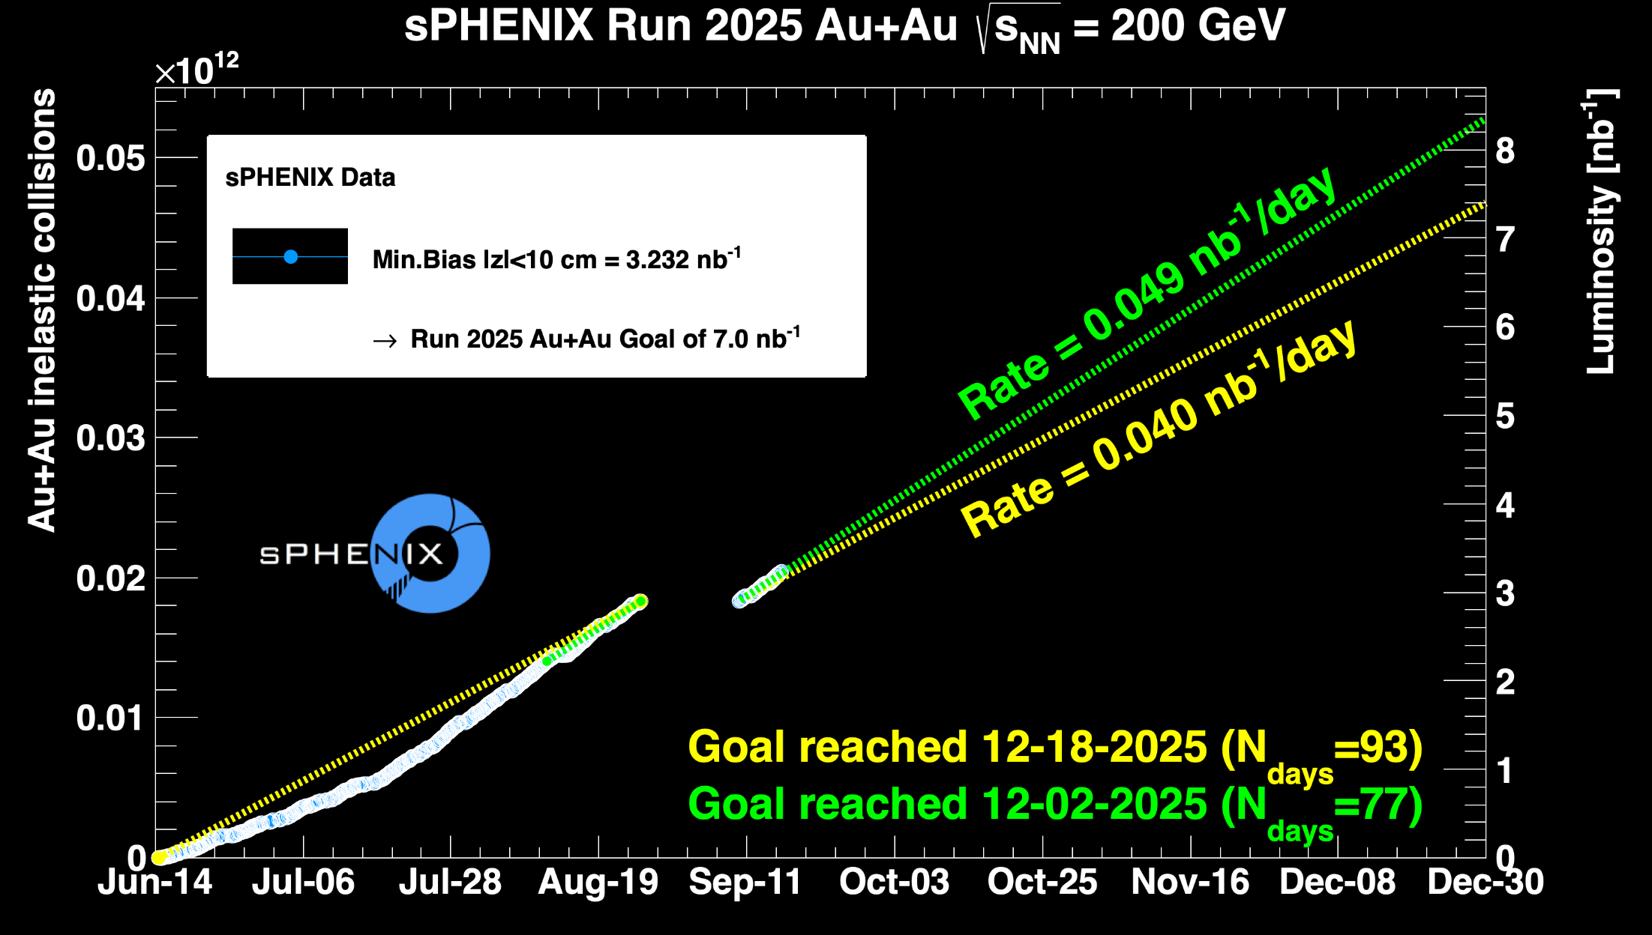
sPHENIX Status

