Slide 1
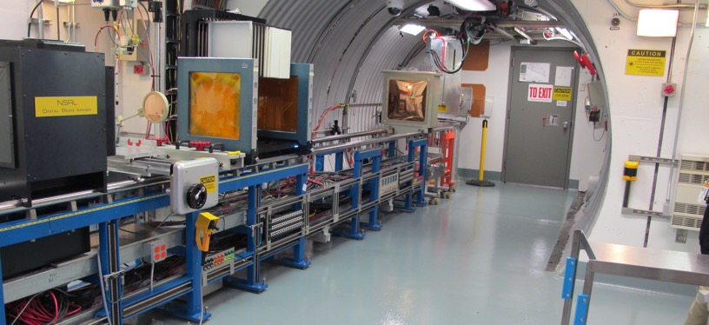
NSRL Time Meeting Report
16 September 2025
Michael Sivertz

Slide 2
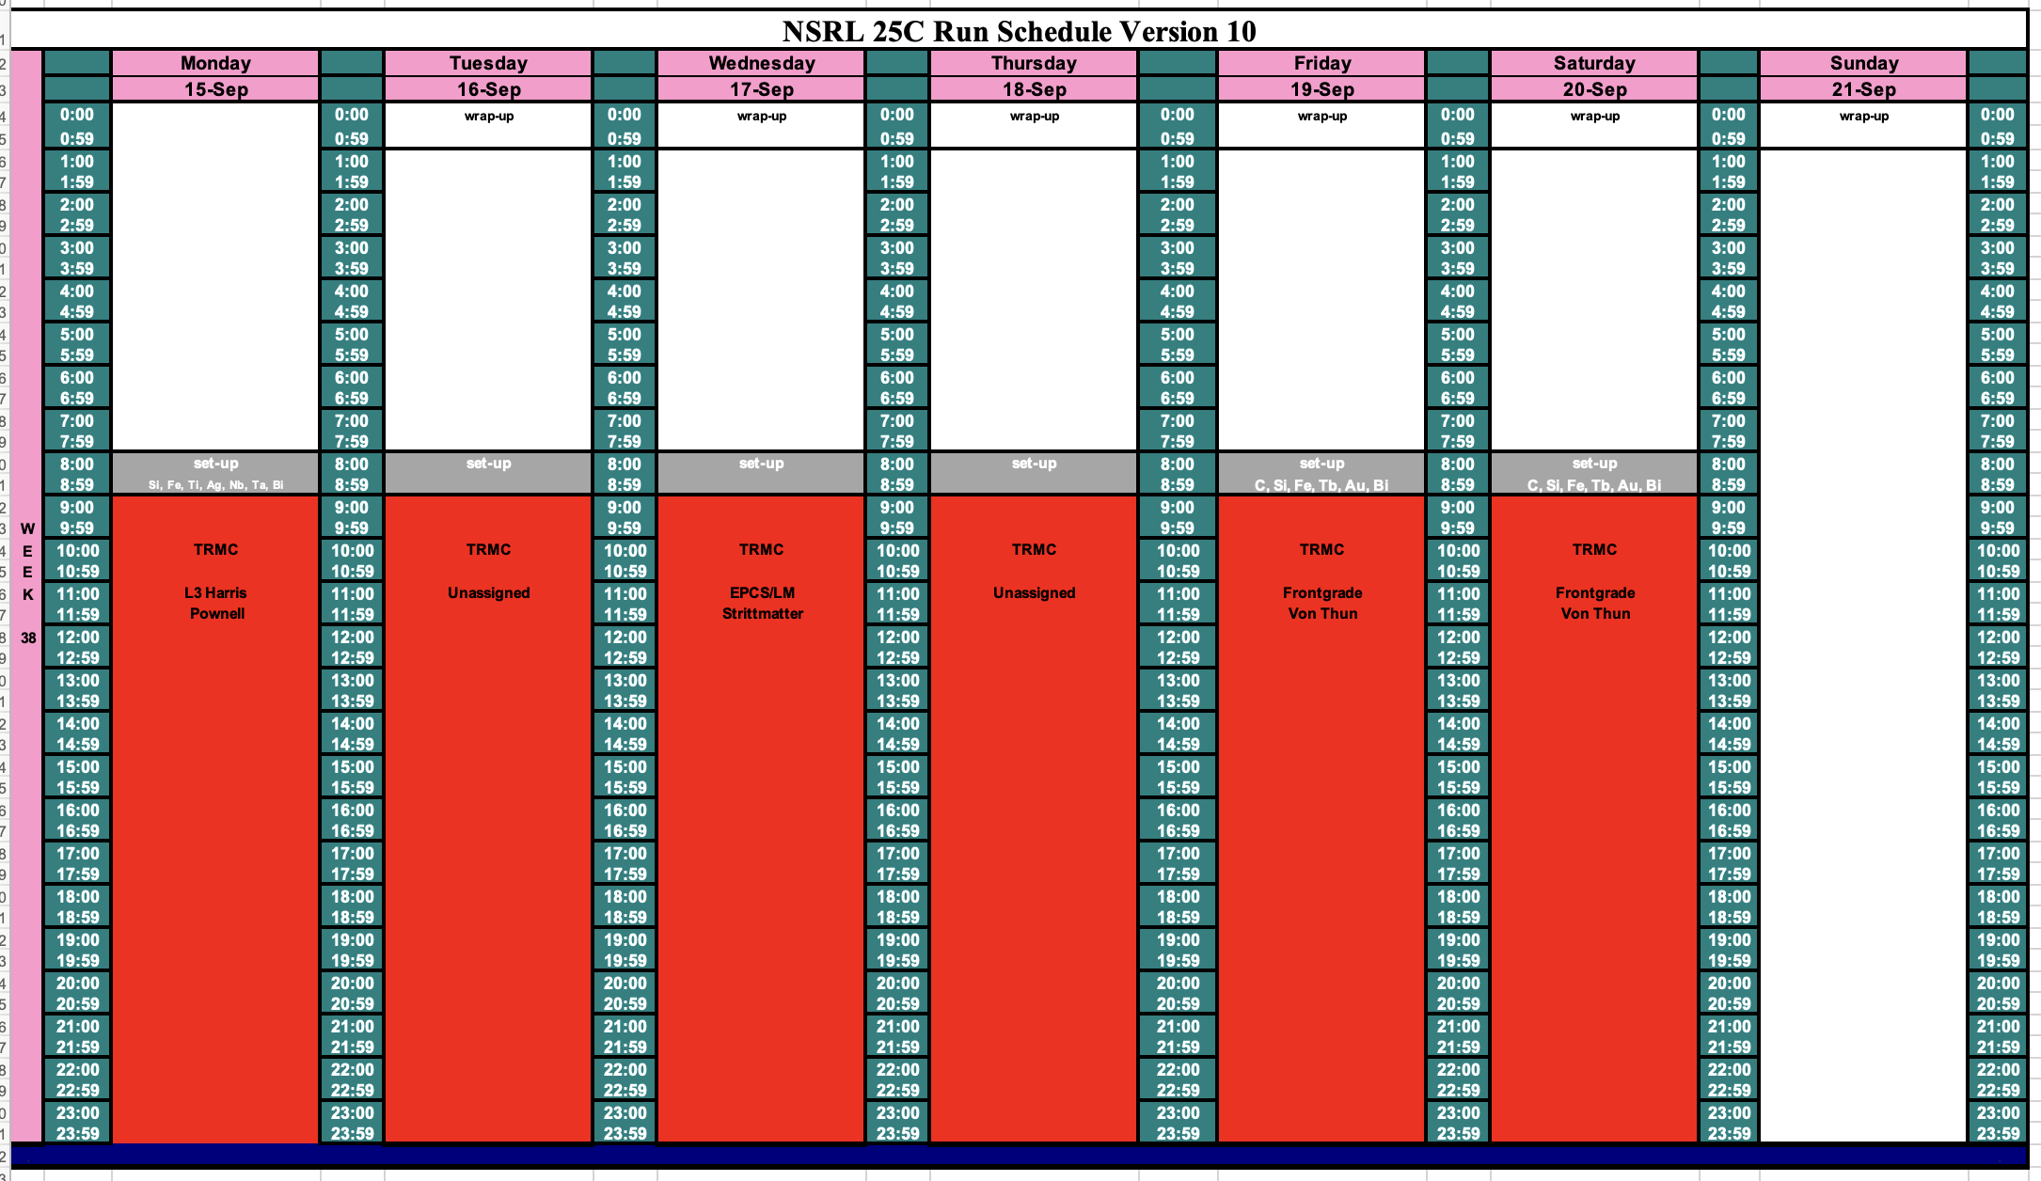
Schedule for this week

Slide 3
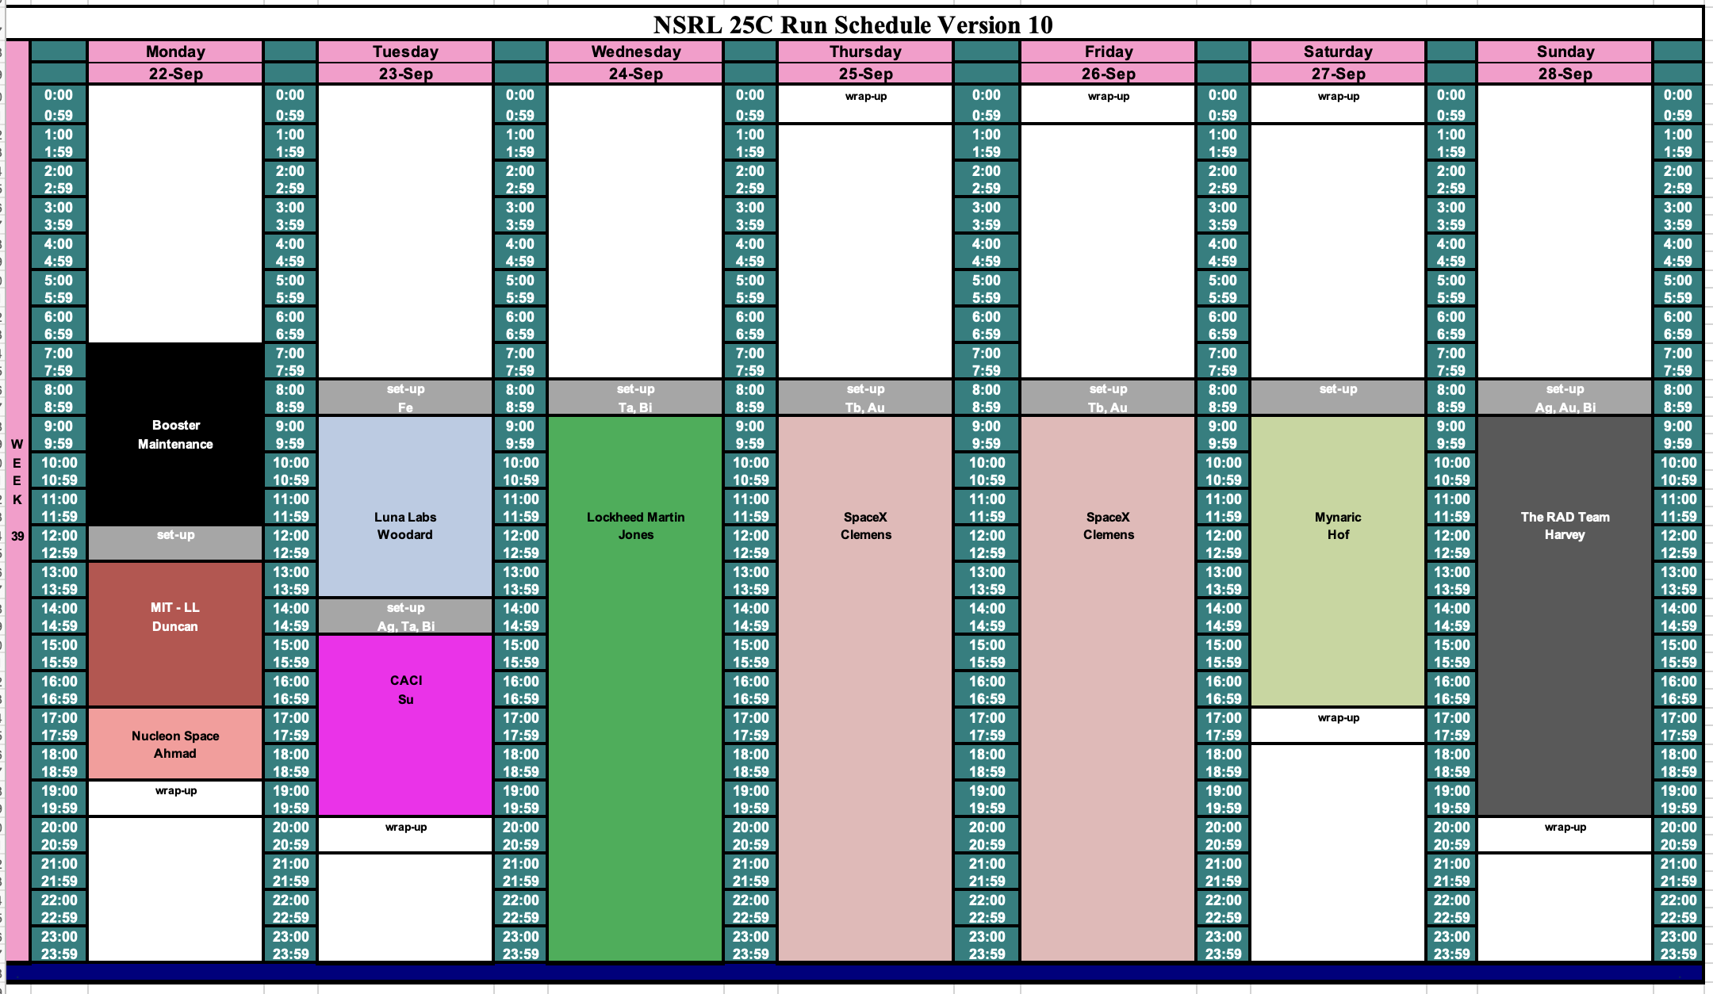
Schedule for next week

Slide 4
Future Schedule
Finishing up the TRMC. Running has been smooth.
Still sorting out the proton source for NASA biology run in October.
Starting to assign NSRL beamtime for November 2025 – March 2026.

