Slide 1
Data courtesy C. Naylor

Slide 2
Data courtesy C. Naylor

Slide 3
Data courtesy C. Naylor

Slide 4
Data courtesy C. Naylor

Slide 6
Data courtesy C. Naylor

Slide 7
Data courtesy C. Naylor

Slide 8
Data courtesy C. Naylor

Slide 9
Data courtesy C. Naylor

Slide 10
Data courtesy C. Naylor

Slide 11
Data courtesy C. Naylor

Slide 12
Data courtesy C. Naylor

Slide 13
Data courtesy C. Naylor

Slide 14
Data courtesy C. Naylor

Slide 15
Operations for BLIP
No BLIP
this past week
BLIP remains in shutdown.
Linac off since 8 July.
Notes:
BLIP plot from LogView /MCR/PerformanceStats/timeMeetingBLIP.lvdisp
Avail calc on nsrl time Excel sheet

Slide 16
NSRL activity past week: 9/2-9/2025 (as of 0800)
NSRL running continues. Various setup and user beam time through the week.
10 species (H, He, O, Si, Fe, Nb, Ag, Tb, Ta, Bi) logged to NSRL.
Run 25-C began 30 June; 25-C schedule posted, updates forthcoming through 1 November.
Anticipating November-March schedules
Availability: 85.7%
Notes:
Graph and avail calc from nsrl time.xlsx

Slide 17
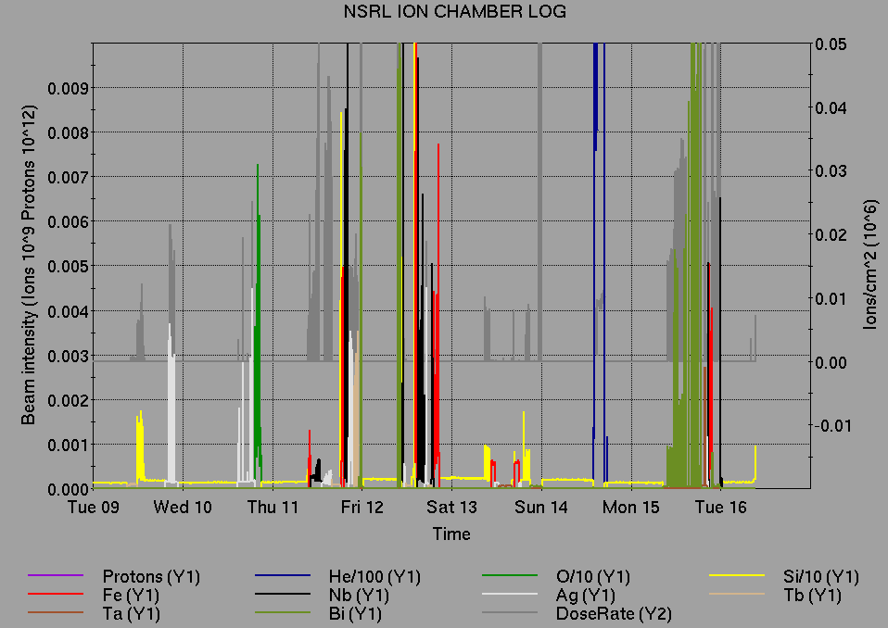
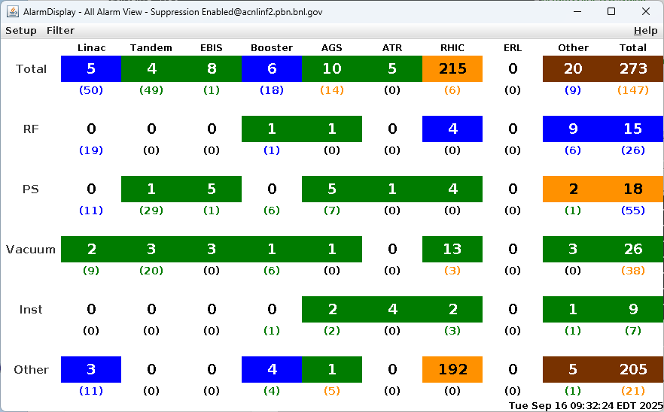
Notes from Operations
Notable failures (>1 hr)
Blue Main Dipole PS failure, various boards and software repairs
STAR Magnet PS failure, substation switch repairs
Blue BA1 RF failure, PA repairs
Booster MMPS failure, voltage stability/noise issues
NQBPS beam abort, y09-qf2 and y6-qf7 PS card, relay repairs
STAR fire alarm, F/R access to reset HSSD
CeC Cryo PLC card failure, access for water blow-down issues
Yellow+Blue QLI at store, 1010A QD systems suspected
Other notes
BPM beam abort (2x); BBQ lost tune lock, bi12bh3 coherence glitch
BLM abort (2x); transition Landau RF, tune feedback issues
Blue QLI at park, main quad PS regulation error
yd31t PS failure, tuned around during repair
AGS vacuum fault, E15 IPM leak problem
Yellow YA1, YA2 RF failures, QEIs replaced
EBIS RFQ trip (5x)
RHIC YA1 RF trips, window comparator adjusted
Collimator, Stochastic Cooling, CPSBPS manager system problems
Other various trips, resets, tuning, foil changes
Over 58 hours CeC beam time; other injector setup, training behind stores as time allows
Notes:
NSRL plot from LogView /MCR/PerformanceStats/timeMeetingNSRL.lvdisp, select Dose Rate and ion species in use
Screenshot of AlarmSummary

Slide 18
Reminder from Operations
MCR beam operations continue
RHIC physics running continues
Tandem (MP7) remains sole provider of Au31 for RHIC
Note RHIC Tour anticipated 9/30
NSRL shifts scheduled for users and MD, generally 6-7 days/2 shifts in weeks upcoming.
Au31 from Tandem for higher intensity; no TVDG protons established (including mode switching)
Other ion beams from EBIS; H₂ intensities nearly sufficient to deliver H
No BLIP published schedules yet
Linac proton beams off until November
AGS tuning, other studies to continue behind stores as time allows
AGS/AtR 3.85 GeV Au setup TBD
MCR shift coverage 24/7.

Slide 19
Keytree notes
Remote keytree systems require a database lookup to validate and authorize distribution of keytokens. The Keytrak system’s database is available for lookup functionality, but can no longer be modified in any way to add or edit qualified personnel.
Personnel affected:
New employees, experimenters arriving after 12/1/2024 could not be enrolled in database
Existing employees & experimenters, not already enrolled, cannot be added or modified in database
Remote keytrees affected:
Iris scan @NSRL
BNLID scan @AGS South gate, North Conjunction Gate
Iris scan @RHIC STAR, sPHENIX, IP12, IP4
Keytrees NOT affected:
BNLID scan @Linac, Booster
BNLID scan @RHIC IP2
MCR keytrees

Slide 20
Keytree notes, continued
Mitigation:
Choose entrants that are currently enrolled to perform the work in the enclosure under Controlled Access (CA).
Obtain CA keys from MCR for remote gate watch
Arrange for local gate watch using other tokens for entrants.
Arrange for Restricted Access, and allow for delays incurred to sweep areas.
CAUTION
Follow procedures. Gate Watch staff will remain vigilant.
No “piggy-backing” – one key/token per entrant.
Access keys are not candy! Authenticated entrant retains possession.
Radiological Controls and the Access Controls System are not to be circumvented. This is (has been) enforced with disciplinary action (dismissal).

Slide 22
Notes:
Reliability comparisons to previous runs

Slide 23
Notes:
Reliability comparisons to previous runs

Slide 24
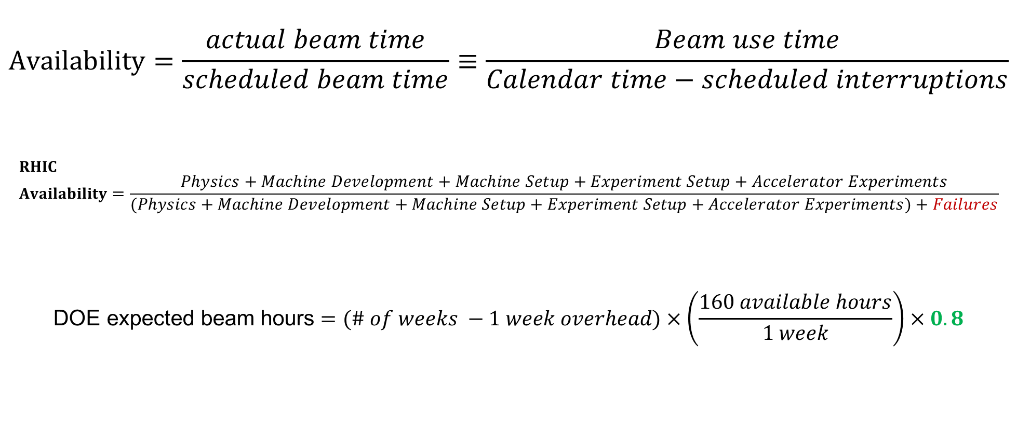
Availability, expected beam hours
$$Availability=\frac{actual beam time}{scheduled beam time}≡\frac{Beam use time}{Calendar time−scheduled interruptions}$$
$$RHIC \\ Availability=\frac{Physics+Machine Development+Machine Setup+Experiment Setup+Accelerator Experiments}{(Physics+Machine Development+Machine Setup+Experiment Setup+Accelerator Experiments)+Failures}$$
$$\text{DOE} \text{expected} \text{beam} \text{hours}=(\# of weeks −1 week overhead)×\left(\frac{160 available hours}{1 week}\right)×0.8$$
Notes:
Normally hidden. Explains how the 85% from DOE comes in to play, & general availability metrics

