Slide 1
sPHENIX Status
Kin Yip
sPHENIX Director of Operations
Time Meeting
Sept. 23, 2025

Slide 2
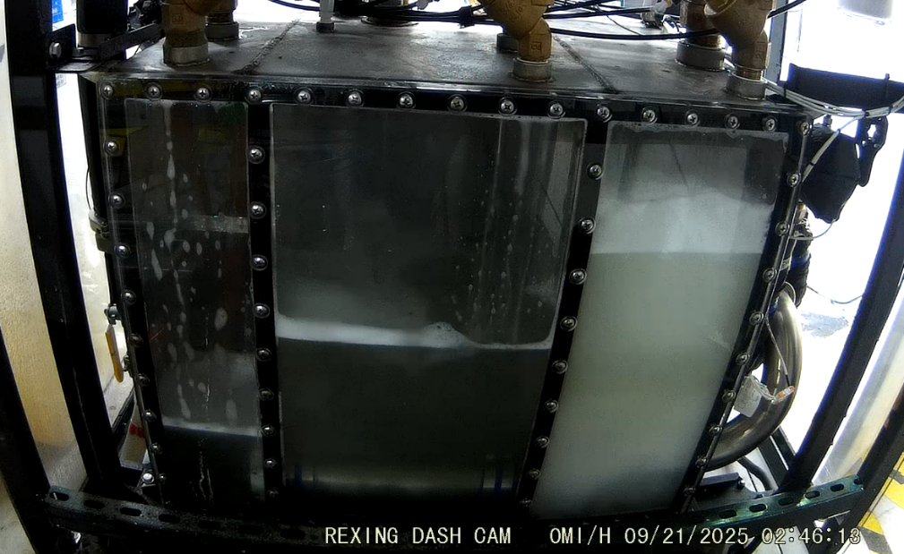
sPHENIX Matters
  sPHENIX mostly has been taking collision data with all detectors.
    TPC Cooling Distribution Unit (CDU) started to trip more frequently
    since ~Sept. 9. Quite a bit of
    investigation and actions followed.
    CDU coolant water was partially
    replaced on Thursday (Sept. 18)
    and it hasn’t tripped since Thur.
    evening.
    TPC Primary/Booster power
    supplies were replaced during an IR
    access Sunday (Sept. 20) morning; and that’s a successful fix.
  We’re back to the mode of two chillers ~1008C since last Thur. (Sept. 18).
  The Access Control Group will help change two ODH sensors on the Maintenance Day (Sept. 25).

Slide 3
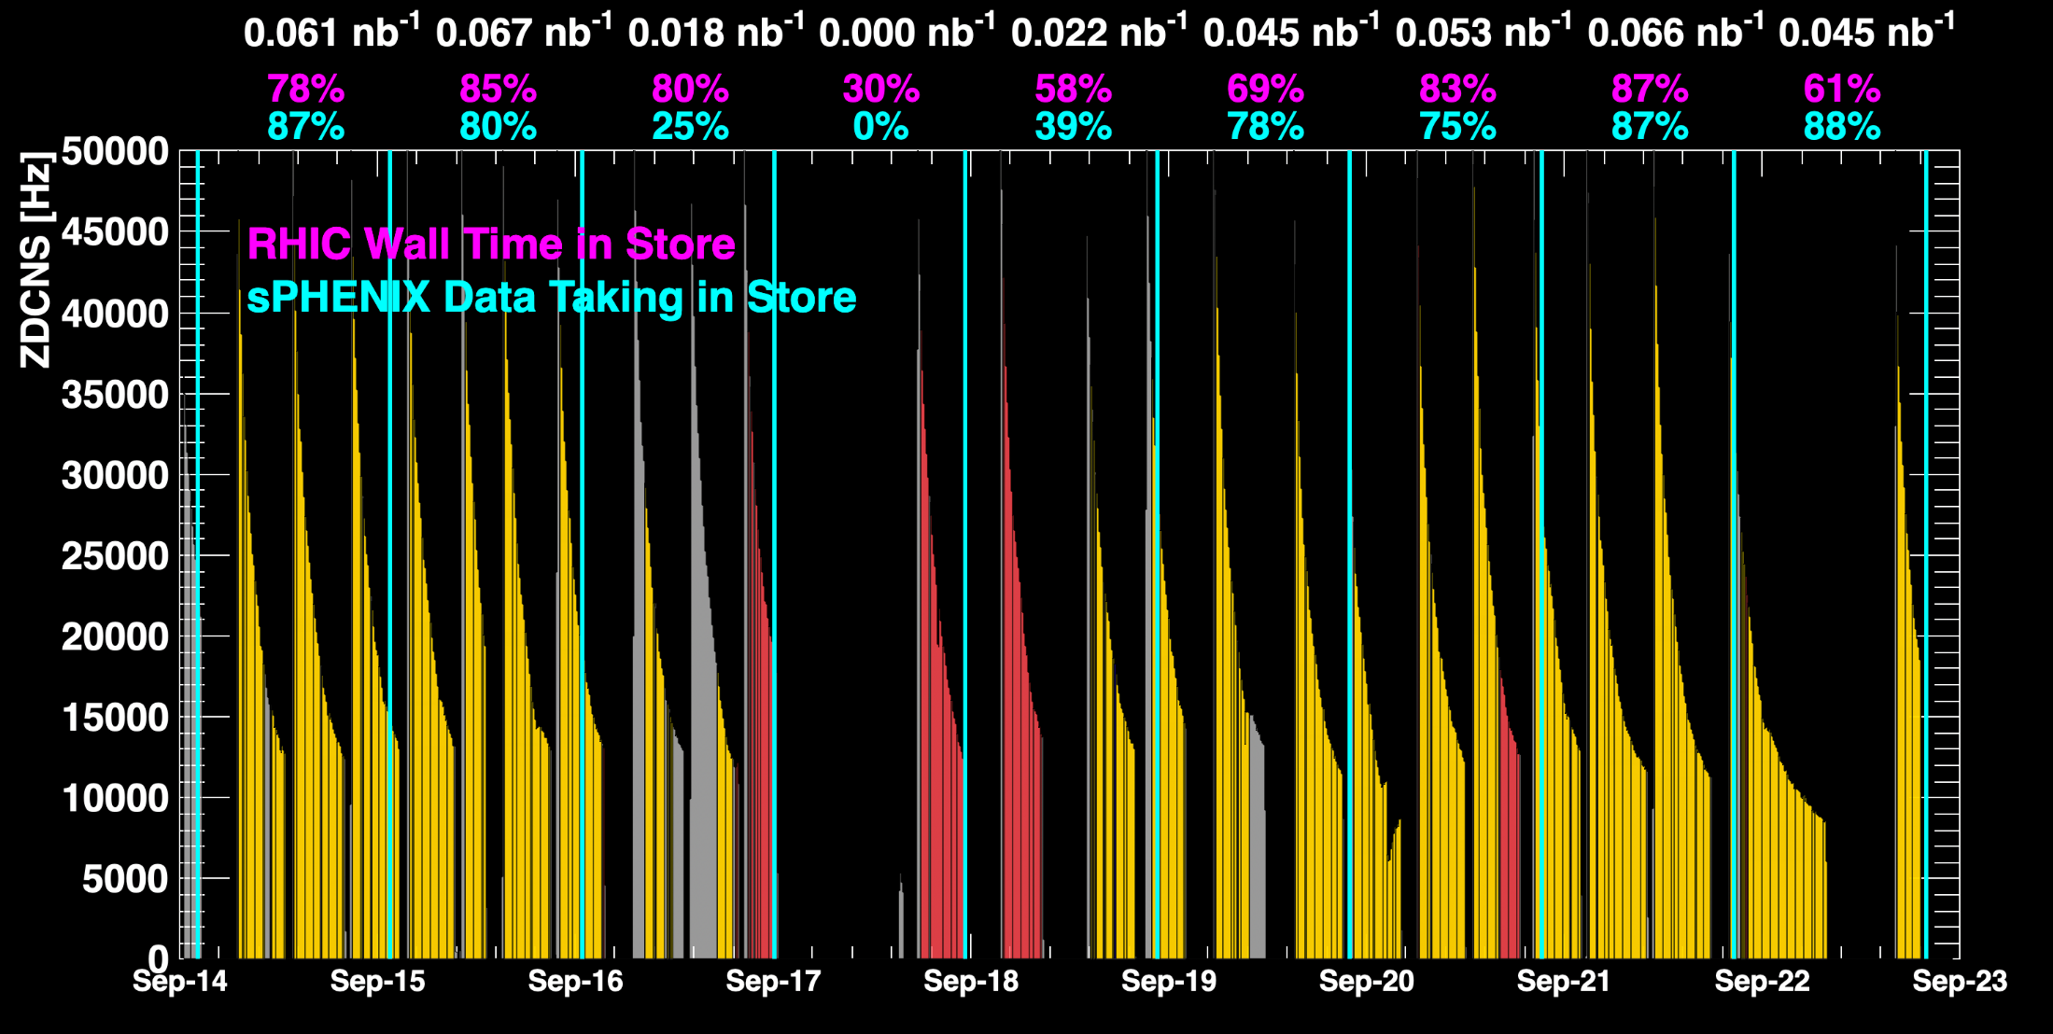
sPHENIX Status
TPC CDU issue
When all sPHENIX detectors were being operated.

Slide 4
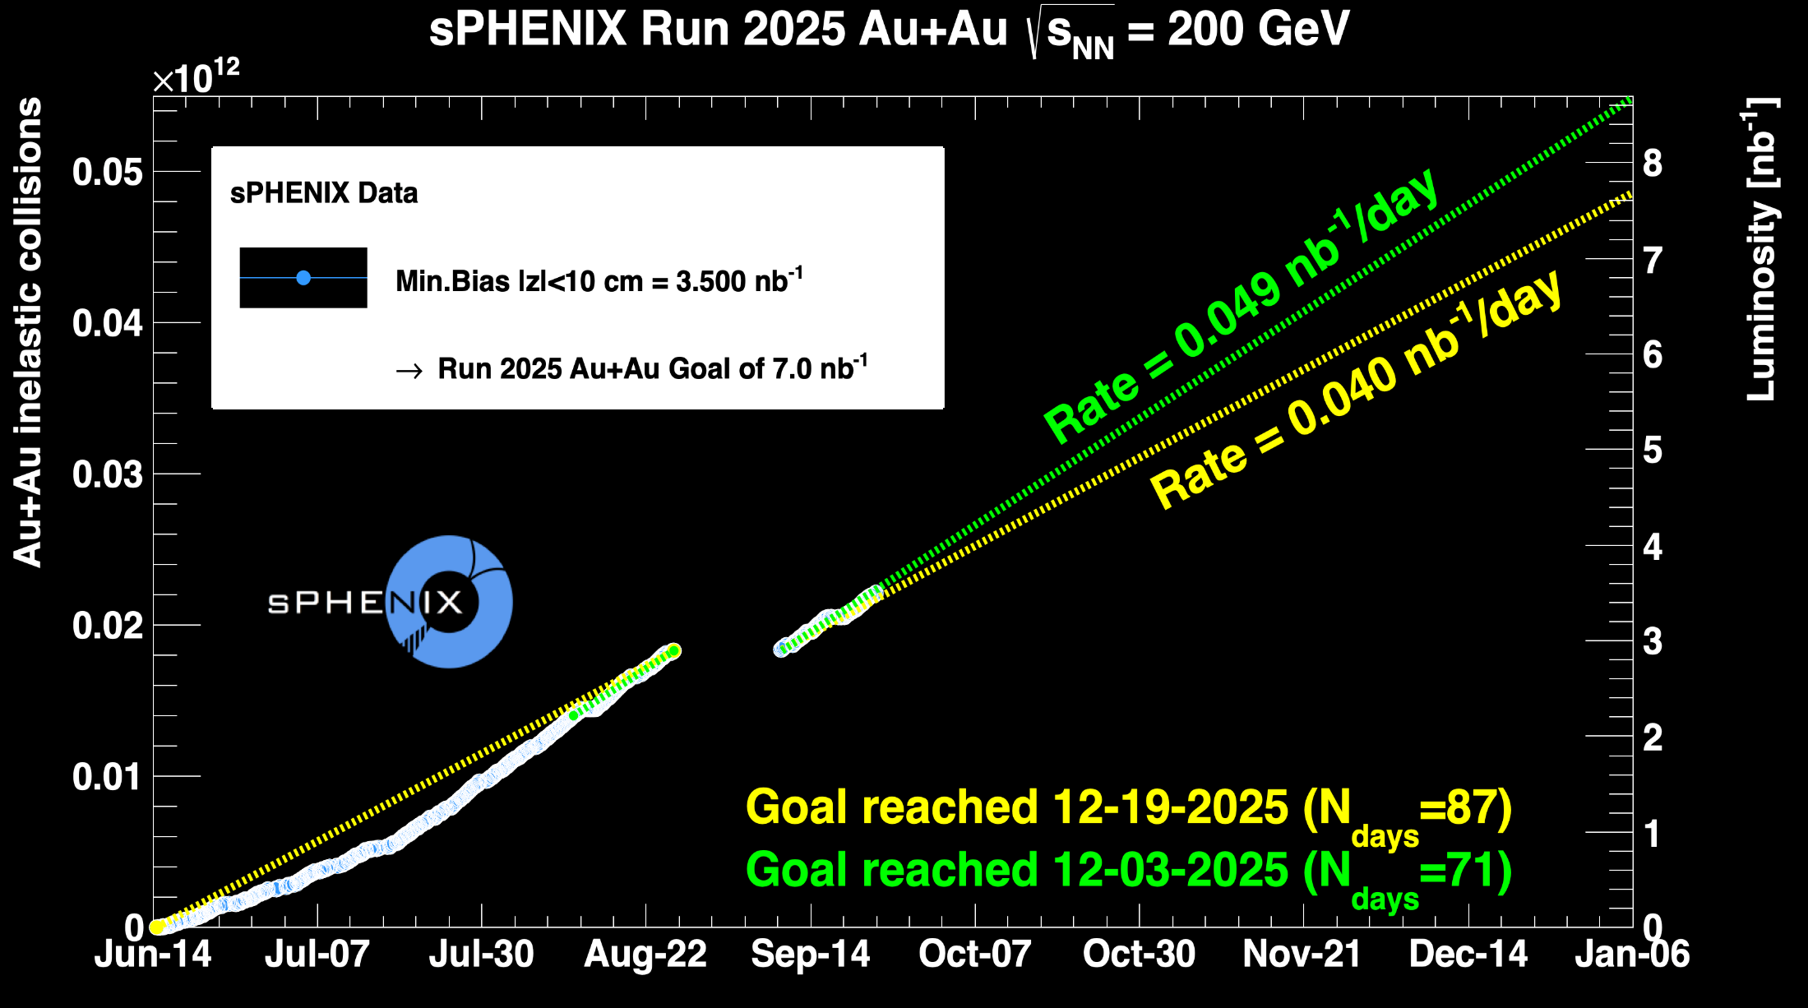
sPHENIX Status

