Slide 1
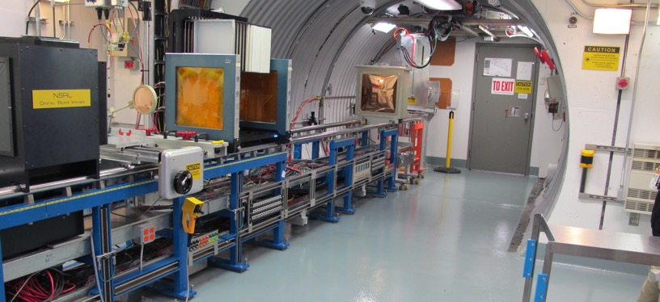
NSRL Time Meeting Report
23 September 2025
Michael Sivertz

Slide 2
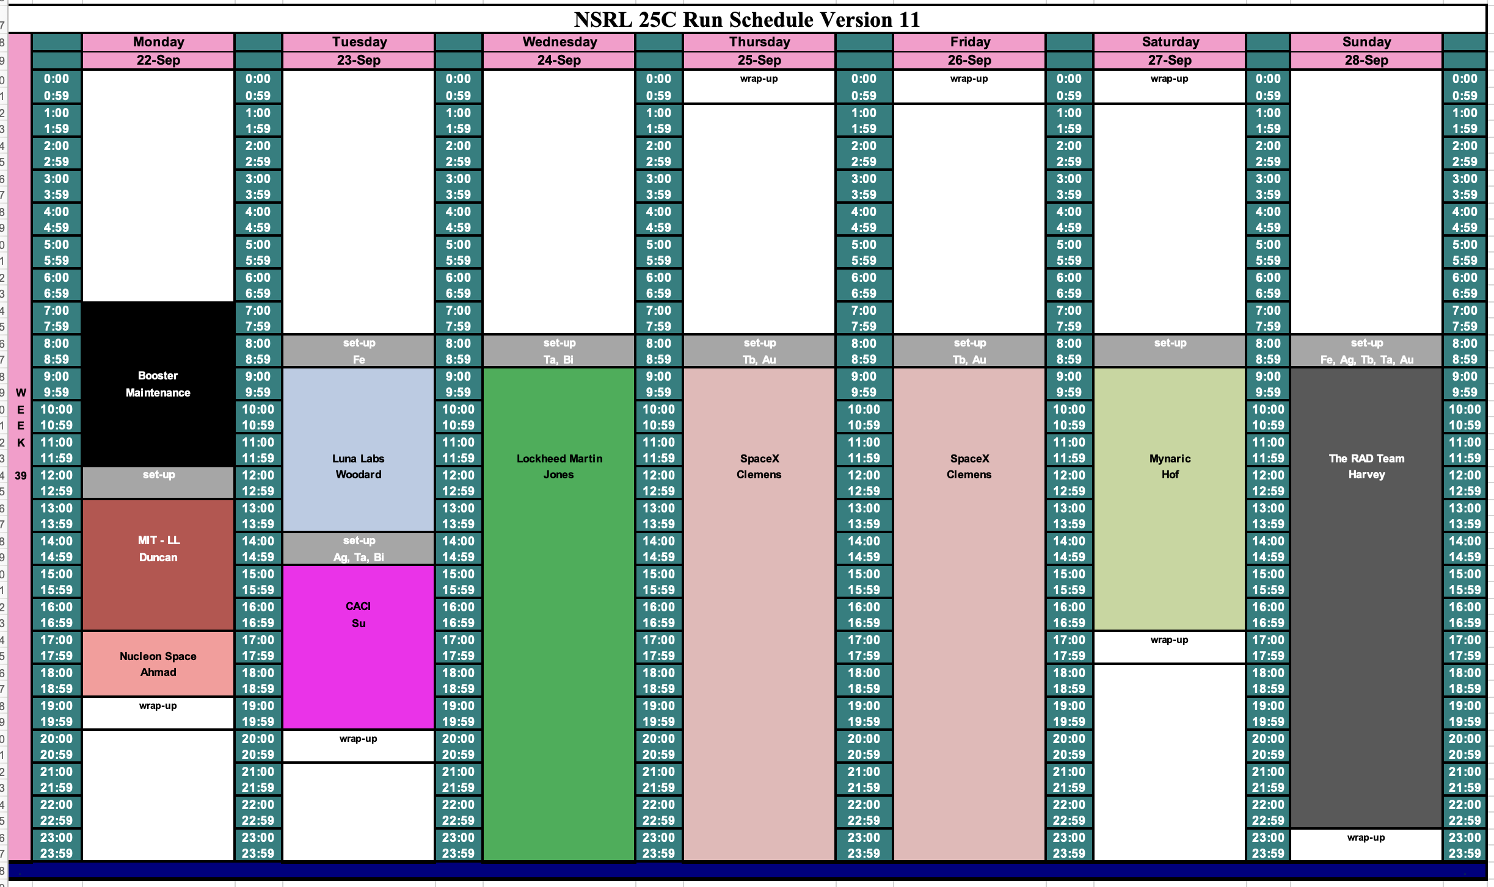
Schedule for this week

Slide 3
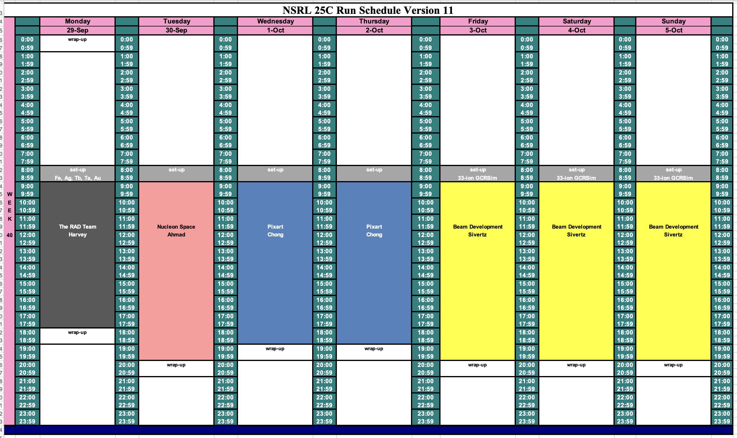
Schedule for next week

Slide 4
Future Schedule
Many electronics testers this week and next.
Running through the weekend, with mostly 16 hour days.
Beam development for Biology at the end of next week.
Working with EBIS and MCR to maximize the proton flux from EBIS using direct injection of molecular H₂⁺
NSRL needs to develop 33-beam GCR Simulation and 5-ion Simplified GCR Sim.
Starting to assign NSRL beamtime for November 2025 – March 2026.

