Slide 1
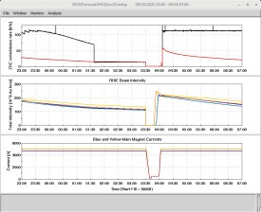
Time Meeting
Accelerator Operations Support

Slide 2
Changes to Maintenance: September:
Sun | Mon | Tues | Weds | Thurs | Fri | Sat
14 | 15 | 16 | 17 APEX LINAC Tower cleaning | 18 | 19 | 20
21 | 22 Booster Maintenance am | 23 | 24 | 25 Maintenance No Booster | 26 | 27
28 | 29 | 30 10-12 RHIC tour

Slide 3
October
September
Sun | Mon | Tues | Weds | Thurs | Fri | Sat
 |  |  | 1 APEX | 2 | 3 | 4
5 | 6 | 7 | 8 Maintenance | 9 | 10 | 11
12 | 13 | 14 | 15 APEX | 16 | 17 | 18
19 | 20 | 21 | 22 APEX | 23 | 24 | 25
26 | 27 | 28 | 29 Maintenance | 30 | 31

Slide 4

Planning and Scheduling
Meeting here and streaming tomorrow 3pm

