Slide 1
APEX Report
Time Meeting, Sept. 23, 2025

Slide 2
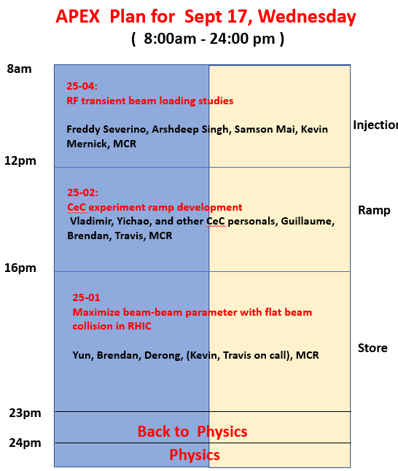
Due to blue ring abort kick repairing ( access), we lost about 3+ hours.
The first two experiment got the beam time as planned. The last experiment cut short 3+ hours.
We stopped APEX around 11:30 ( other than 11pm sharp) simply because we couldn’t dump the already cooled beams for nothing.

Slide 3
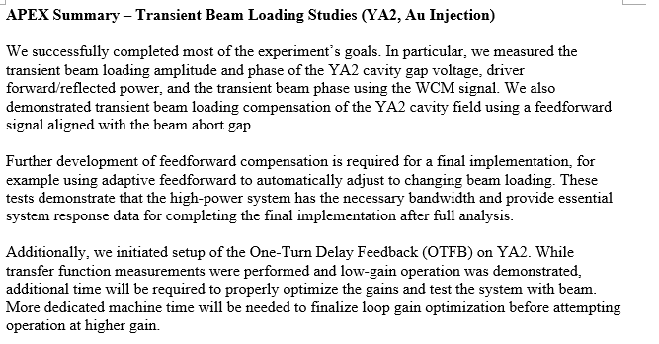
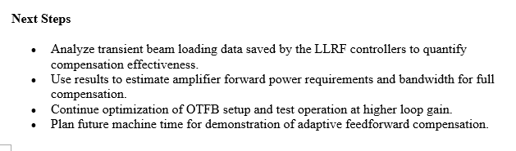
25-04: RF transient beam loading
@Freddy

Slide 4
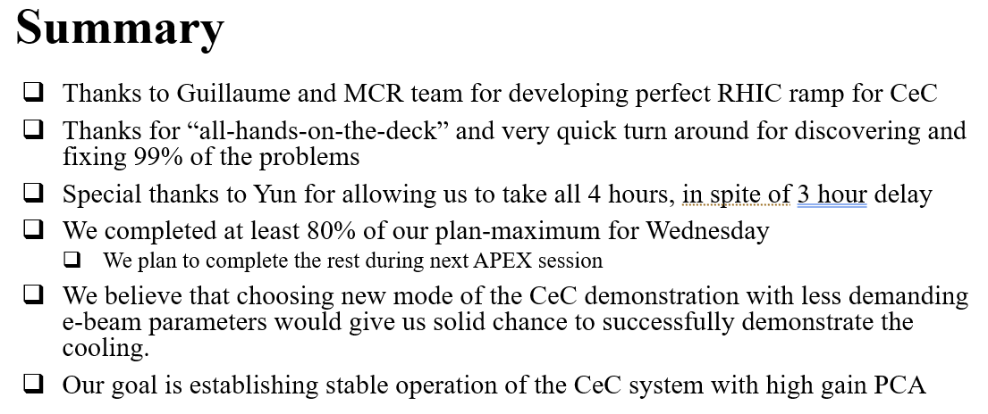
Coherent electron Cooling experiment
@Vladimir

Slide 5
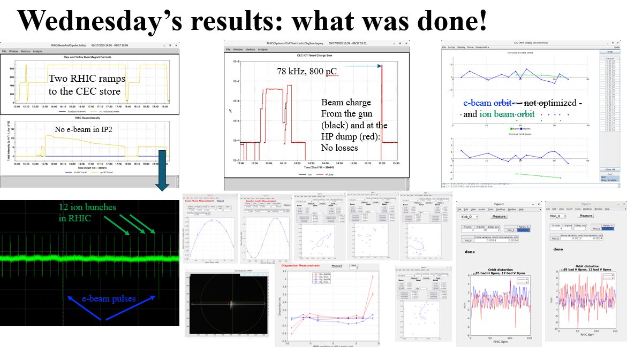
@Vladimir

Slide 6
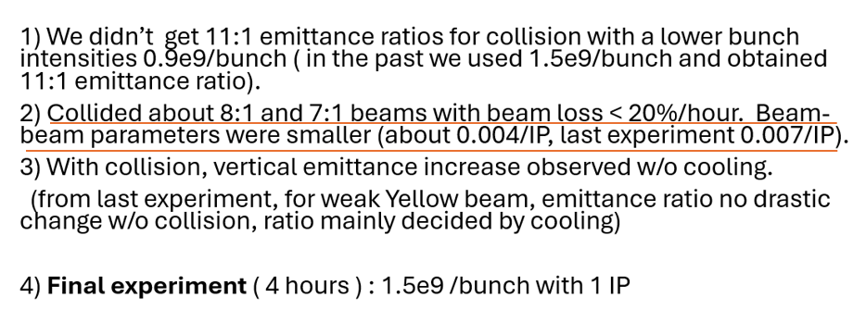
25-01: Maximize BB parameters for flat beam collision
@Yun

Slide 7
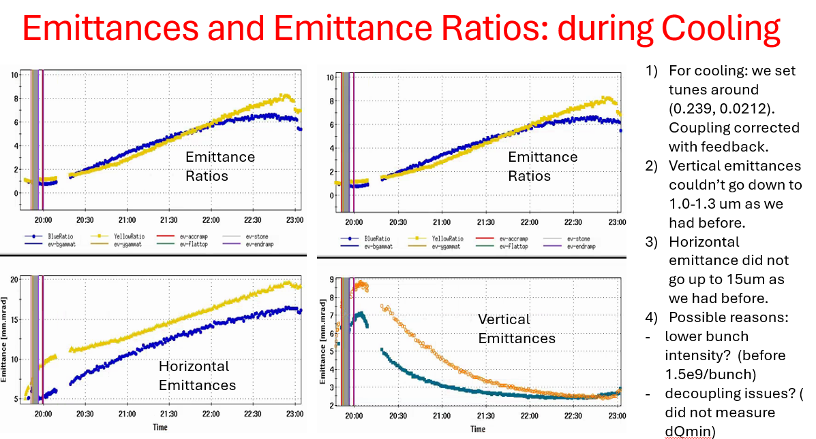

Slide 8
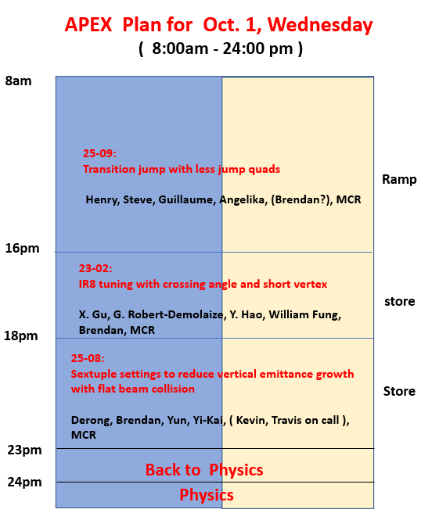
Outlook:
Oct 1 APEX Session
Note: draft schedule

