Slide 1
TAKE FIVE for Safety-
Work Planning and Fall Protection
Frank Craner
September 30, 2025

Slide 2
Recent Work Planning Effort
Work being planned to remove components from the RF Test Facility (former ERL) in building 912
Roof blocks needed to be removed to allow for removal of several components.
Personnel needed to be on the roof during the removal of blocks.
Work exposes personnel to Fall Hazard of more than 4 feet in height.
Use of “Preferred” Fall Prevention measures was not feasible for the work.

Slide 3
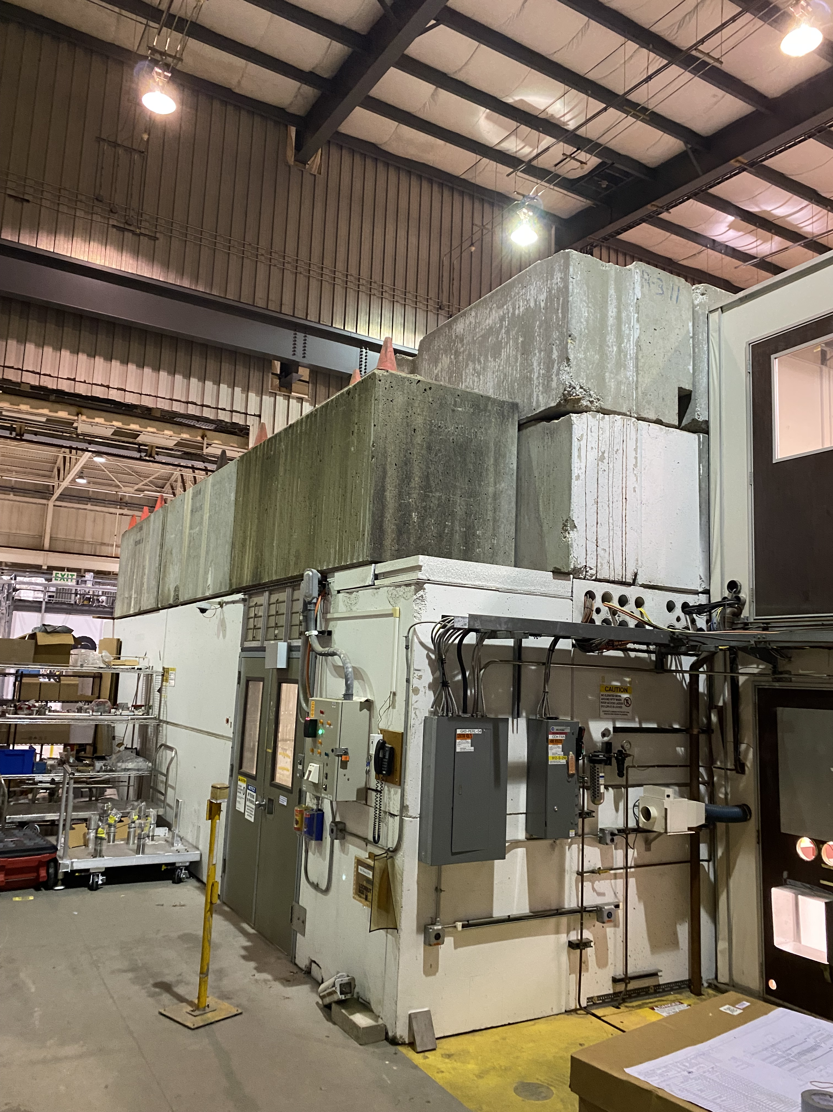

Slide 4
OSHA Standard Excerpts
The employer must ensure that each employee on a walking-working surface with an unprotected side or edge that is 4 feet (1.2 m) or more above a lower level is protected from falling by one or more of the following:
  Guardrail systems;
  Safety net systems; or
  Personal fall protection systems, such as personal fall arrest, travel restraint, or positioning systems.
When the employer can demonstrate that it is not feasible or creates a greater hazard to use guardrail, safety net, or personal fall protection systems on residential roofs, the employer must develop and implement a fall protection plan that meets the requirements of 29 CFR 1926.502(k) and training that meets the requirements of 29 CFR 1926.503(a) and (c).
Note to this section: There is a presumption that it is feasible and will not create a greater hazard to use at least one of the above-listed fall protection systems specified in this section. Accordingly, the employer has the burden of establishing that it is not feasible or creates a greater hazard to provide the fall protection systems specified and that it is necessary to implement a fall protection plan that complies with § 1926.502(k) in the particular work operation, in lieu of implementing any of those systems.

Slide 5
SBMS Planning Work for Fall Hazard
(condensed version)
The Fall Protection Competent Person (JTA GE-153) or Fall Protection Qualified Person (TA-FALLPROTECT-Q) must have evaluated the work to determine the best strategy for elimination or control of fall hazards when feasible.
Methods to control fall hazards include:
  Installation of a temporary engineered rail system (for workers being protected, Fall Protection training is not required);
  Use of Fall Arrest/Travel Restraint Personnel Protective Equipment (see the section Using Personal Protective Equipment);
  Use of a Designated Area (in the section Working on a Low-slope or Flat Roof and refer to the subsection Establishing a Designated Area on a Low-slope or Flat Roof).

Slide 6
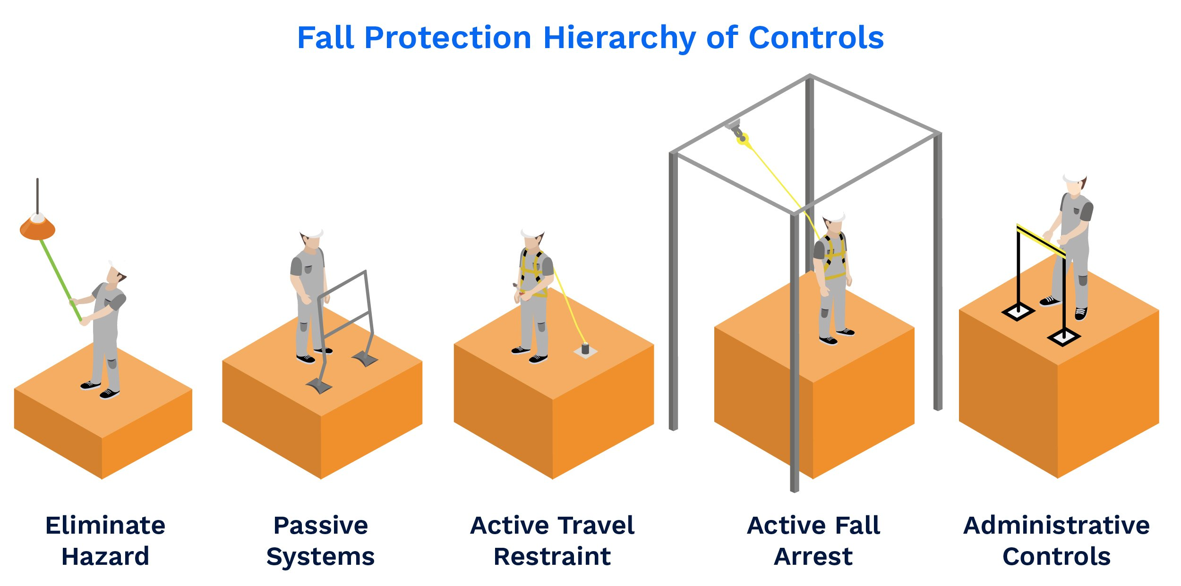

Slide 7
“Safety monitoring systems”
Safety monitoring systems and their use shall comply with the following provisions:
The employer shall designate a competent person to monitor the safety of other employees and the employer shall ensure that the safety monitor complies with the following requirements:
  The safety monitor shall be competent to recognize fall hazards;
  The safety monitor shall warn the employee when it appears that the employee is unaware of a fall hazard or is acting in an unsafe manner;
  The safety monitor shall be on the same walking/working surface and within visual sighting distance of the employee being monitored;
  The safety monitor shall be close enough to communicate orally with the employee; and
  The safety monitor shall not have other responsibilities which could take the monitor's attention from the monitoring function.
Mechanical equipment shall not be used or stored in areas where safety monitoring systems are being used to monitor employees engaged in roofing operations on low-slope roofs.
No employee, other than an employee engaged in roofing work [on low-sloped roofs] or an employee covered by a fall protection plan, shall be allowed in an area where an employee is being protected by a safety monitoring system.
Each employee working in a controlled access zone shall be directed to comply promptly with fall hazard warnings from safety monitors.

Slide 8
Conclusion
A Fall Protection Plan incorporating a “Safety Montor” employee was developed for this work.
BNL SME approved the plan and provided needed OJT training to workers.
Safety Watch person monitored active worker and provided communication of hazard (“How close to the edge”).
Removal of equipment was completed safely.
SCoR Principle:
  Hazards are identified for every task, every time.

