Slide 1
Preinjector Status
D. Raparia
Time Meeting
September 30, 2025

Slide 2
Tandem
AGS late 3e9 with chopper at 500.
AGS late 3e9 with chopper at 500.
AGS late 3e9 with chopper at 500.
MP7- RHIC support
Switch to MP7,
Beam will be available some time tomorrow ( mp6 work)
- MP6
OPEN for foil change and work on stability

Slide 3
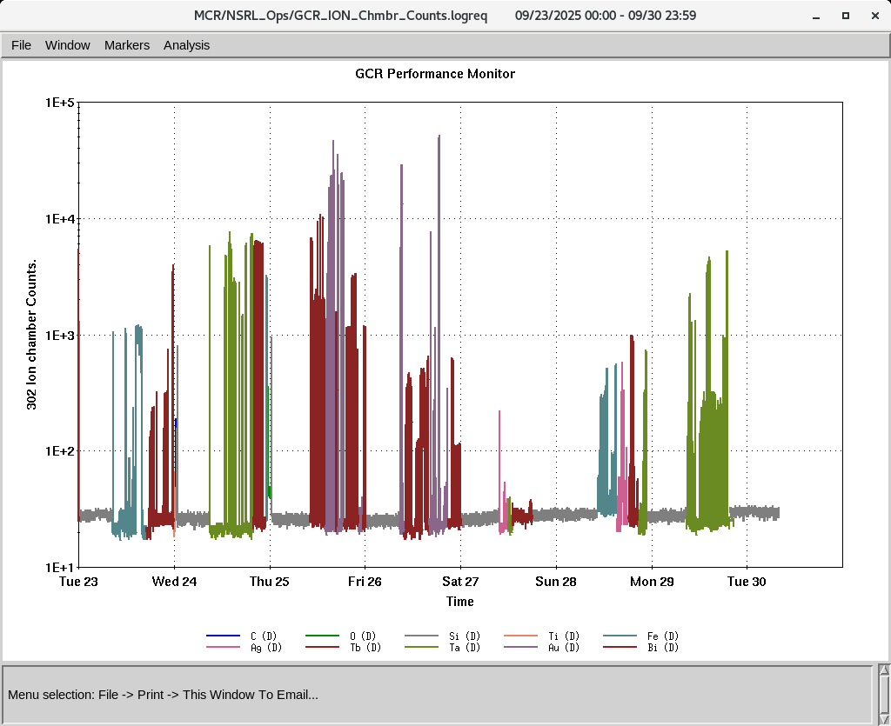
EBIS
Smooth operation for NSRL
Test for switching H₂⁺ and He , this Friday
RF of RFQ is degrading , need time to diagnosis (~ day)
IONS to NSRL
C⁺⁵ O⁺⁷ Si^{+11 ,}Ti⁺¹⁷ Fe⁺²⁰ , Ag⁺²⁹, Tb⁺³⁵, Ta⁺³⁸,Bi⁺⁴³
Au⁺³¹ (Tandem)

Slide 4
LINAC
BLIP requesting beam in last week of December
Vacuum pump down l started ~ 1e-6 torr
OPPIS preparation is underway, will start in first week of October
(some electrical work is needed to install UPS)
Linac will be ready for beam by 2nd week of Nov

