Slide 1
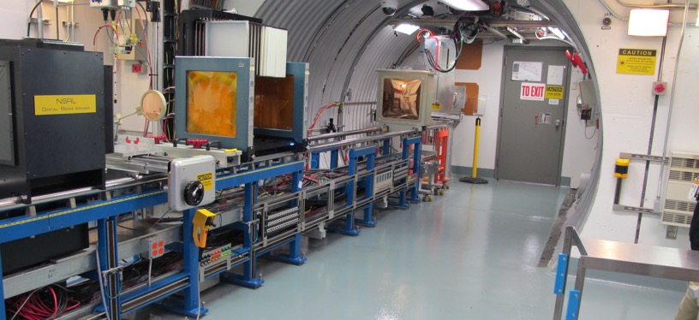
NSRL Time Meeting Report
30 September 2025
Michael Sivertz

Slide 2
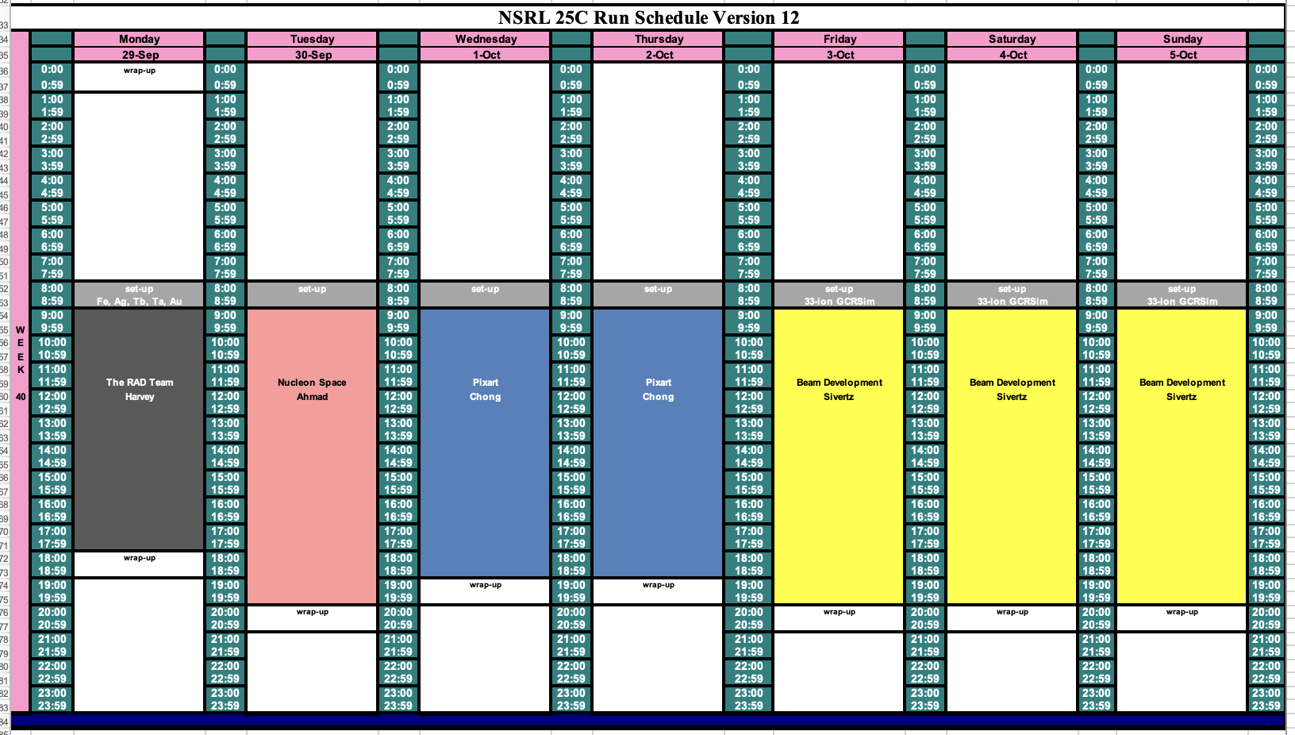
Schedule for this week

Slide 3
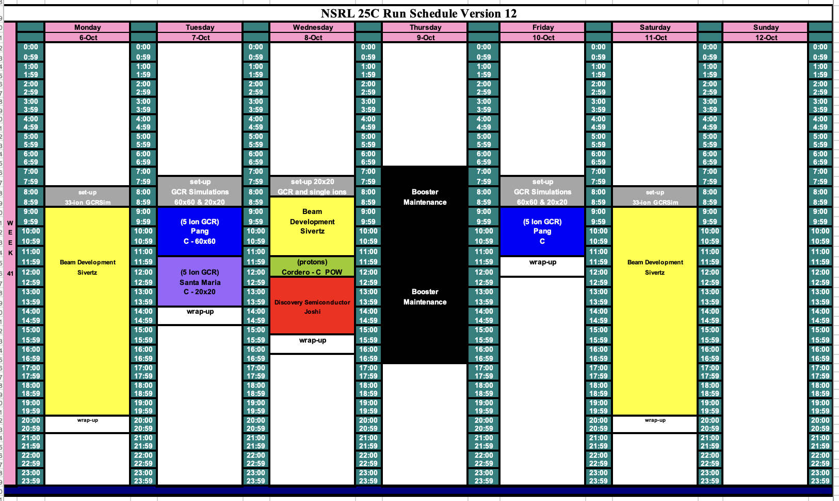
Schedule for next week

Slide 4
Future Schedule
Finishing with the electronics testers this Thursday.
Beam Development for Biology through the weekend, with mostly 12 - 16 hour days.
Working with EBIS and MCR to maximize the proton flux from EBIS using direct injection of molecular H₂⁺ or possibly H₃⁺
NSRL needs to develop 33-beam GCR Simulation and 5-ion Simplified GCR Sim.
NASA Radiobiology program begins next week, independent of any government shutdown.

