Slide 1
Data courtesy C. Naylor

Slide 2
Data courtesy C. Naylor

Slide 3
Data courtesy C. Naylor

Slide 4
Data courtesy C. Naylor

Slide 5
Data courtesy C. Naylor

Slide 6
Data courtesy C. Naylor

Slide 8
Data courtesy C. Naylor

Slide 9
Data courtesy C. Naylor

Slide 10
Data courtesy C. Naylor

Slide 11
Data courtesy C. Naylor

Slide 12
Data courtesy C. Naylor

Slide 13
Data courtesy C. Naylor

Slide 14
Data courtesy C. Naylor

Slide 15
Operations for BLIP
No BLIP
this past week
BLIP remains in shutdown.
Linac off since 8 July.
Notes:
BLIP plot from LogView /MCR/PerformanceStats/timeMeetingBLIP.lvdisp
Avail calc on nsrl time Excel sheet

Slide 16
NSRL activity past week: 9/23-30/2025 (as of 0800)
NSRL running continues.
Various setup and user beam time through the week.
10 species (H, He, O, Si, Fe, Nb, Ag, Tb, Ta, Bi) logged to NSRL.
Run 25-C began 30 June; concludes. updates forthcoming through 31 October.
Run 26-A schedule posted with users up to 19 December.
Availability: 94.9%
Notes:
Graph and avail calc from nsrl time.xlsx

Slide 17
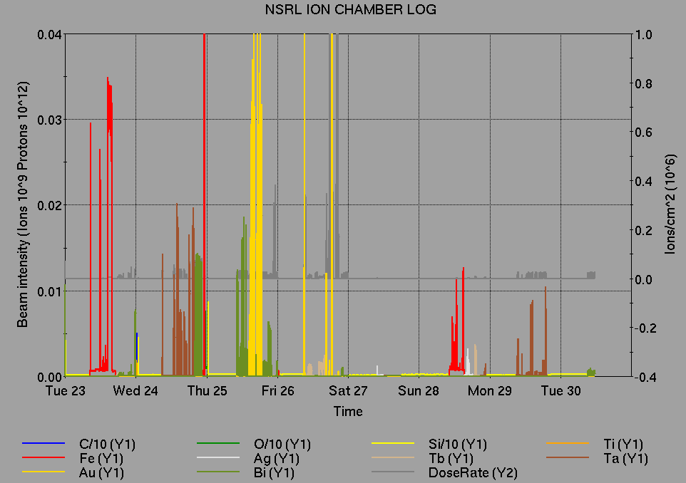
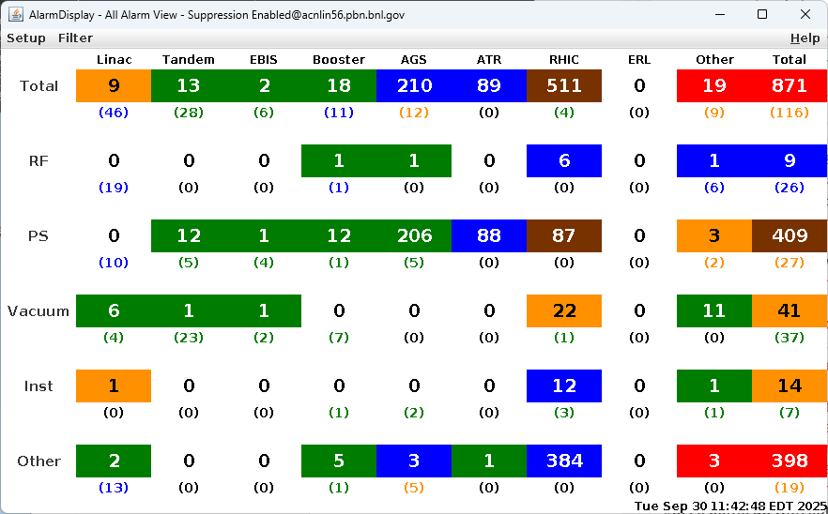
Notes from Operations
Notable failures (>1 hr)
ODH system failure sector 10 during maintenance
day, Fire/Rescue access; ACS replaced PS
EBIS drift tube 19 PS failure, replaced with spare
Beam-induced quench; anomalous Yellow abort
kicker prefire caused vacuum leak at dump;
repairs ongoing, abort system diagnosis pending
  Subsequent ODH sensor failures/response to
  Sectors 8, 12
Other notes
BPM abort, Blue corrector PS trip
STAR access for Fire/Rescue HSSD trip
RHIC BS3 RF crowbar trip, breaker reset (2x); addressed
during extended maintenance
EBIS RFQ (5x), Collector (4x) trips
BtA QF14 PS failure, ongoing; retuned line
Other various trips, resets, tuning, foil changes
Over 60 hours CeC beam time;
other injector setup, training behind stores
Notes:
NSRL plot from LogView /MCR/PerformanceStats/timeMeetingNSRL.lvdisp, select Dose Rate and ion species in use
Screenshot of AlarmSummary

Slide 18
Reminder from Operations
MCR beam operations continue
  RHIC physics resumption TBD
    Tandem (MP7) remains sole provider of Au31 for RHIC
    Beam operations pending availability of Blue beam, abort kicker diagnostics
  NSRL shifts scheduled for users, MD, and NASA biology, 7 days/2 shifts this week.
    Au31 from Tandem for higher intensity; no TVDG protons established (including mode switching)
    Other ion beams from EBIS; H₂ intended for H delivery
  No BLIP published schedules yet
    Linac proton beams off until November
  AGS tuning, other studies to continue behind stores as time allows
    AGS/AtR 3.85 GeV Au setup TBD
  MCR shift coverage 24/7 when RHIC resumes.

Slide 19
Keytree notes
Remote keytree systems require a database lookup to validate and authorize distribution of keytokens. The Keytrak system’s database is available for lookup functionality, but can no longer be modified in any way to add or edit qualified personnel.
Personnel affected:
New employees, experimenters arriving after 12/1/2024 could not be enrolled in database
Existing employees & experimenters, not already enrolled, cannot be added or modified in database
Remote keytrees affected:
Iris scan @NSRL
BNLID scan @AGS South gate, North Conjunction Gate
Iris scan @RHIC STAR, sPHENIX, IP12, IP4
Keytrees NOT affected:
BNLID scan @Linac, Booster
BNLID scan @RHIC IP2
MCR keytrees

Slide 20
Keytree notes, continued
Mitigation:
Choose entrants that are currently enrolled to perform the work in the enclosure under Controlled Access (CA).
Obtain CA keys from MCR for remote gate watch
Arrange for local gate watch using other tokens for entrants.
Arrange for Restricted Access, and allow for delays incurred to sweep areas.
CAUTION
Follow procedures. Gate Watch staff will remain vigilant.
  No “piggy-backing” – one key/token per entrant.
  Access keys are not candy! Authenticated entrant retains possession.
Radiological Controls and the Access Controls System are not to be circumvented. This is (has been) enforced with disciplinary action (dismissal).

Slide 22
Notes:
Reliability comparisons to previous runs

Slide 23
Notes:
Reliability comparisons to previous runs

Slide 24
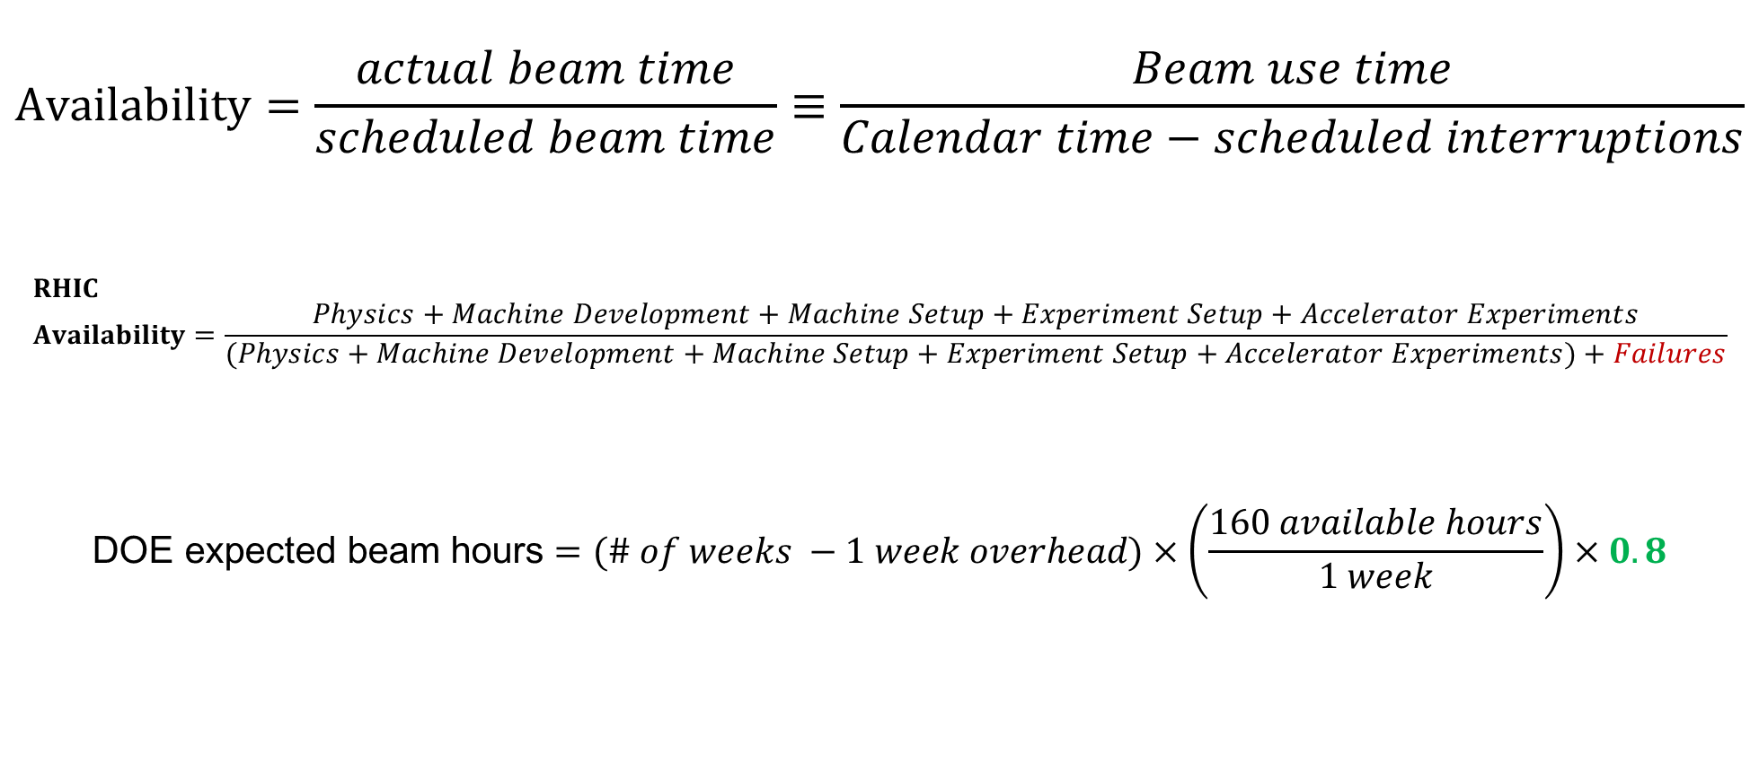
Availability, expected beam hours
$$Availability=\frac{actual beam time}{scheduled beam time}≡\frac{Beam use time}{Calendar time−scheduled interruptions}$$
$$RHIC \\ Availability=\frac{Physics+Machine Development+Machine Setup+Experiment Setup+Accelerator Experiments}{(Physics+Machine Development+Machine Setup+Experiment Setup+Accelerator Experiments)+Failures}$$
$$\text{DOE} \text{expected} \text{beam} \text{hours}=(\# of weeks −1 week overhead)×\left(\frac{160 available hours}{1 week}\right)×0.8$$
Notes:
Normally hidden. Explains how the 85% from DOE comes in to play, & general availability metrics

