Slide 1
Preinjector Status
D. Raparia
Time Meeting
October 07, 2025

Slide 2
Tandem
AGS late 3e9 with chopper at 500.
AGS late 3e9 with chopper at 500.
AGS late 3e9 with chopper at 500.
MP7- RHIC support
working well
- MP6 – external users
Closed and conditioning
No external user till end of month

Slide 3
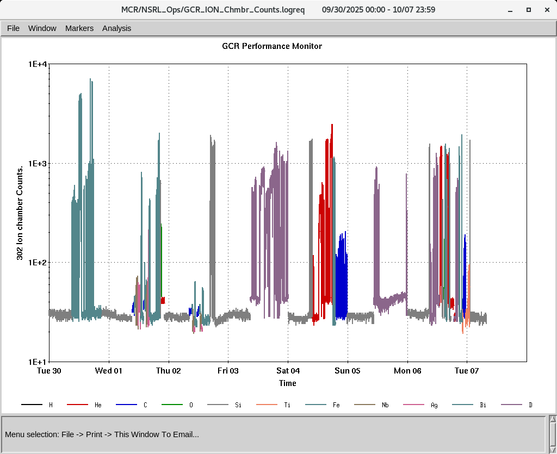
EBIS
Smooth operation for NSRL
Test for switching H₂⁺ and He completed
Providing ions to setup GCR
RF of RFQ is degrading , need time to diagnosis (~ day)
IONS to NSRL
H₂⁺ He⁺ ²C⁺⁵ O⁺⁷ Si^{+11 ,}Ti⁺¹⁷ Fe⁺²⁰ , Ag⁺²⁹, Nb⁺²³,Bi⁺⁴³

Slide 4
LINAC
BLIP requesting beam in last week of December (12/29/2025)
OPPIS preparation is underway, will start in this week
Linac will be ready for beam by 2nd week of Nov
Linac check off list out for signature

