Slide 1
sPHENIX Status
Kin Yip
sPHENIX Director of Operations
Time Meeting
Oct. 7, 2025

Slide 2
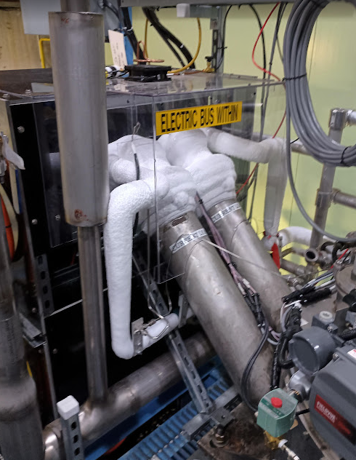
sPHENIX Status
sPHENIX was able to take beam collision data as soon as RHIC delivered “physics” in the morning of Oct. 6 (Monday).
Before that, we were taking cosmic and calibration data.
Refreshing firmware for the TPC CDU (Cooling Distribution Unit) system seems to have eliminated the recent CDU tripping occurrences (last week).
Late last week, we noticed unusual amount of ice
covering the Current Leads of the sPHENIX Magnet
on the top platform of IR8. Eventually, we ramped
down the Magnet and found that both heaters were
broken. The heaters were then replaced by the C-AD
Cryo Group.
We appreciate the help from the Cryo Group
again.
Maybe, we should add a temperature alarm for these heaters (HTR435/436).

Slide 3
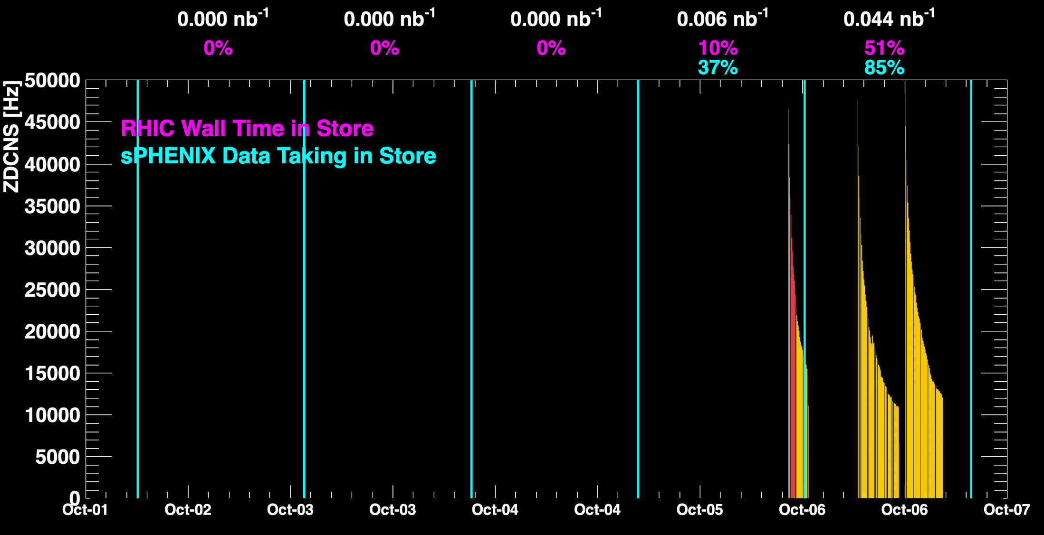
sPHENIX Status (cont.)
When all sPHENIX detectors were being operated.

Slide 4
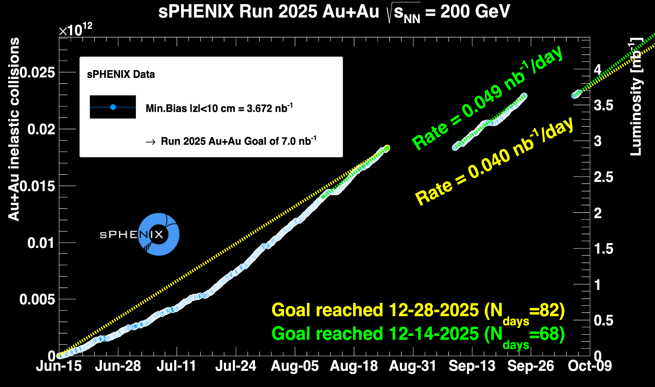
sPHENIX Status (cont.)

