Slide 1
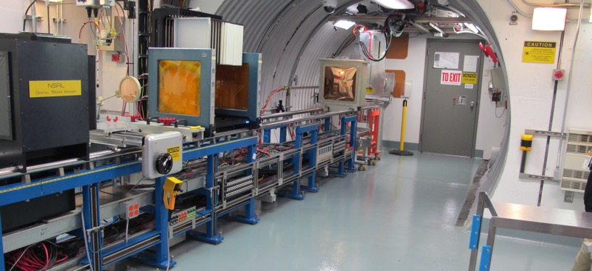
NSRL Time Meeting Report
7 October 2025
Michael Sivertz

Slide 2
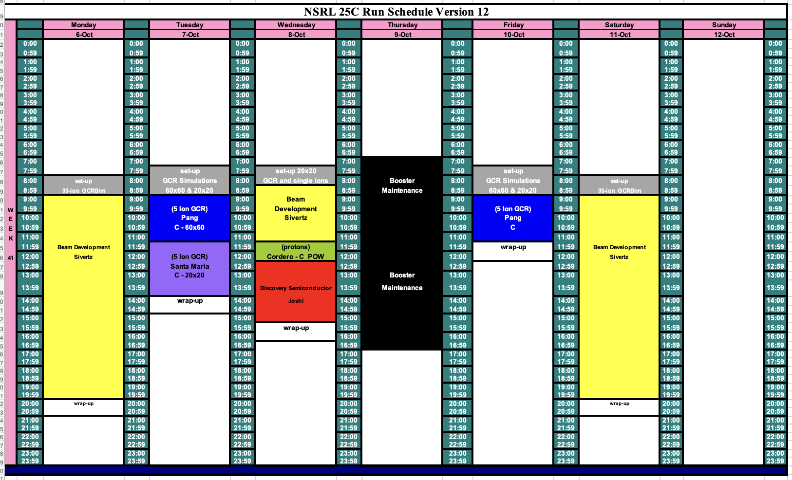
Schedule for this week

Slide 3
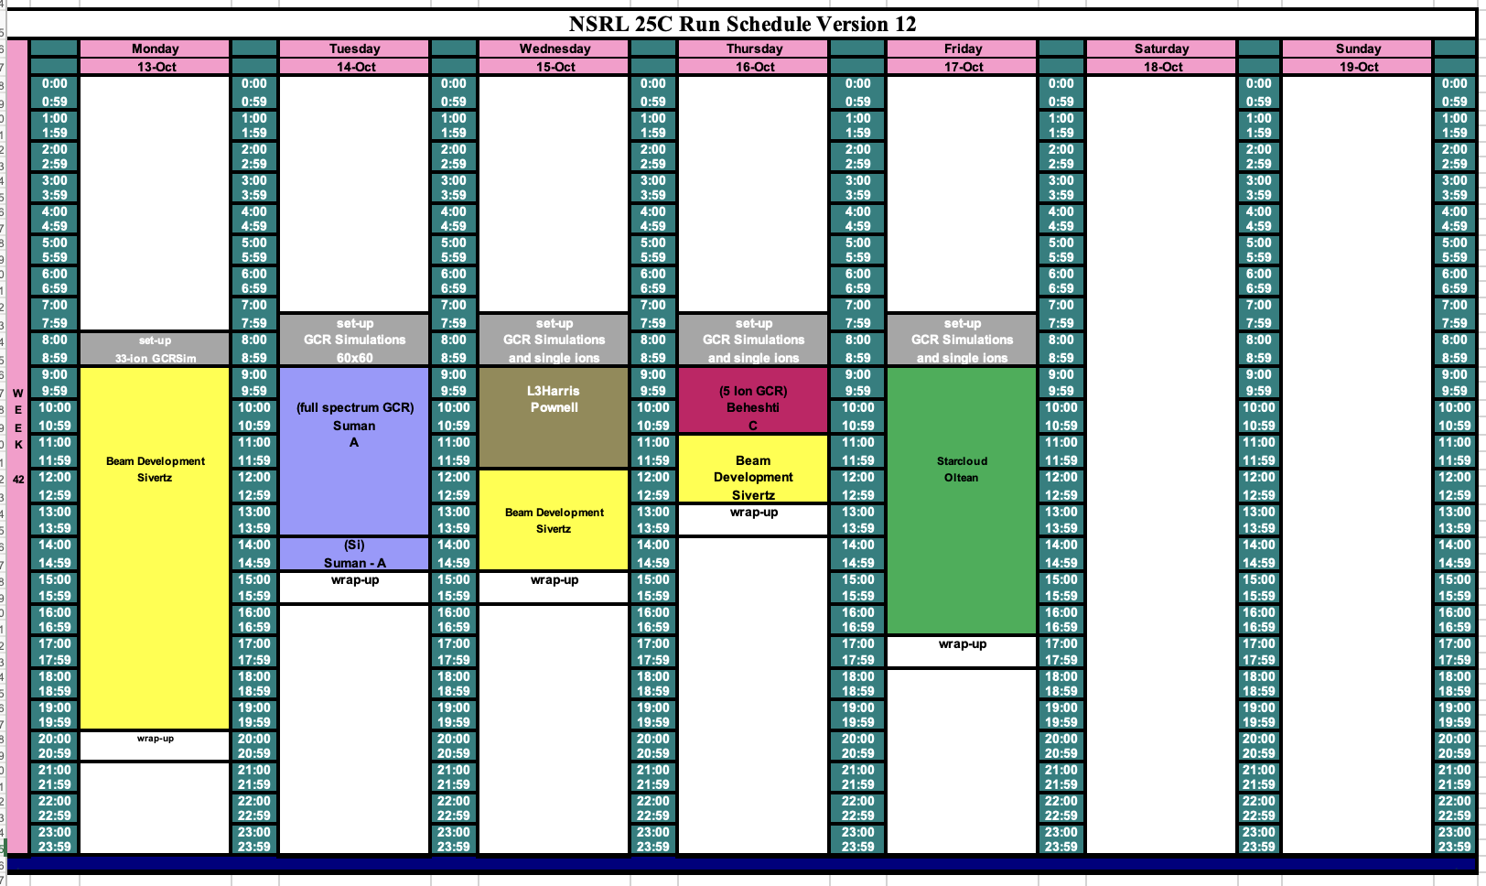
Schedule for next week

Slide 4
Future Schedule
Working with EBIS and MCR to maximize the proton flux from EBIS using direct injection of molecular H₂⁺ or possibly H₃⁺. Concerns about the cross-contamination of the Helium and Hydrogen beams.
NSRL has developed the 5-ion GCR Sim and is in the process of developing the 33-beam GCR Simulation for next week.
Still questions about the functionality of the automated tape sequence for changing ion species for the GCRSim.

