Slide 1
Preinjector Status
D. Raparia
Time Meeting
October 14, 2025

Slide 2
Tandem
MP7- RHIC support
Working well
Charging power supply was replaced, beam is stable now
- MP6 – external users
Closed and conditioning
Investigation gridded lens
No external user till end of month

Slide 3
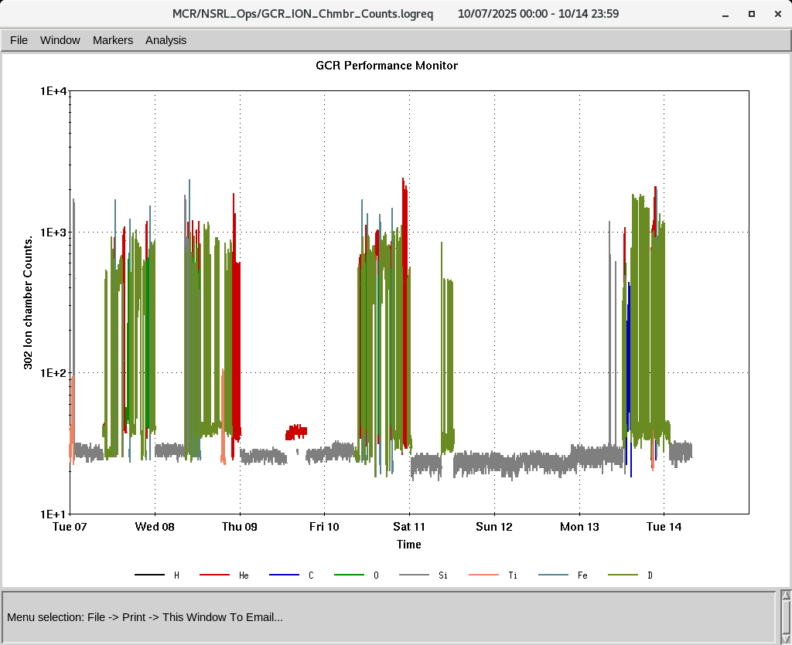
EBIS
Smooth operation for NSRL
Providing all the ions to setup GCR
RF of RFQ is degrading , need time to diagnosis (~ day)
LION target chamber turbo fail, need to replace , Thursday ?
IONS to NSRL
H₂⁺ He⁺ ² C⁺⁵ O⁺⁷ Si^{+11 ,}Ti⁺¹⁷ Fe⁺²⁰ ,

Slide 4
LINAC
BLIP requesting beam in last week of December (12/29/2025)
OPPIS started yesterday
Linac will be ready for beam by 2nd week of Nov
Linac check off sign off today , RF conditioning will start today

