Slide 1
sPHENIX Status
Kin Yip
sPHENIX Director of Operations
Time Meeting
Oct. 14, 2025

Slide 2
sPHENIX Status
The sPHENIX collaboration continued accumulating luminosity towards the luminosity goal of 7/nb (Au + Au).
Two facility-related downtime, resolved quickly:
Last week, 1008C cooling water pumps tripped twice (Oct. 8/Oct. 9) which then tripped the sPHENIX Magnet, and all the racks (for detectors and electronics) also needed to be shut off.
Thanks for the C-AD group of Water Systems to come in at night to fix the problem. The nature of the 2nd trip was not understood. PK Feng and his colleagues are also investigating.
Sunday night (Oct. 12), our “Advantage chiller” (TPC) in the Assembly Hall chiller platform seemed to stop running. But later, with the help of on-site AC techs, we found that the real problem was the CDU (Cooling Distribution Unit) due to humidity change.

Slide 3
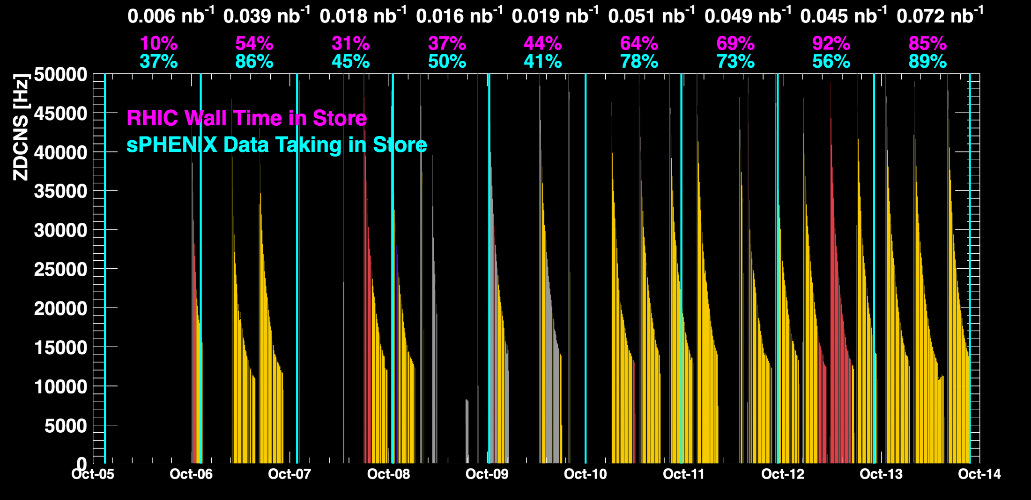
sPHENIX Status (cont.)
1008C pump trips
CDU issue
1008C pump trips
CDU issue
When all sPHENIX detectors were being operated.

Slide 4
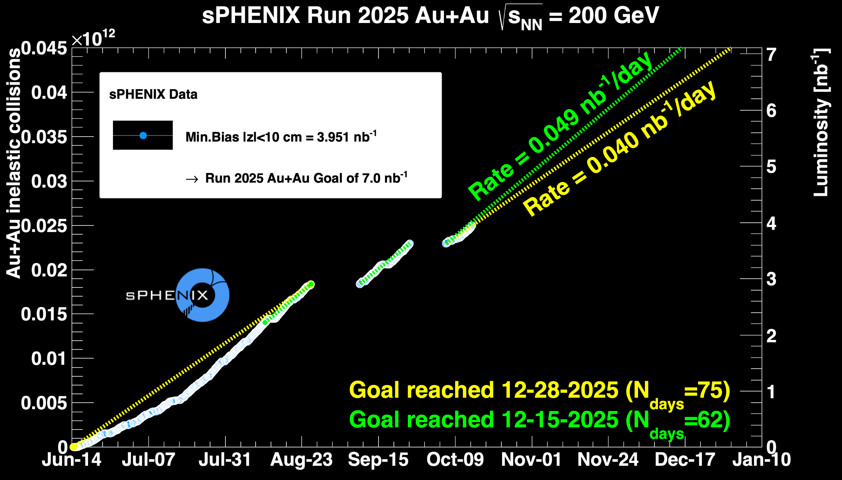
sPHENIX Status (cont.)

