Slide 1
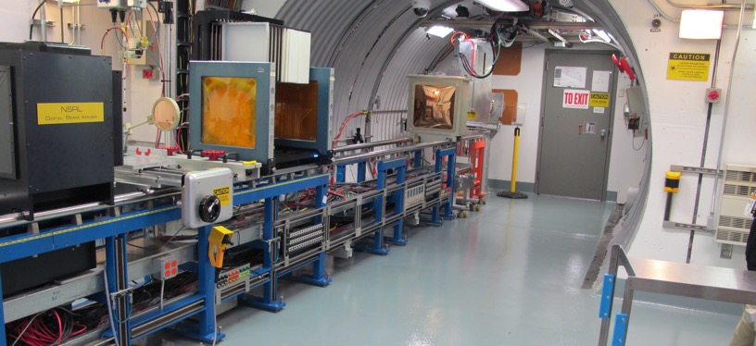
NSRL Time Meeting Report
14 October 2025
Michael Sivertz

Slide 2
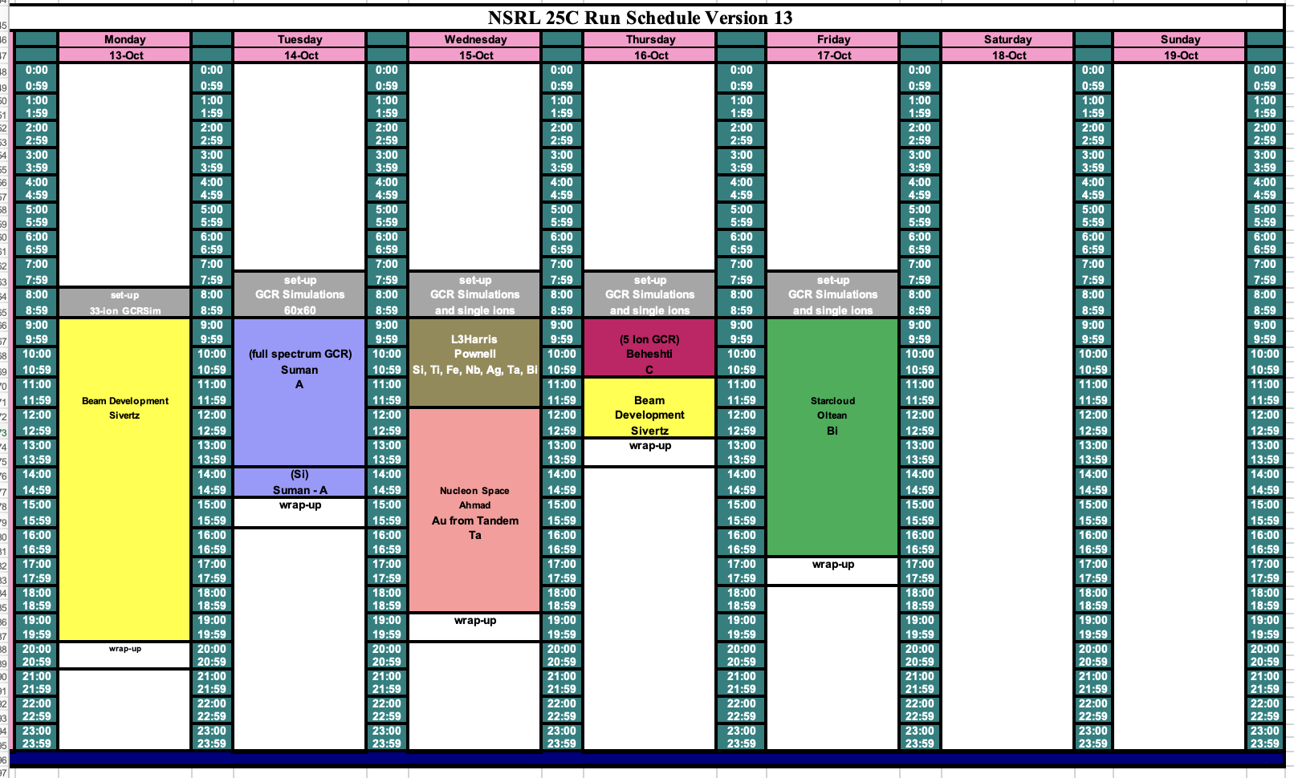
Schedule for this week

Slide 3
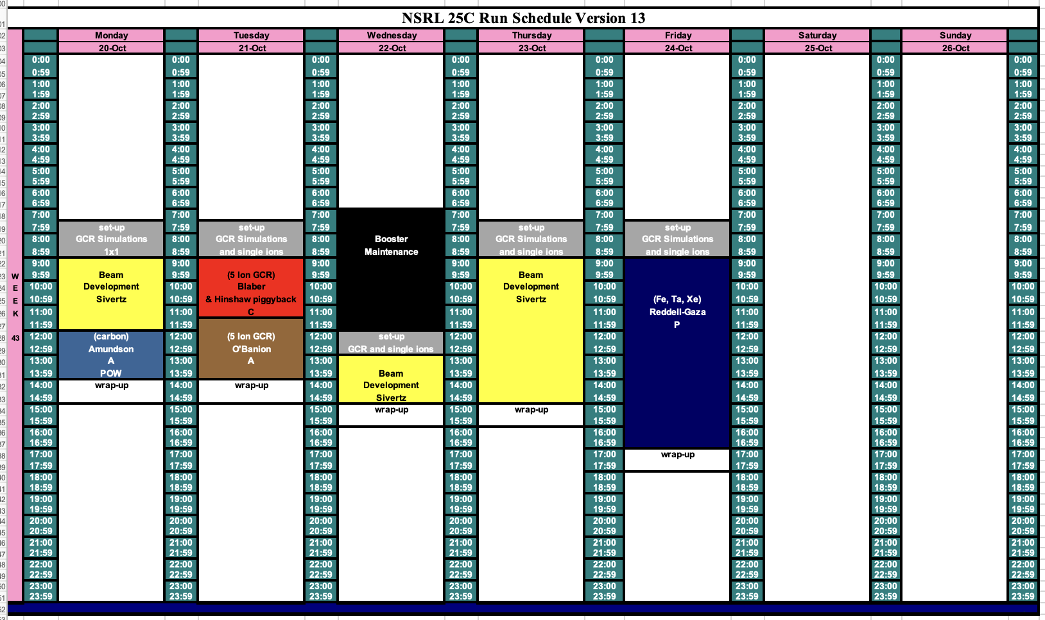
Schedule for next week

Slide 4
Future Schedule
Working with EBIS and MCR to maximize the proton flux from EBIS using direct injection of molecular H₂⁺ or possibly H₃⁺. Concerns about the cross-contamination of the Helium and Hydrogen beams. The He fraction in the H beam is measured to be ~10% out of the Booster.
NSRL has developed the 5-ion GCR Sim and the 33-beam GCR Simulation for next week. The 33-beam GCR Sim is running right now.
Automated tape sequence for changing ion species for the GCRSim has been working very well.
Tomorrow we will do a day of electronics testing, with a request for Au from Tandem in the afternoon.

