Slide 1
Preinjector Status
D. Raparia
Time Meeting
October 21, 2025

Slide 2
Tandem
MP7- RHIC support
Running well
MP6 – external users
Conditioning
Investigating gridded lens
Wiil be ready for external user by end of the week

Slide 3
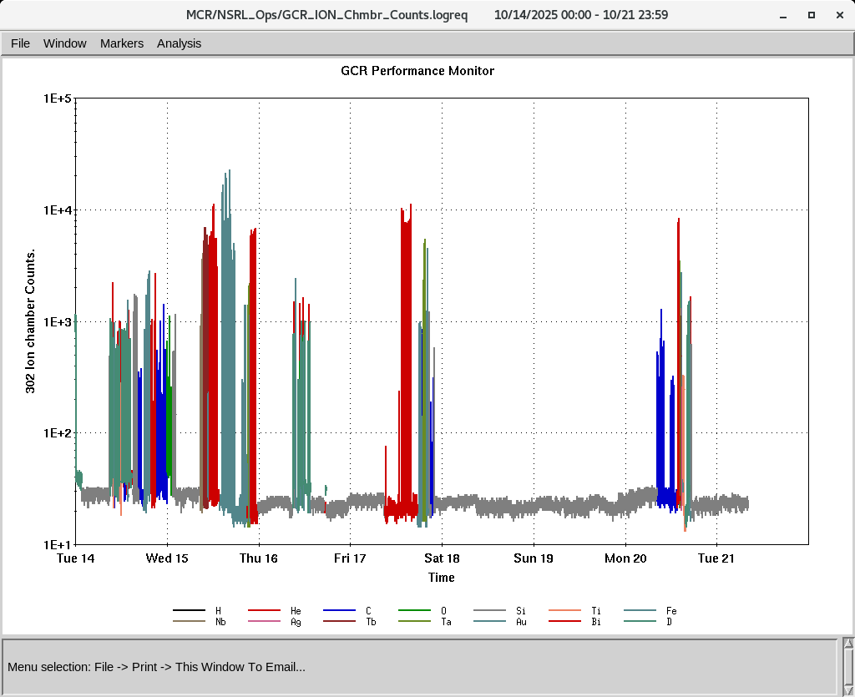
EBIS
Smooth operation for NSRL
Providing all the ions to setup GCR
RF of RFQ is degrading , need to replace caps
LION target chamber turbo was replaced on last Thursday.
IONS to NSRL
H₂⁺ He⁺ ² C⁺⁵ O⁺⁷ Si^{+11 ,}Ti⁺¹⁷ Fe⁺²⁰ , Nb⁺²³ Ag⁺²⁹ Tb⁺³⁵
Ta⁺³⁸, Bi⁺⁴³ ,Au⁺⁴³

Slide 4
LINAC
Linac will be ready for PP beam by 2nd week of Nov
BLIP requesting beam on 12/29/2025
OPPIS, conditioning < ~ 500 uA at FC4 ( before RFQ)
RF conditioning started , Mod 8 50 kV PS need fuse replacement

