Slide 1
sPHENIX Status
Kin Yip
sPHENIX Director of Operations
Time Meeting
Oct. 21, 2025

Slide 2
sPHENIX Status
The sPHENIX collaboration continued accumulating luminosity towards the luminosity goal of 7/nb (Au + Au).
6x6 with no-magnetic-field runs ~Oct. 14/15.
Access: Changed a fuse for the LV distribution board for EMCAL (Oct. 16).
sPHENIX Magnet tripped due to the interlock of Quench Watch Dog Timer (Oct. 18) and was recovered within a few hours.
Access: Replacement of TPC CAEN power supplies, Oct. 18/19.

Slide 3
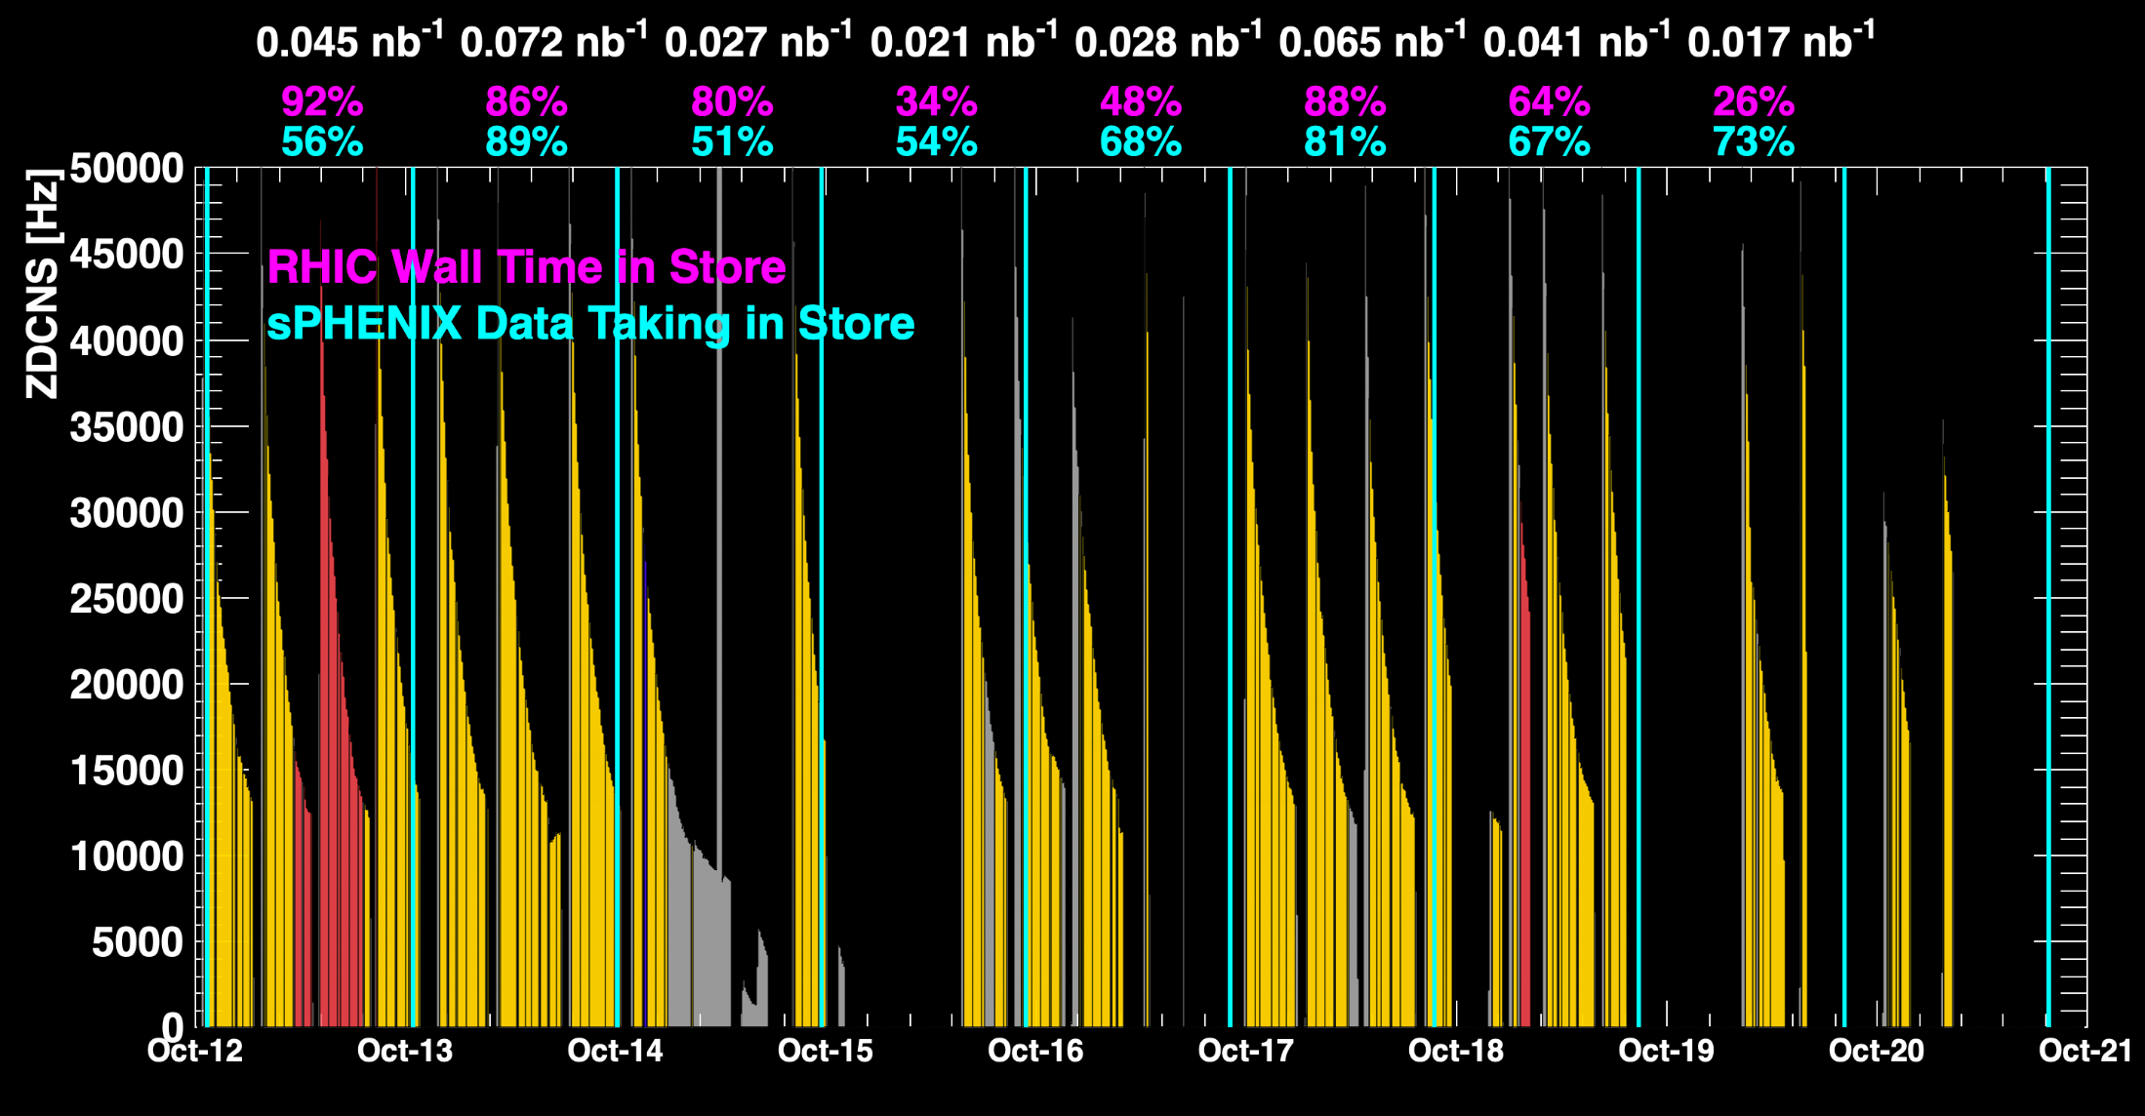
sPHENIX Status (cont.)
1008C pump trips
CDU issue
1008C pump trips
CDU issue
6x6
When all sPHENIX detectors were being operated.

Slide 4
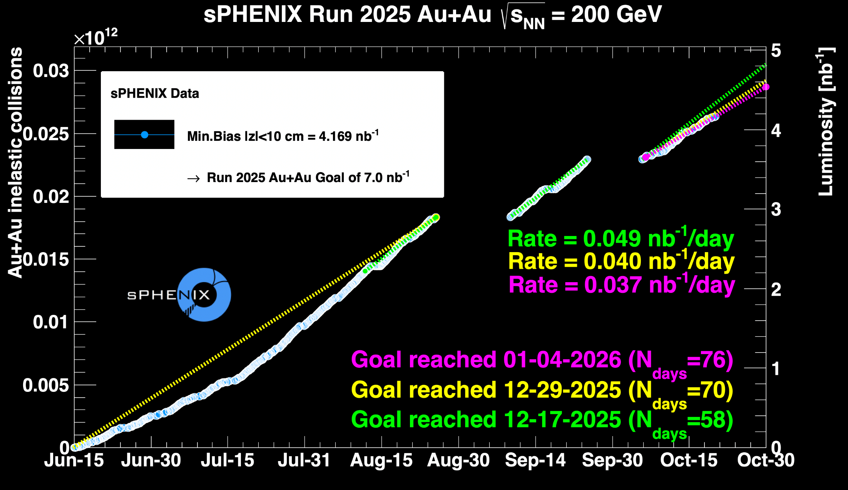
sPHENIX Status (cont.)

