Slide 1
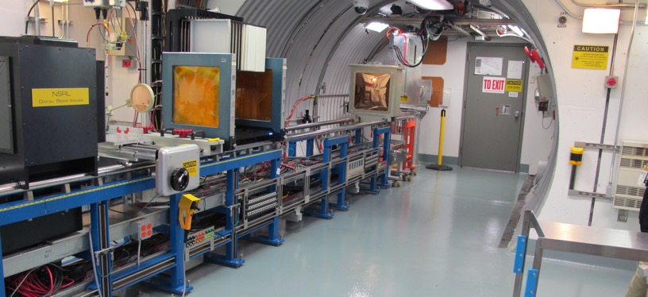
NSRL Time Meeting Report
21 October 2025
Michael Sivertz

Slide 2
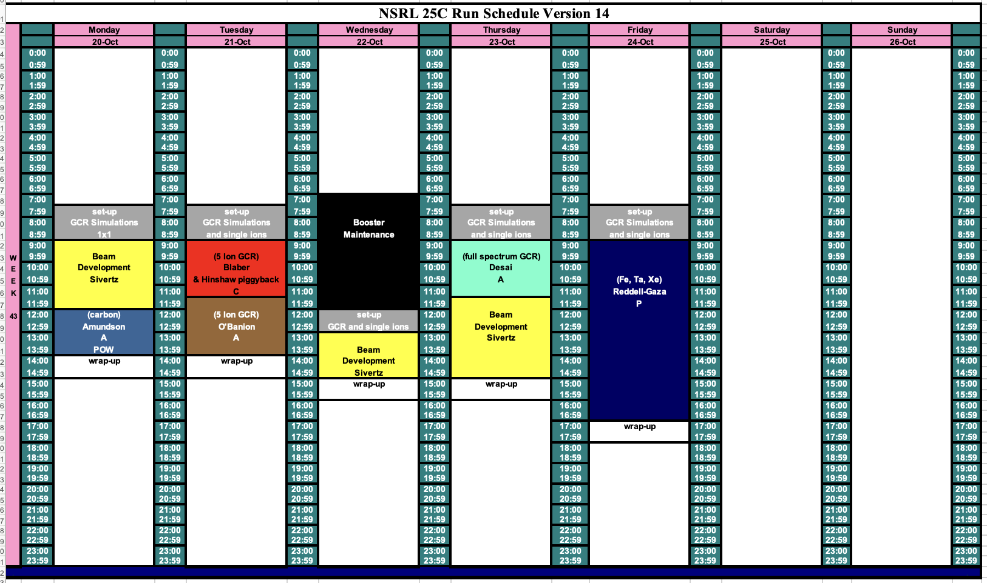
Schedule for this week

Slide 3
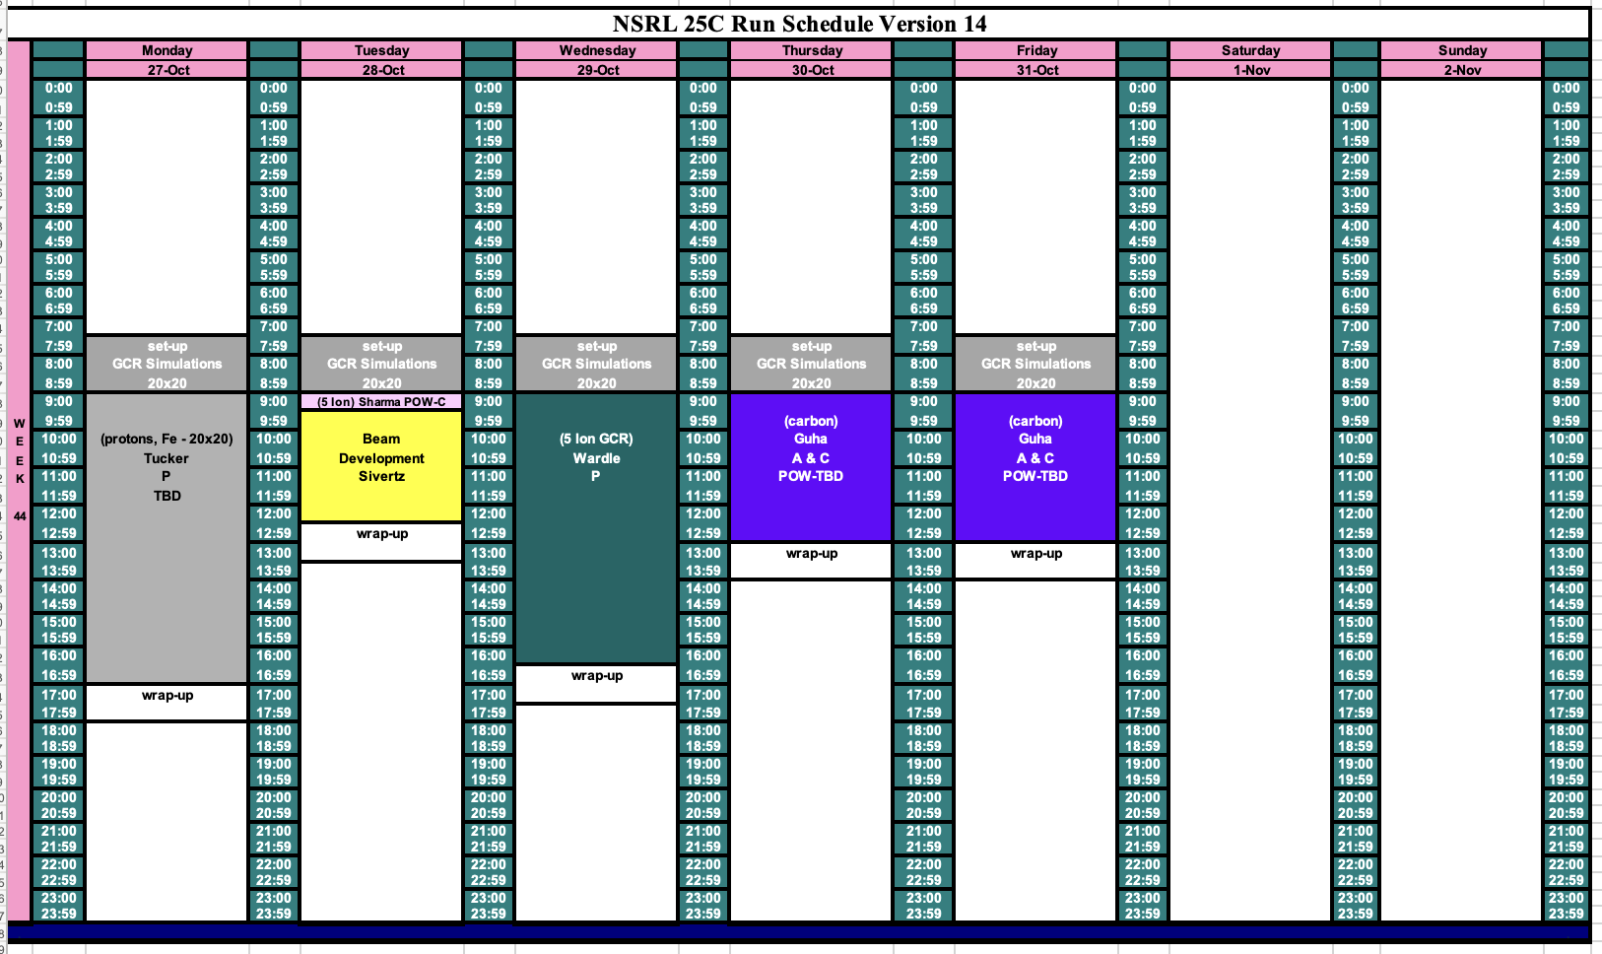
Schedule for next week

Slide 4
Future Schedule
NSRL has developed the 5-ion GCR Sim and the 33-beam GCR Simulation for next week. The 5-ion Simplified GCR Sim is running right now.
We measured the Helium contamination in the H2+ beam again, and this time we got 0.2% Helium2+. Last week we got 10%, so a puzzle remains.
Automated tape sequence for changing ion species for the GCRSim has been working very well.
Electronics testing in November and December is in jeopardy due to government shutdown. The lab is unable to accept funds, even though we have them in hand.

