Slide 1
APEX Report
Time Meeting, Oct 21, 2025

Slide 2
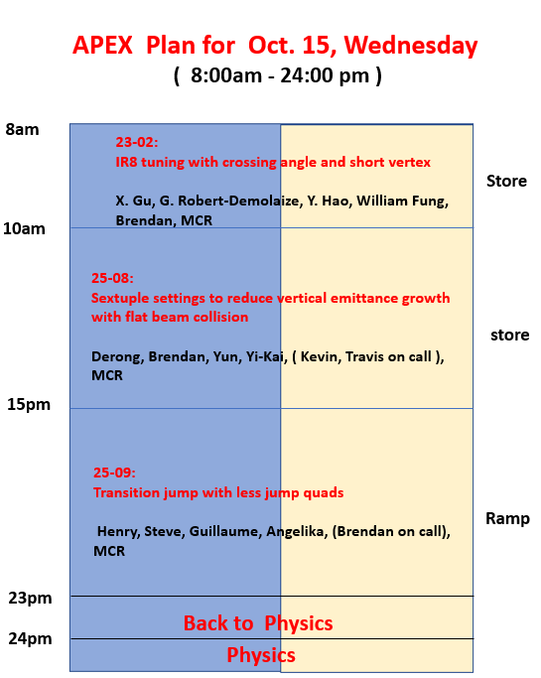
One of a few best APEX sessions:
No machine failure caused down time, planned 15 hours and used 15 hours!

Slide 3

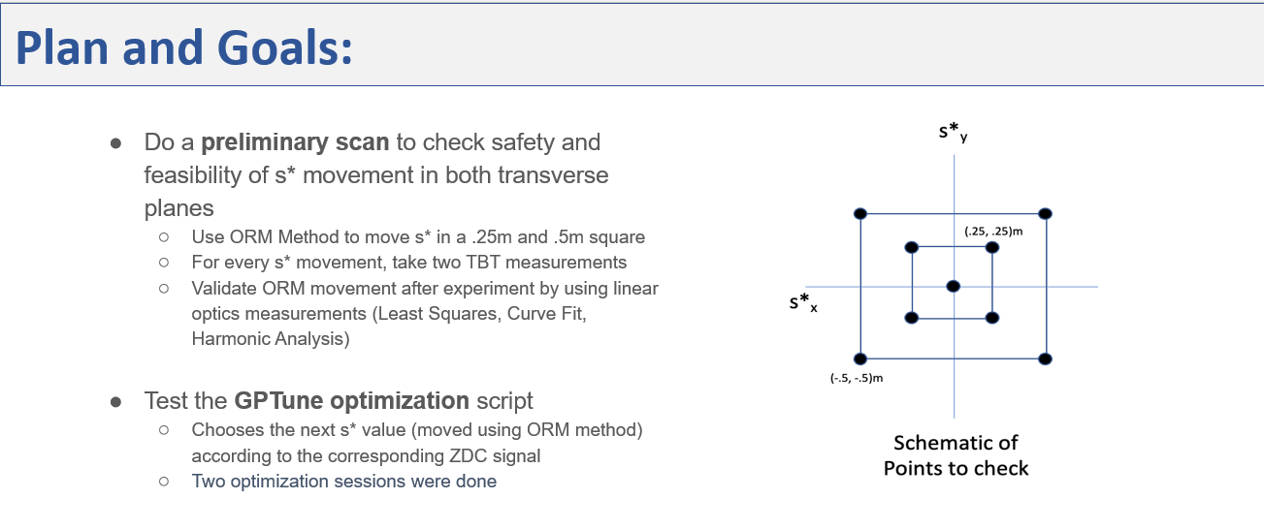
@Xiaofeng

Slide 4
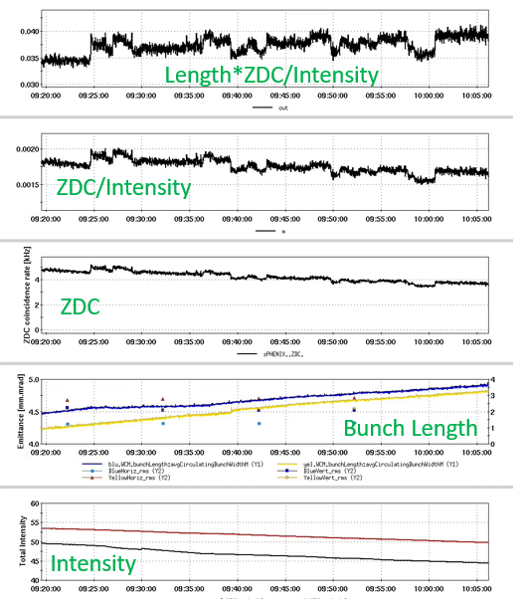
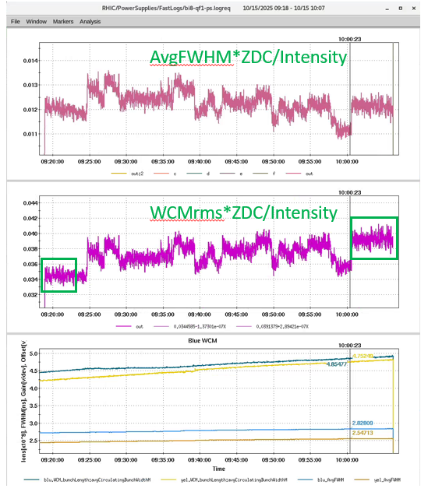
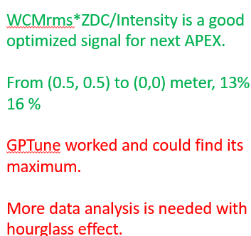

Slide 5

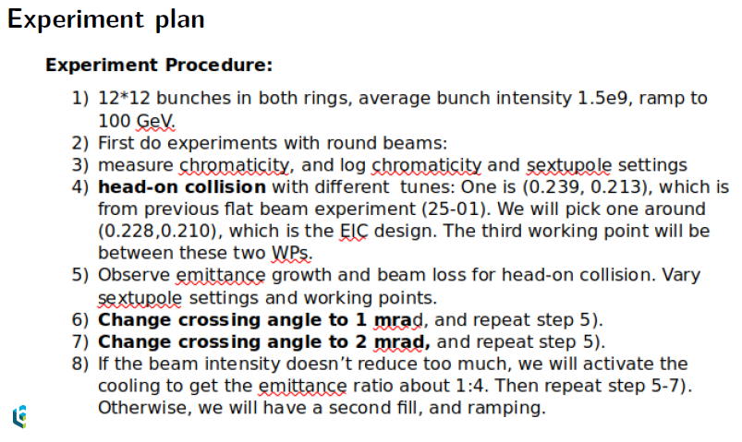
@Derong

Slide 6
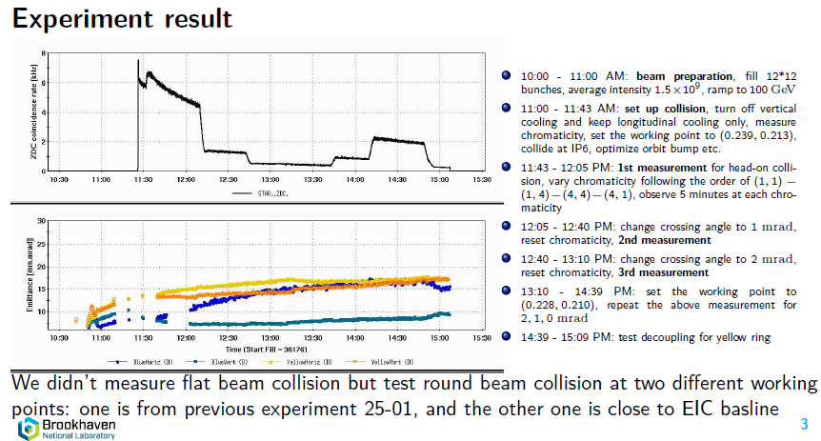

Slide 7
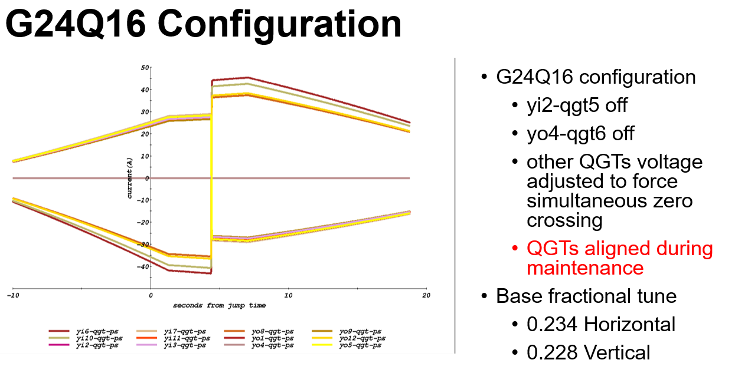
Transition Experiment with Less Jump Quads
@Henry

Slide 8
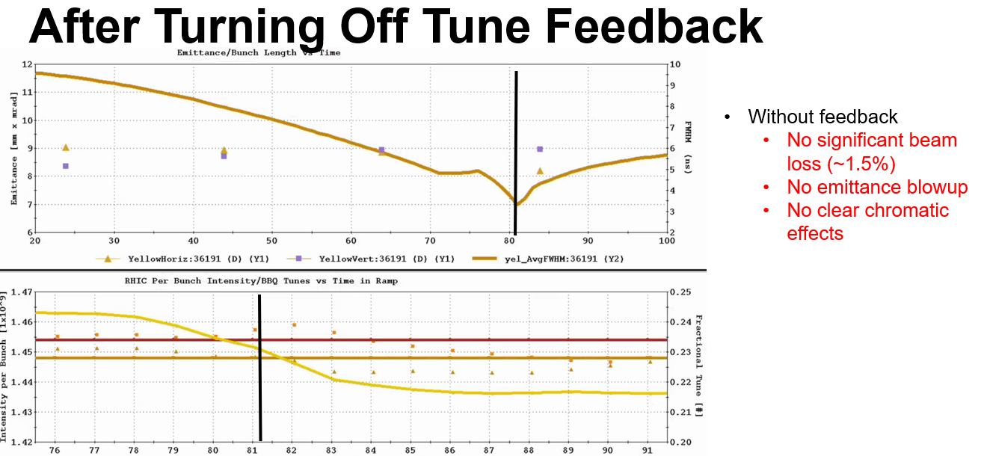
Totally did 16 ramps!!

Slide 9
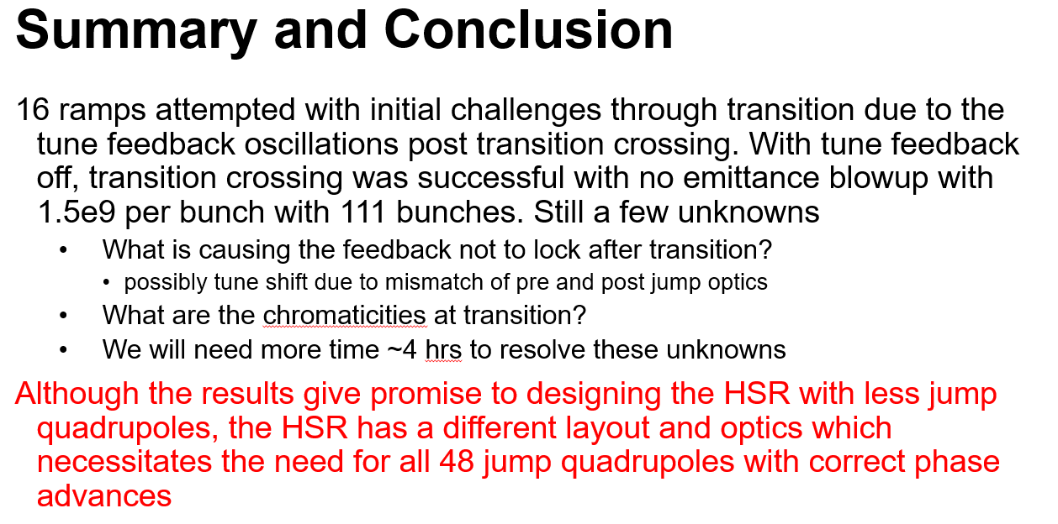

Slide 10
