Slide 1
C-AD Work Planning & Control,
Review of Expectations for OPM 2.28
Time Meeting, Supervisor’s Meeting
Presenter(s): Michael Dany
Date: 10/28/2025, 10/30/2025

Slide 2
Agenda:
What is Work?
Types of Work
Work Control Coordinator Expectations & Accountabilities
Supervisor Expectations & Accountabilities
ES&H Expectations & Accountabilities
IEWR Expectations
Worker Oversight Expectations

Slide 3
What is Work?
SBMS Definition …. “all physical activities that involve the design, set-up, operation, maintenance, servicing, troubleshooting, material handling, remediation, installation, repair, modification, testing, construction, demolition, decommissioning of facilities, systems, or experiments”….
If you’re not behind the desk….its probably work!
Troubleshooting / Diagnosing IS considered work
  May be required to develop a plan, but
  The repair work is a separate step (avoid ‘scope-creep’)
ALL Work is Planned!

Slide 4
Types of Work*
Worker Planned Work
  Walk-down, Identify Hazards, Select PPE, JHAs,
  LOTO Instructions, Electrical Pre-Job Brief,
  Other permits as needed (Hot Work, Confined Space, etc.)
Prescribed / Procedures (OPMs)
  Active Status –Use as approved
  Not Active –Use the Work Permit Process
Permit Planned (Green Sheet)
ES&H Rep.
Work Control Coordinator
Independent Reviewer
Minimum Reviewers,
Planning Team Unlimited
* As Determined by the Work Control Coordinator

Slide 5
C-AD OPM 2.28 Requirements
Work Planning and Control is implemented via the SBMS WP&C Subject Area
OPM 2.28 Provides Supplements to the SBMS Subject Area for C-AD Specific Requirements, such as:
  USI Screening Checklist for Work Permits
  Independent Electrical Work Reviewer for elec. work over 50V
  Coordination with External Workers
  Work Permits use Green paper
  Contractor / Vendor work is Permit Planned
  Requirements for worker oversight by supervisors and ES&H

Slide 6
Work Control Coordinator Expectations and Accountabilities
Walk-down the job and the location
Convene a planning team (ESH Rep, SMEs, Sys. Expert, etc.) as needed
Identify job specific hazards,
Develop a detailed scope of work and an effective detailed work plan, job steps, clear instructions
Complete a USI screening checklist for work permits
Prepare and/or gather work plan documents (Permits, LOTO, Electrical PJB, etc.),
Pause and re-plan / re-evaluate when changes occur,
Obtain feedback, share lessons learned

Slide 7
Supervisor Expectations and Accountabilities
Walk-down tours of the job,
Identify job specific hazards, and controls,
Review scope of work with workers,
Review work plan documents (Permits, LOTO, Electrical PJB, etc.),
Communicate, Coordinate, Schedule work,
Ensure proper execution of job plan, job oversight,
Pause and re-plan / re-evaluate when changes occur,
Obtain feedback, verify job completion,
Document worker engagements and observations twice a month

Slide 8
ES&H Expectations and Accountabilities
Walk-down the job,
Identify job specific hazards,
Recommend appropriate hazard controls,
Specify minimum PPE requirements,
Participate in job planning,
Provide worker support, (Air/Noise monitoring, Ind.Hy., Environmental sampling, Posting/Warning signs, etc.)
Pause work when hazardous conditions are identified,
Obtain feedback, share lessons learned,
Document worker observations four times a month

Slide 9
Worker Expectations and Accountabilities
Maintain assigned training,
Walk-down the job, Identify job specific hazards,
Participate in job planning,
Review and acknowledge work planning documents
Implement appropriate hazard controls,
Utilize appropriate PPE (identified during work planning)
Work safely using training, PPE and hazard controls,
Pause work when hazardous conditions are identified,
Provide feedback to Supervisor

Slide 10
Independent Electrical Work Reviewer Expectations (IEWR)
Review and check electrical job planning / briefing forms,
Check written LOTO instructions,
Independent of the person preparing the documents,
Check for compliance with SBMS Electrical Safety and LOTO subject areas, initial / sign acknowledgement

Slide 11
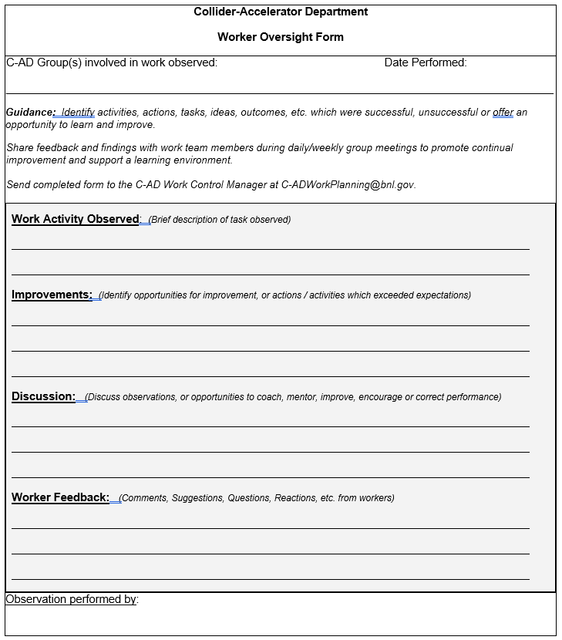
Work Oversight Expectations
OPM 2.28
Attachment 1
Forward Completed Forms To:
C-ADWorkPlanning@bnl.gov

Slide 12
Questions,
Comments,
Concerns,
Open Discussion
SCoR Principle #1:
“Everyone is personally responsible for ensuring safe operations”
2025 Q4

