Slide 1
Preinjector Status
D. Raparia
Time Meeting
October 28, 2025

Slide 2
Tandem
MP7- RHIC support
Running well
MP6 – external users
External user since last Sunday to Tuesday

Slide 3
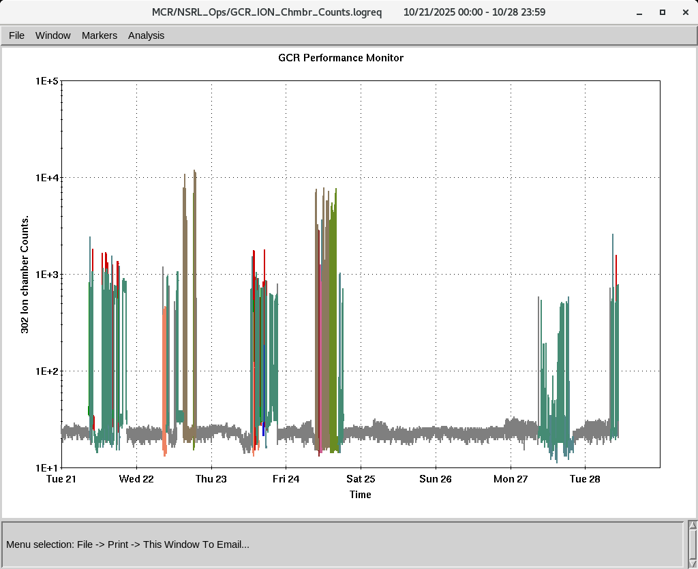
EBIS
Smooth operation for NSRL
Providing all the ions to setup GCR and electronics
Working molecule H₃^{+.} Today
Planning to provided molecular HeH⁺ to NSRL to provide He and H both. Only change in the NSRL beam line (R-Line) . Working on USI
IONS to NSRL
H₂⁺ He⁺ ² C⁺⁵ O⁺⁷ Si^{+11 ,}Ti⁺¹⁷ Fe⁺²⁰ , Ag⁺²⁹ Tb⁺³⁵
Ta⁺³⁸, Bi⁺⁴³

Slide 4
LINAC
Linac will be ready for PP beam by 1st week of Nov
BLIP requesting beam on 12/29/2025
OPPIS, conditioning < ~ 500 uA at FC4 ( before RFQ)
RF conditioning , will be ready by Wednesday
Will try PP to 200 MeV polarimeter on Wednesday or Thursday

