Slide 1
sPHENIX Status
Kin Yip
sPHENIX Director of Operations
Time Meeting
Oct. 28, 2025

Slide 2
sPHENIX Status
The sPHENIX collaboration continued accumulating luminosity towards the luminosity goal of 7/nb (Au + Au).
In the new mode of running, during the initial 10 Hz gap cleaning at the beginning of the store, TPC is off until the frequency of gap cleaning reduces to 1 Hz ⎯ minimal delay (few minutes).
TPC hasn’t suffered from major damage since we used this mode.
There is a leak of the cooling fluid for Electromagnetic Calorimeter in a panel in the northeastern corner of 1008-IR, outside the detectors.
We (R. Pisani et. al.) plan to fix this tomorrow/Maintenance-Day with the help of C-AD mechanical technicians.
Also, on Maintenance Day, C-AD water group & power distribution group will install UPS for the PLC in the 1008C pump room.
C. Schultheiss will also change the timeout for the watchdog timer in quench detection system of the sPHENIX Magnet.

Slide 3
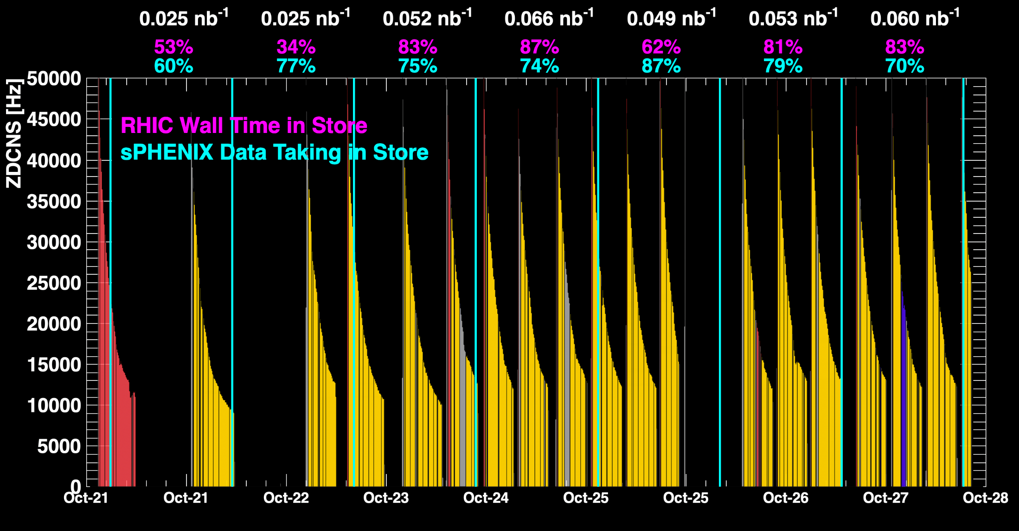
sPHENIX Status (cont.)
1008C pump trips
CDU issue
1008C pump trips
CDU issue
6x6
When all sPHENIX detectors were being operated.
MVTX sensor reset

Slide 4
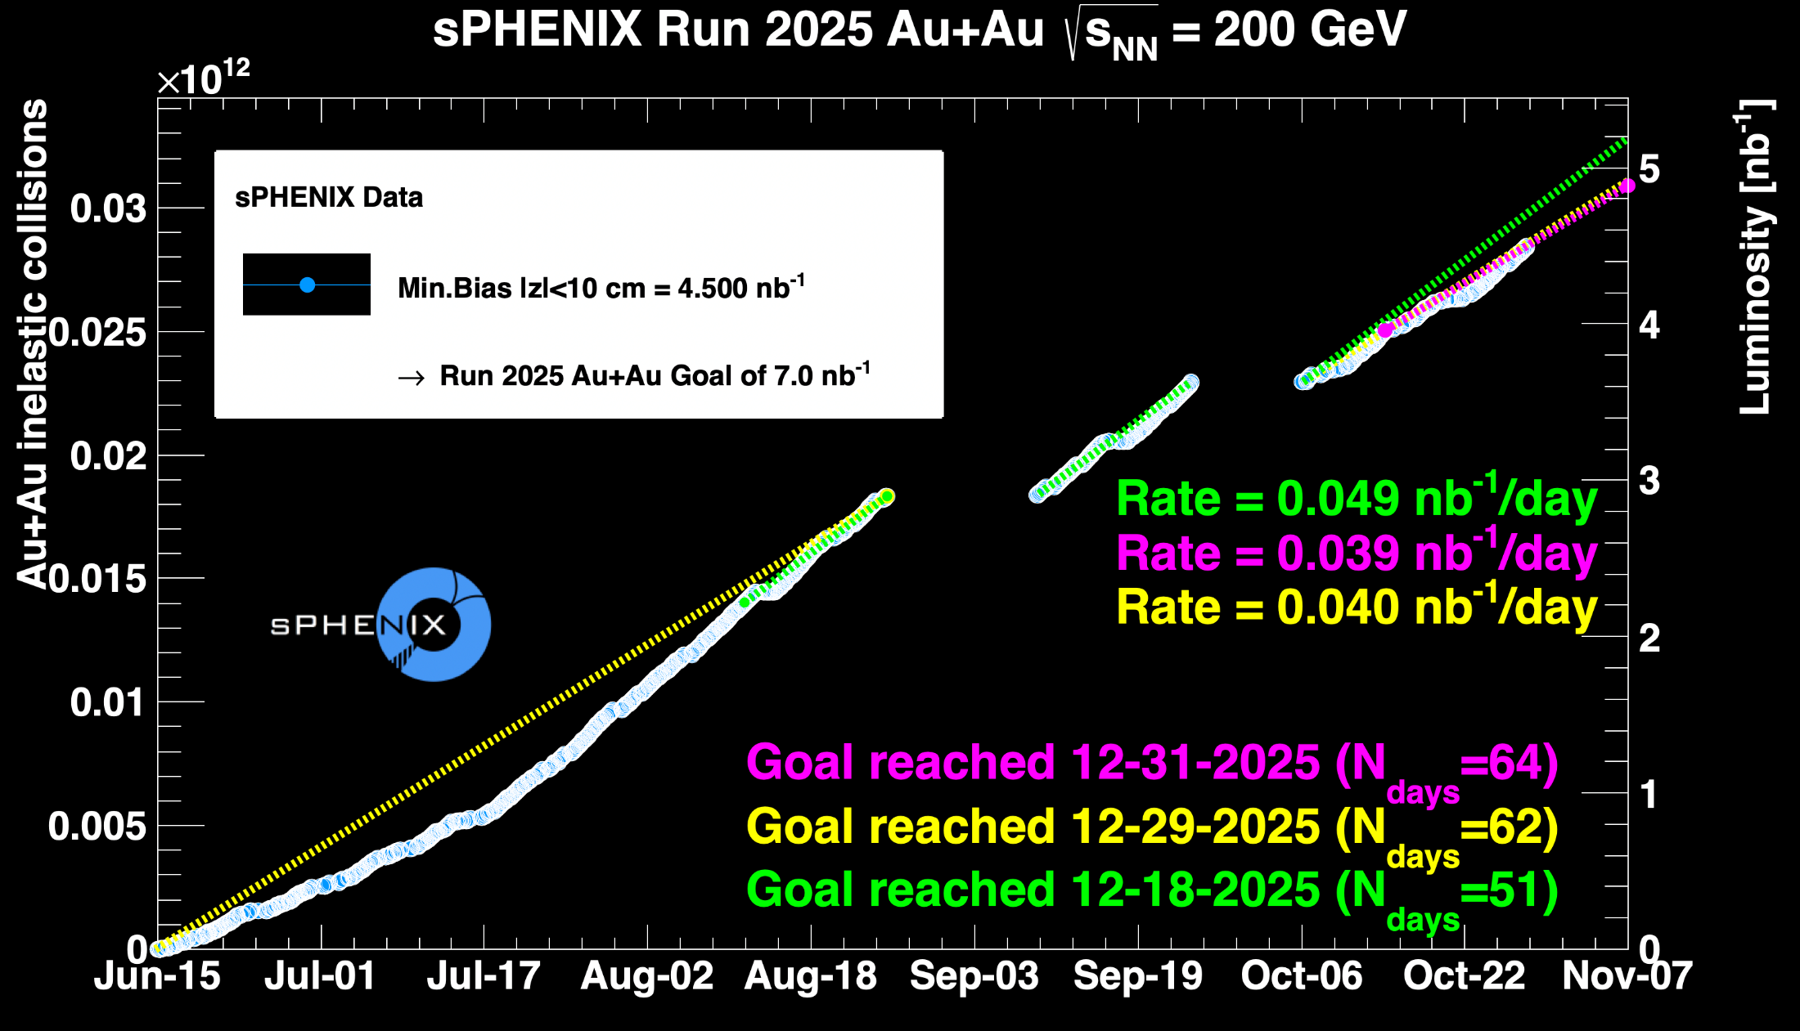
sPHENIX Status (cont.)

