Slide 1
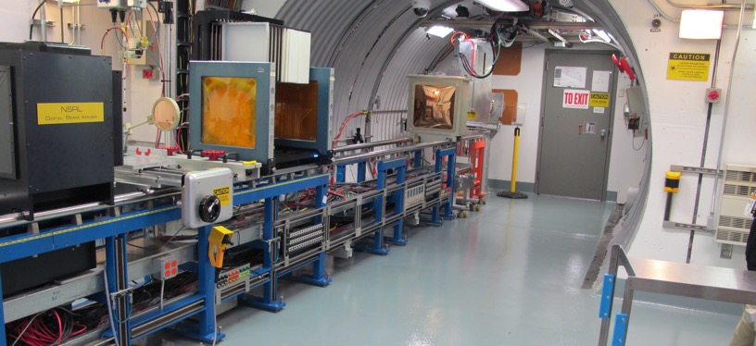
NSRL Time Meeting Report
28 October 2025
Michael Sivertz

Slide 2
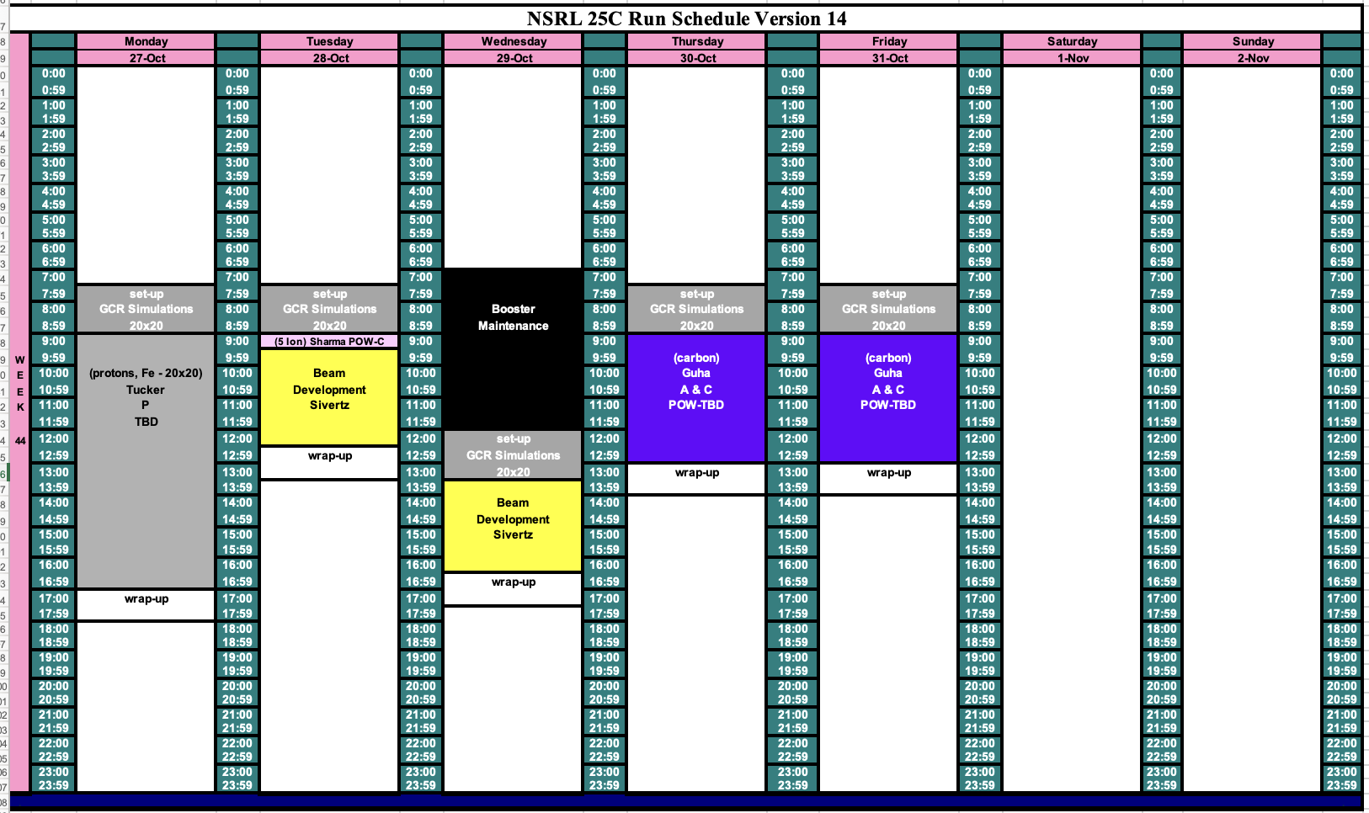
Schedule for this week

Slide 3
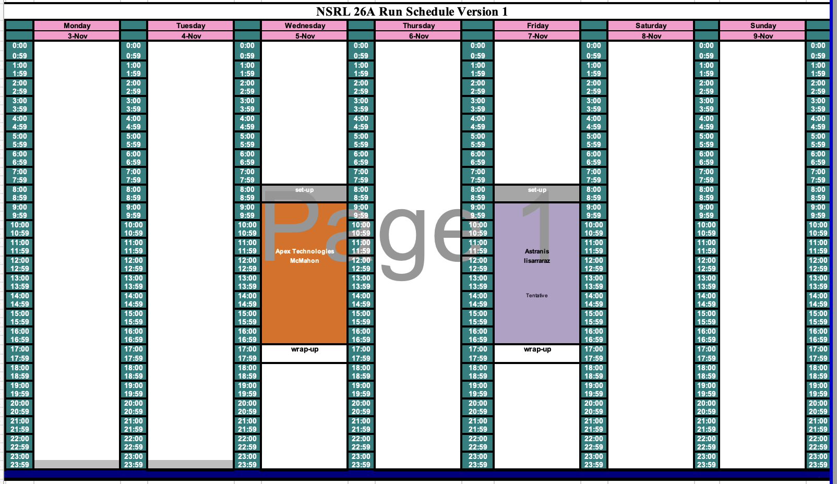
Schedule for next week

Slide 4
Future Schedule
This is the last week of NASA Radiobiology.
Electronics testing in November and December is STILL in jeopardy due to government shutdown. The lab is unable to accept funds, even though we have them in hand.
Working with EBIS to develop H3+ beam as the source for protons to NSRL.
Also studying molecular H-He+ as the source for both protons and Helium without having to change EBIS set-up. Only changing the R-line to switch species.

