Slide 1
Data courtesy C. Naylor

Slide 2
Data courtesy C. Naylor

Slide 3
Data courtesy C. Naylor

Slide 4
Data courtesy C. Naylor

Slide 5
Data courtesy C. Naylor

Slide 6
Data courtesy C. Naylor

Slide 7
Data courtesy C. Naylor

Slide 9
Data courtesy C. Naylor

Slide 10
Data courtesy C. Naylor

Slide 11
Data courtesy C. Naylor

Slide 12
Data courtesy C. Naylor

Slide 13
Data courtesy C. Naylor

Slide 14
Data courtesy C. Naylor

Slide 15
Data courtesy C. Naylor

Slide 16
Data courtesy C. Naylor

Slide 17
Operations for BLIP
No BLIP
this past week
BLIP remains in shutdown.
Linac off since 8 July.
Notes:
BLIP plot from LogView /MCR/PerformanceStats/timeMeetingBLIP.lvdisp
Avail calc on nsrl time Excel sheet

Slide 18
NSRL activity past week: 10/21-28/2025 (as of 0800)
NSRL running continues.
Various setup, NASA biology and user beam time through the week.
11 EBIS species logged to NSRL.
Run 25-C began 30 June; concludes 31 October.
Run 26-A schedule posted with users up to 19 December.
Availability: 93.4%
Notes:
Graph and avail calc from nsrl time.xlsx

Slide 19
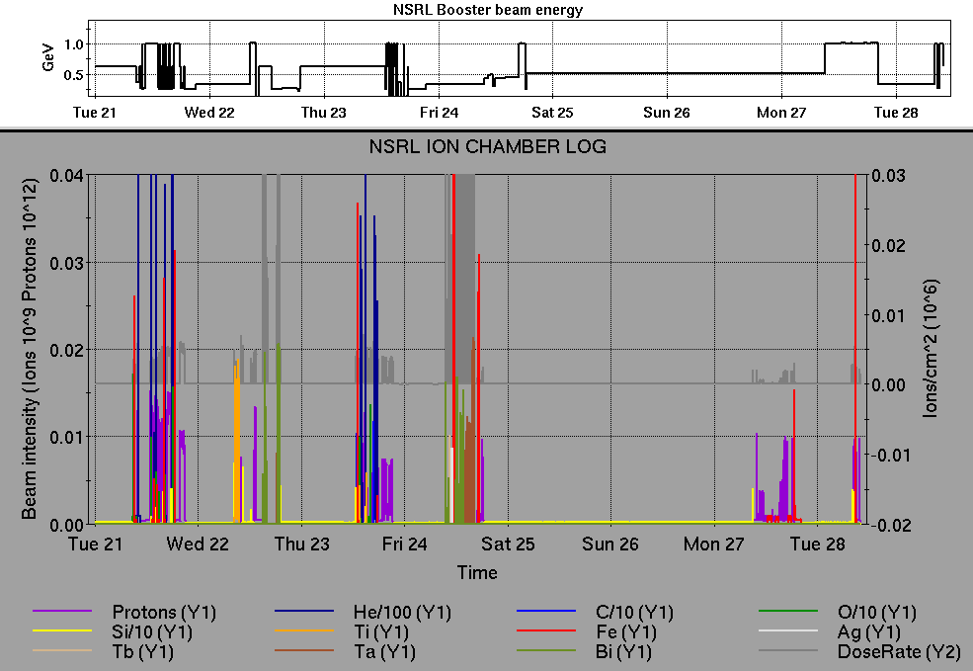
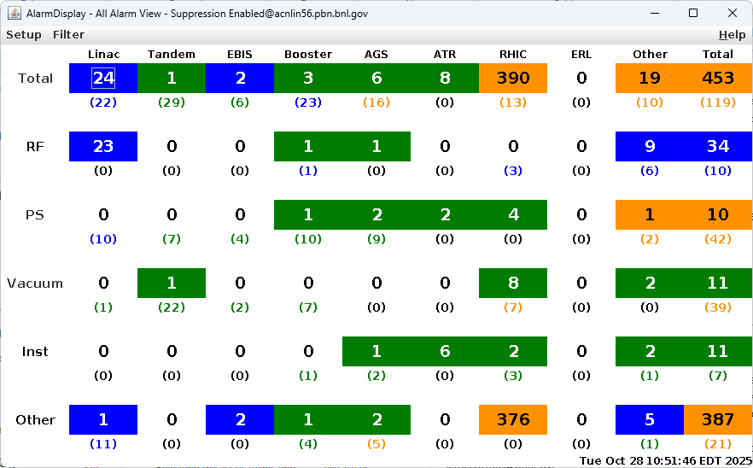
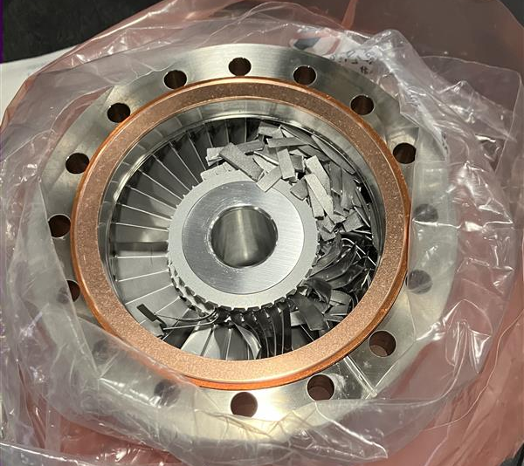
Notes from Operations
Notable failures (>1 hr)
AGS MMPS relay failure, replacement required halting motor
Access for Yellow abort kicker fiber optic cable; delays
restoring operation, scope logging
Blue abort kicker timing monitor software errors
YA2 multiple trips, access for tuner servo repair
Tandem TtB section 27 trim dipoles overvoltage failure (2x);
DAC card replaced, breakers & valves reset
7b-qd1 quench detector card failure voltage tap signal drift,
access for (unsuccessful) swap
EBIS short trap turbo pump mechanical failure, replaced.
Other notes
BPM beam abort, 9A network switch reset
Blue BS1 (2x), BS3 RF crowbar fault (1x), reset; BS3 required
grid supply replacement
NQBPS abort; sextupole trip and possible line voltage fluctuations
STAR low level gas alarm, beam dumped for access
BLM abort at transition
STAR magnet system communications failure
7C network switch failure, reset
H10 septum PS water flow trips
sPHENIX access for water leak check
Controlled Access key left the BNL site
Other various trips, resets, tuning, foil
changes (28 resets logged, in addition to
short failures)
Over 41 hours CeC time logged this week, prior
to halt for SRF gun; other injector setup,
training behind stores
Notes:
NSRL plot from LogView /MCR/PerformanceStats/timeMeetingNSRL.lvdisp, select Dose Rate and ion species in use
Screenshot of AlarmSummary

Slide 20
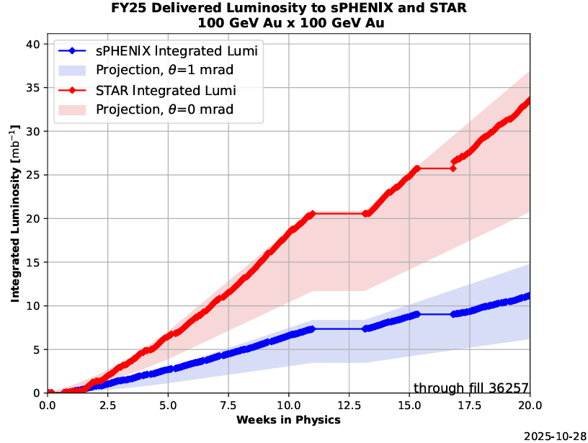
Reminder from Operations
MCR beam operations continue
  RHIC physics continues
    Tandem (MP7) remains sole provider of Au31 for RHIC
  NSRL shifts scheduled for users, MD, and NASA biology, 5-6 days/1-2 shifts this week and next.
    Au31 from Tandem for higher intensity
    Other ion beams from EBIS; H₂ intended for H delivery
  No BLIP runs on calendar yet. ORC TBD.
    Linac OPPIS beam to HEBT, Booster
    expected next week.
  AGS tuning, other studies to continue behind
  stores as time allows
  MCR shift coverage 24/7.
Data courtesy A. Nicola/C.S. Towle

Slide 21
Keytree notes
Remote keytree systems require a database lookup to validate and authorize distribution of keytokens. The Keytrak system’s database is available for lookup functionality, but can no longer be modified in any way to add or edit qualified personnel.
Personnel affected:
New employees, experimenters arriving after 12/1/2024 could not be enrolled in database
Existing employees & experimenters, not already enrolled, cannot be added or modified in database
Remote keytrees affected:
Iris scan @NSRL
BNLID scan @AGS South gate, North Conjunction Gate
Iris scan @RHIC STAR, sPHENIX, IP12, IP4
Keytrees NOT affected:
BNLID scan @Linac, Booster
BNLID scan @RHIC IP2
MCR keytrees

Slide 22
Keytree notes, continued
Mitigation:
Choose entrants that are currently enrolled to perform the work in the enclosure under Controlled Access (CA).
Obtain CA keys from MCR for remote gate watch
Arrange for local gate watch using other tokens for entrants.
Arrange for Restricted Access, and allow for delays incurred to sweep areas.
CAUTION
Follow procedures. Gate Watch staff will remain vigilant.
  No “piggy-backing” – one key/token per entrant.
  Access keys are not candy! Authenticated entrant retains possession.
Radiological Controls and the Access Controls System are not to be circumvented. This is (has been) enforced with disciplinary action (dismissal).

Slide 24
Notes:
Reliability comparisons to previous runs

Slide 25
Notes:
Reliability comparisons to previous runs

Slide 26
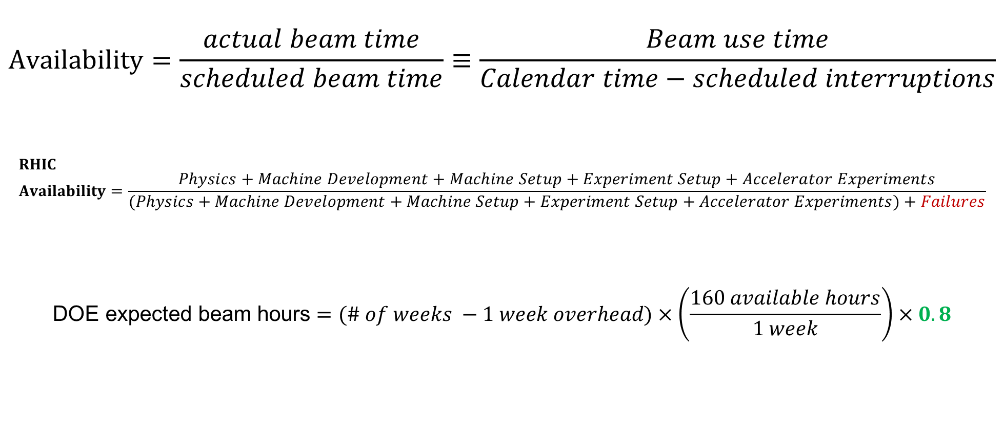
Availability, expected beam hours
$$Availability=\frac{actual beam time}{scheduled beam time}≡\frac{Beam use time}{Calendar time−scheduled interruptions}$$
$$RHIC \\ Availability=\frac{Physics+Machine Development+Machine Setup+Experiment Setup+Accelerator Experiments}{(Physics+Machine Development+Machine Setup+Experiment Setup+Accelerator Experiments)+Failures}$$
$$\text{DOE} \text{expected} \text{beam} \text{hours}=(\# of weeks −1 week overhead)×\left(\frac{160 available hours}{1 week}\right)×0.8$$
Notes:
Normally hidden. Explains how the 85% from DOE comes in to play, & general availability metrics

