Slide 1
APEX Report
Time Meeting, Oct. 28, 2025

Slide 2
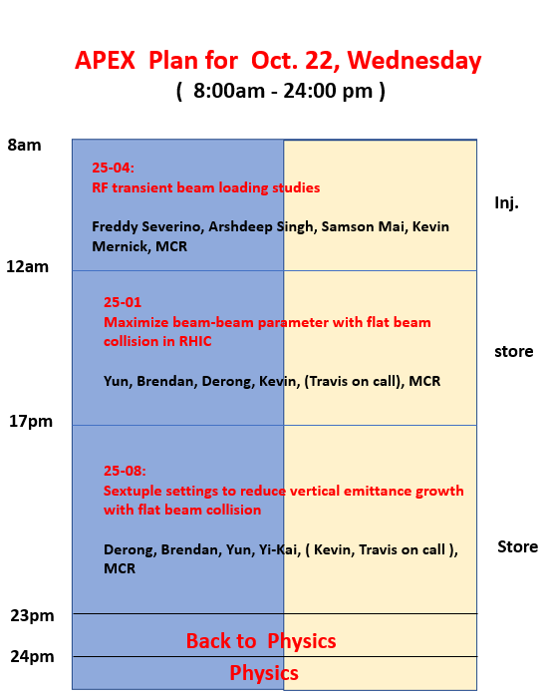
Planned 15 hours, used 12 hours. Stopped experiments earlier since the last experiment lost beams at collision.

Slide 3
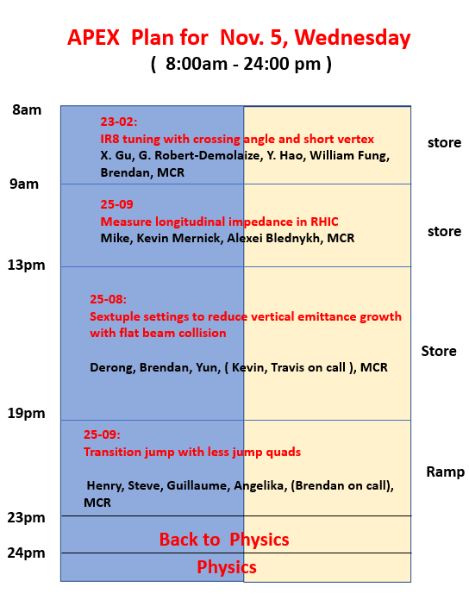
DRAFT

