Slide 1
Preinjector Status
D. Raparia
Time Meeting
November 04, 2025

Slide 2
Tandem
MP7- RHIC support
Running well
MP6 – external users
External user Wednesday-Thursday

Slide 3
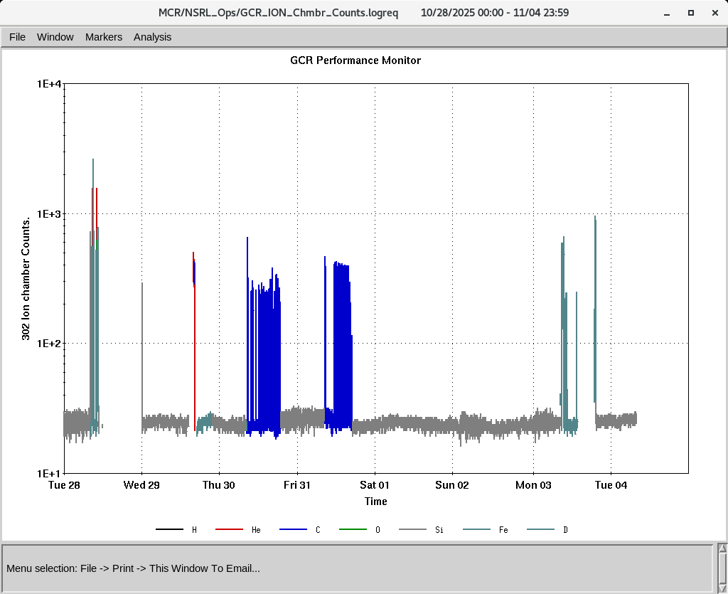
EBIS
Smooth operation for NSRL
Providing all the ions to setup GCR and electronics
Working molecular hydrogen
Planning to provided molecular HeH⁺ to NSRL to provide He and H both. Only change in the NSRL beam line (R-Line) . Working on USI
IONS to NSRL
H₂⁺ He⁺ ² C⁺⁵ O⁺⁷ Si^{+11 ,}Fe⁺²⁰

Slide 4
LINAC
Linac will be ready for PP beam by 2st week of Nov
BLIP requesting beam on 12/29/2025
OPPIS, conditioning < ~ 500 uA at FC4 ( before RFQ)
High intensity H- source is conditioning
Last Thursday and Friday, due to excessive vacuum activity in Tank 5 at full gradient, we opened and cleaned two collars and four tuners.
RF conditioning well , should be ready by Friday
Possibily try PP to 200 MeV polarimeter on Friday

