Slide 1
sPHENIX Status
Kin Yip
sPHENIX Director of Operations
Time Meeting
Nov. 4, 2025

Slide 2
sPHENIX Status
sPHENIX continues to accumulate luminosity towards the luminosity goal of 7/nb (Au + Au).
TPC and other subsystems have survived ~4 unplanned beam aborts on Oct. 30 without harm.
sPHENIX work hard to resolve emerging issues expeditiously:
Computer node gserver1 (nfs server that stores log files) has been unstable and resulted in a few hours of downtime in sPHENIX data taking.
MVTX data link errors (affecting 1% of the sensors) were first thought to be due to transceiver issue; but investigation during Monday’s (Nov. 3) access narrowed down the issue to the Readout Unit board which was then replaced.

Slide 3
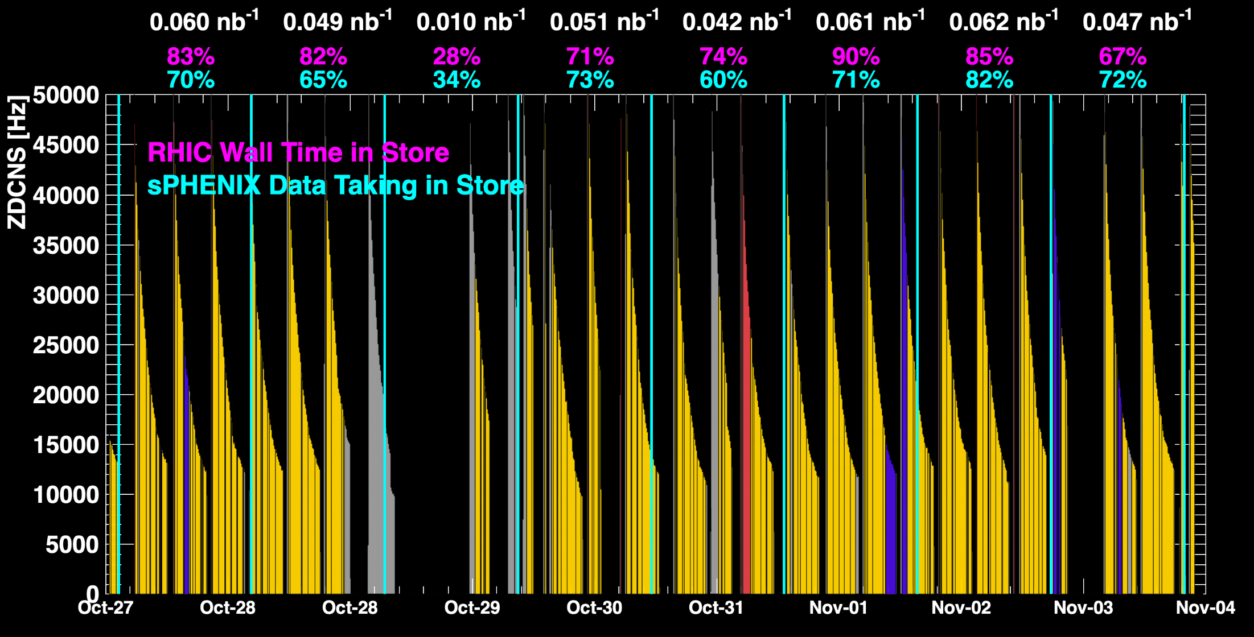
sPHENIX Status (cont.)
1008C pump trips
CDU issue
1008C pump trips
CDU issue
6x6
When all sPHENIX detectors were being operated.
No MVTX
No TPC

Slide 4
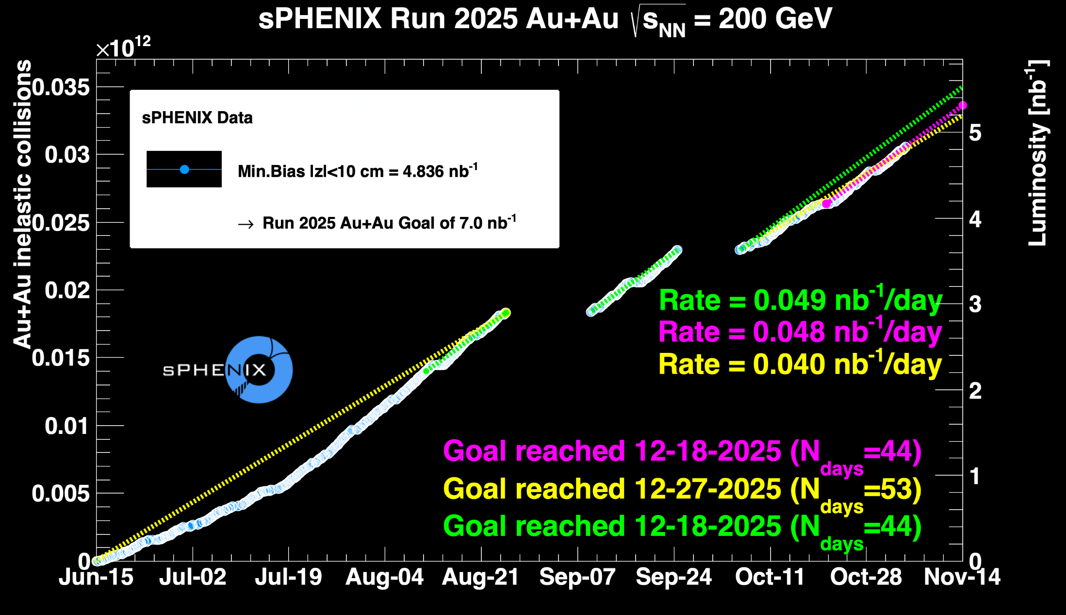
sPHENIX Status (cont.)
> 69%

