Slide 1
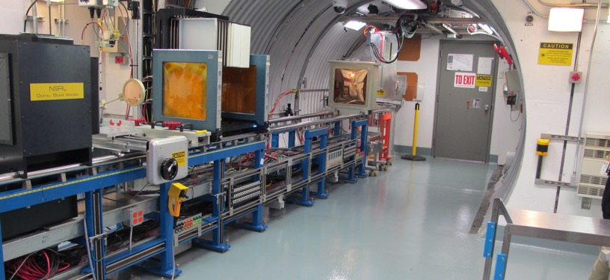
NSRL Time Meeting Report
4 November 2025
Michael Sivertz

Slide 2
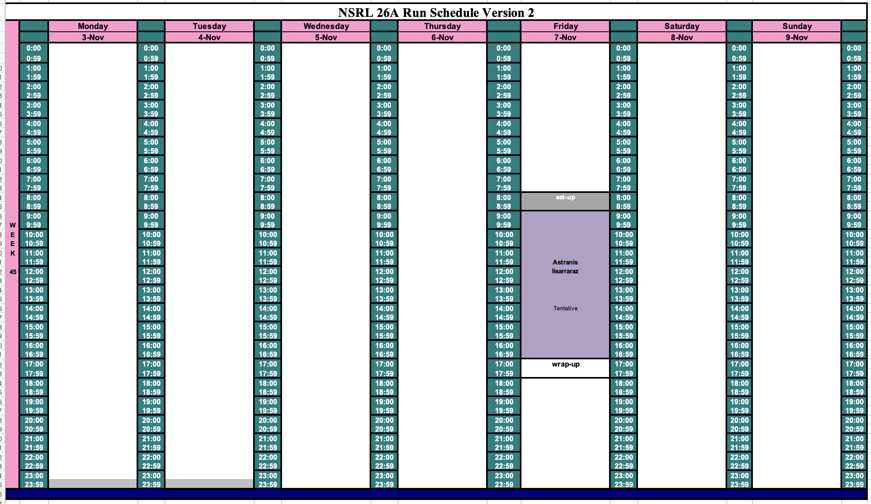
Schedule for this week

Slide 3
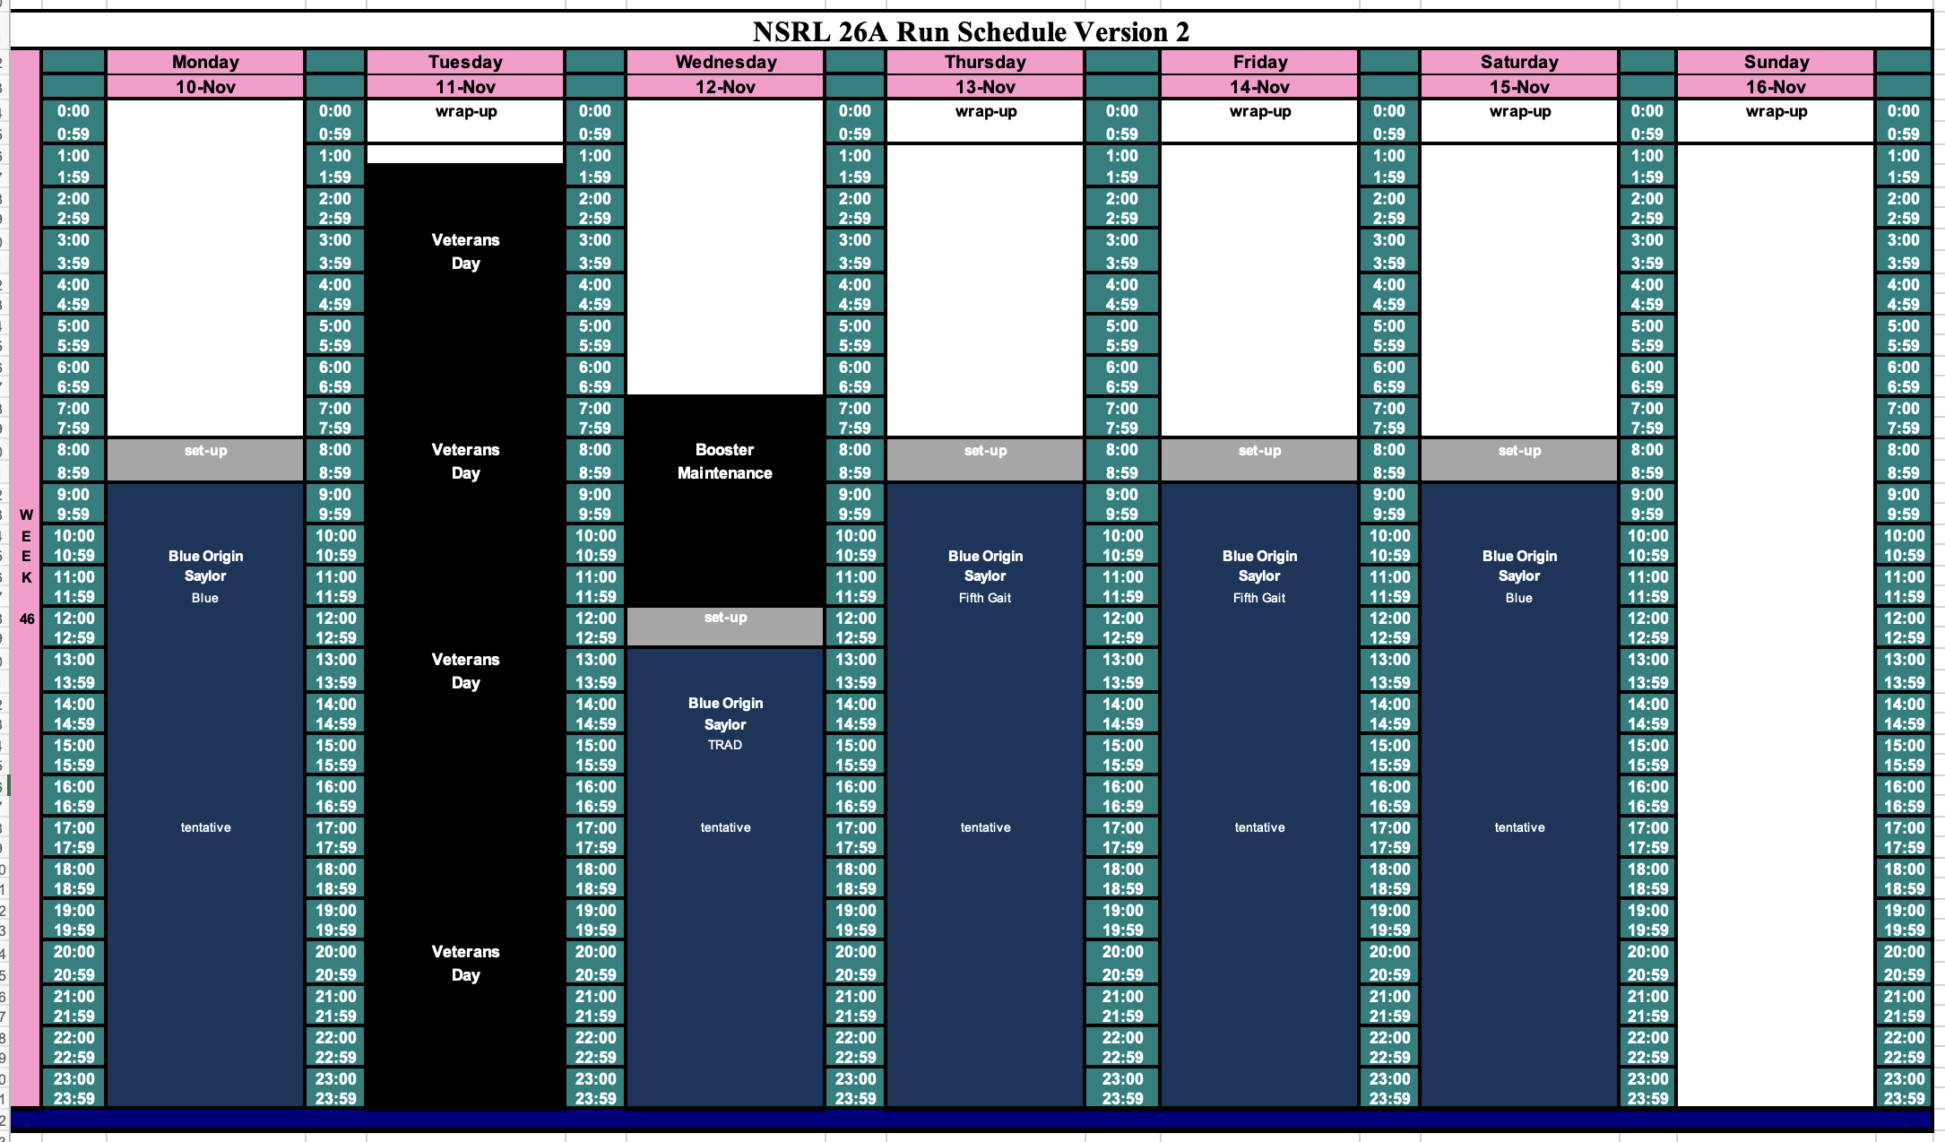
Schedule for next week

Slide 4
Future Schedule
NASA Radiobiology is finished for the year. No booties required at NSRL.
Beam development from EBIS (H3+ and noble gases) this week.
Electronics testing in November and December is starting on Friday.
Many groups have cancelled due to funding uncertainty.

