Slide 1
Preinjector Status
D. Raparia
Time Meeting
November 18, 2025

Slide 2
Tandem
MP7- RHIC support
Running well
Au⁺³¹ to NSRL on Saturday and Monday
MP6 – external users
This week Ion source group experiment

Slide 3
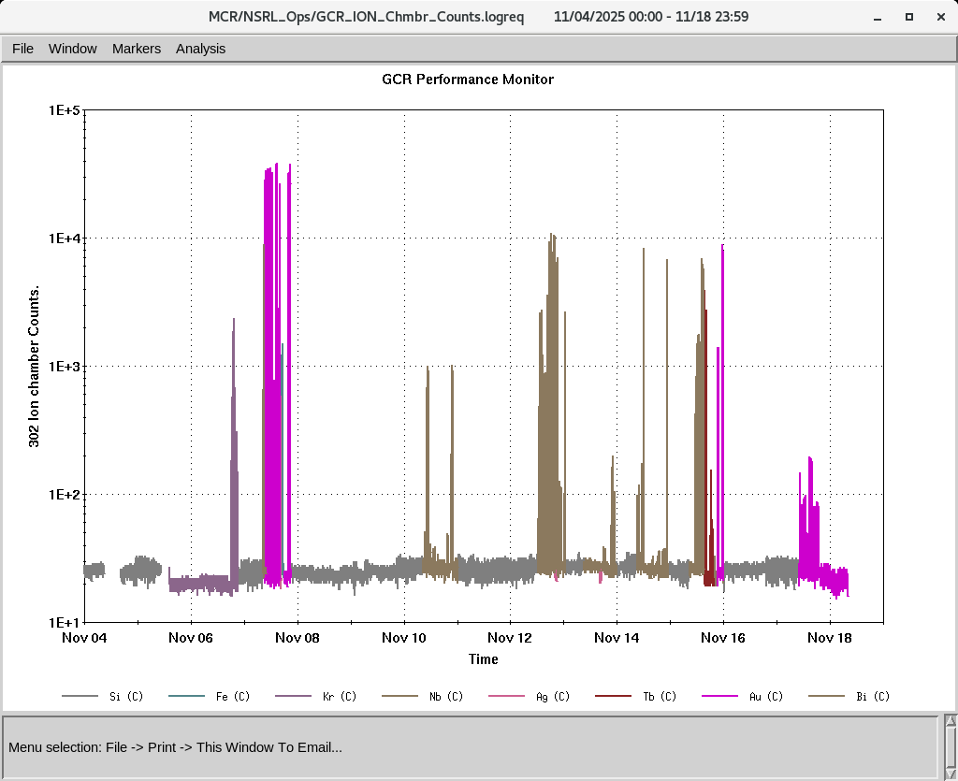
EBIS
Smooth operation for NSRL
Providing all ions
On Saturday ETB quad PS failed; was repaired on Monday
IONS to NSRL
Si^{+11 ,}Fe⁺²⁰ , Kr⁺¹⁸,Nb⁺²³,Ag⁺²⁹, Tb⁺³⁵,Bi⁺⁴³,
Au⁺³¹ (Tandem)

Slide 4
LINAC
BLIP requesting beam on 12/19/2025
PP beam to booster yesterday
OPPIS running with norm beam current , Pol ~ 80%
High intensity H- source is conditioning
Tank 7 has an issue for high current operation, ( fine for PP operation) Diagnosis is scheduled for Wednesday (11/19) and text Tuesday (11/25) .

