Slide 1
sPHENIX Status
Kin Yip
sPHENIX Director of Operations
Time Meeting
Nov. 18, 2025

Slide 2
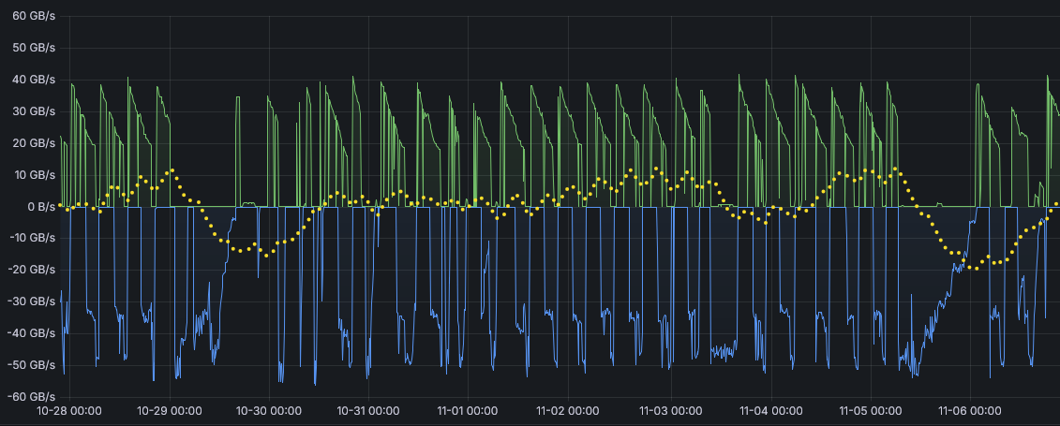
sPHENIX Status
sPHENIX continues to accumulate luminosity towards the luminosity goal of 7/nb (Au + Au).
Efficient data operation peaking at 40 GB/s (intake) and 50 GB/s (SCDF migration):
Thanks to SCDF maintaining high up time for data migration.
sPHENIX recording → ~40GB/s
(RHIC APEX)
(RHIC maintenance)
Data in – Data out
SCDF migration → 50 GB/s

Slide 3
sPHENIX Status
The TPC trip recovery tools for the shifters are getting better and better.
Works on Nov. 12 (Maintenance Day) include cooling for TPC laser (South), power supply for TPC Central Membrane, MPOD (chassis) for EMCAL.
PLC software in 1008 Gas Mixing House crashed late Sunday night which disturbed gas flow to TPC for ~4 hours. The TPC gas composition was recovered to the appropriate proportions Monday evening ~8 pm.
One of the 3 compressors for Chiller #4 started to trip at the end of last week. Motor fan replacement last Fri. didn’t fix the problem.
Thanks F&O for giving us top priority to repair it.

Slide 4
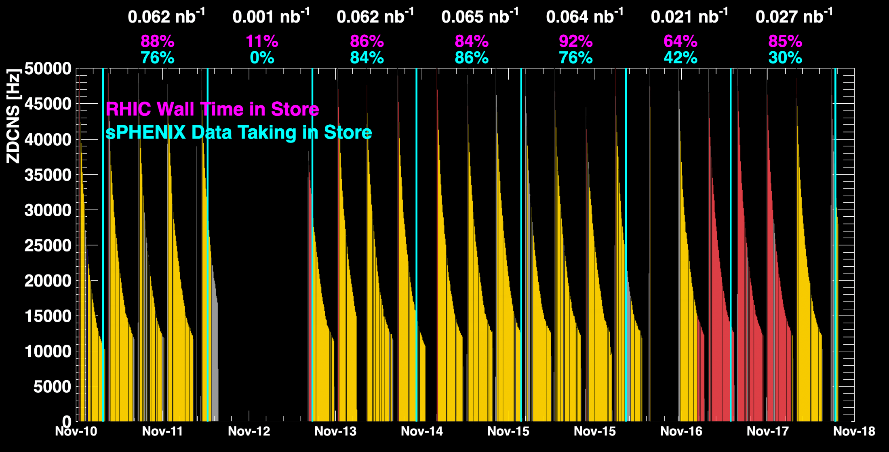
sPHENIX Status (cont.)
1008C pump trips
CDU issue
1008C pump trips
CDU issue
6x6
When all sPHENIX detectors were being operated.
No TPC

Slide 5
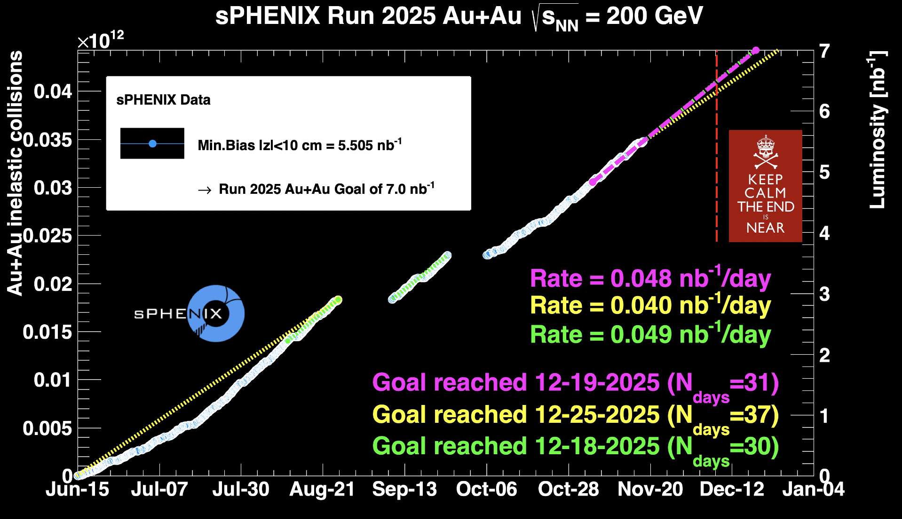
sPHENIX Status (cont.)
~ 78.6%

