Slide 1
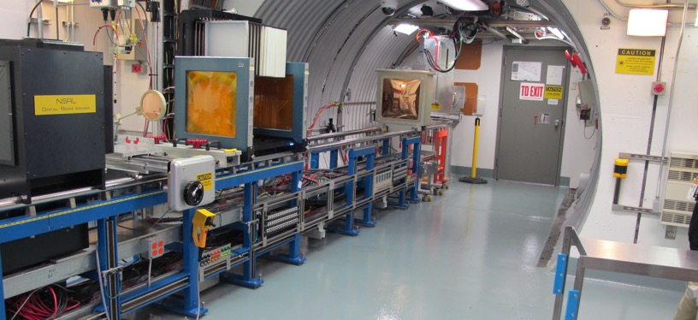
NSRL Time Meeting Report
18 November 2025
Michael Sivertz

Slide 2
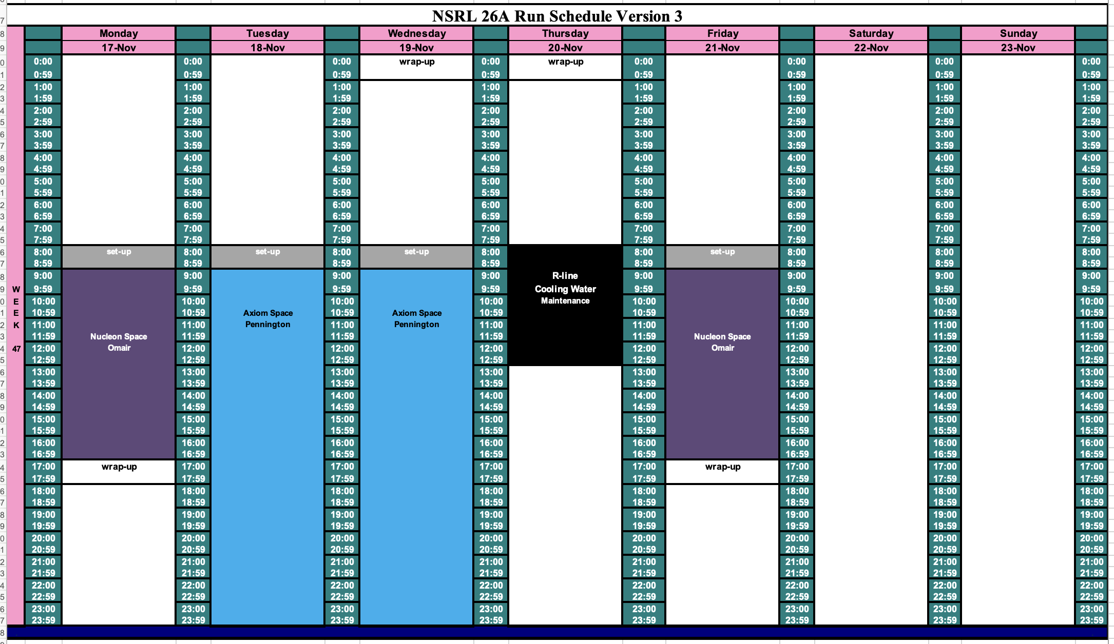
Schedule for this week

Slide 3
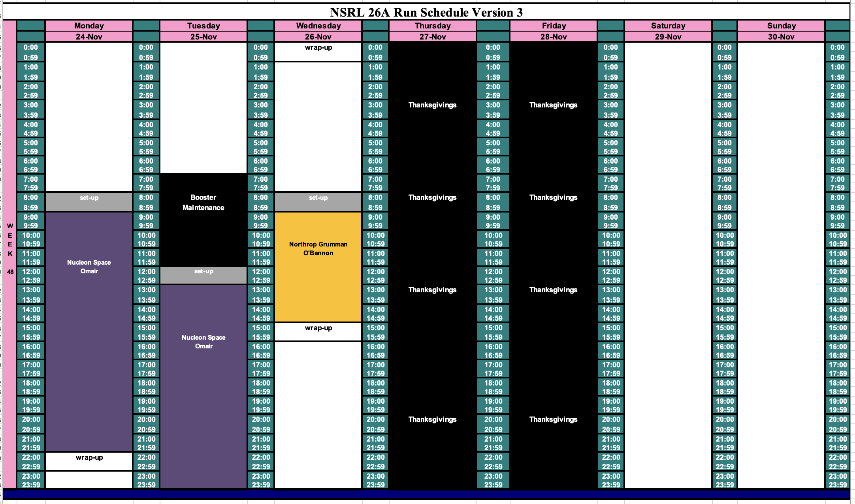
Schedule for next week

Slide 4
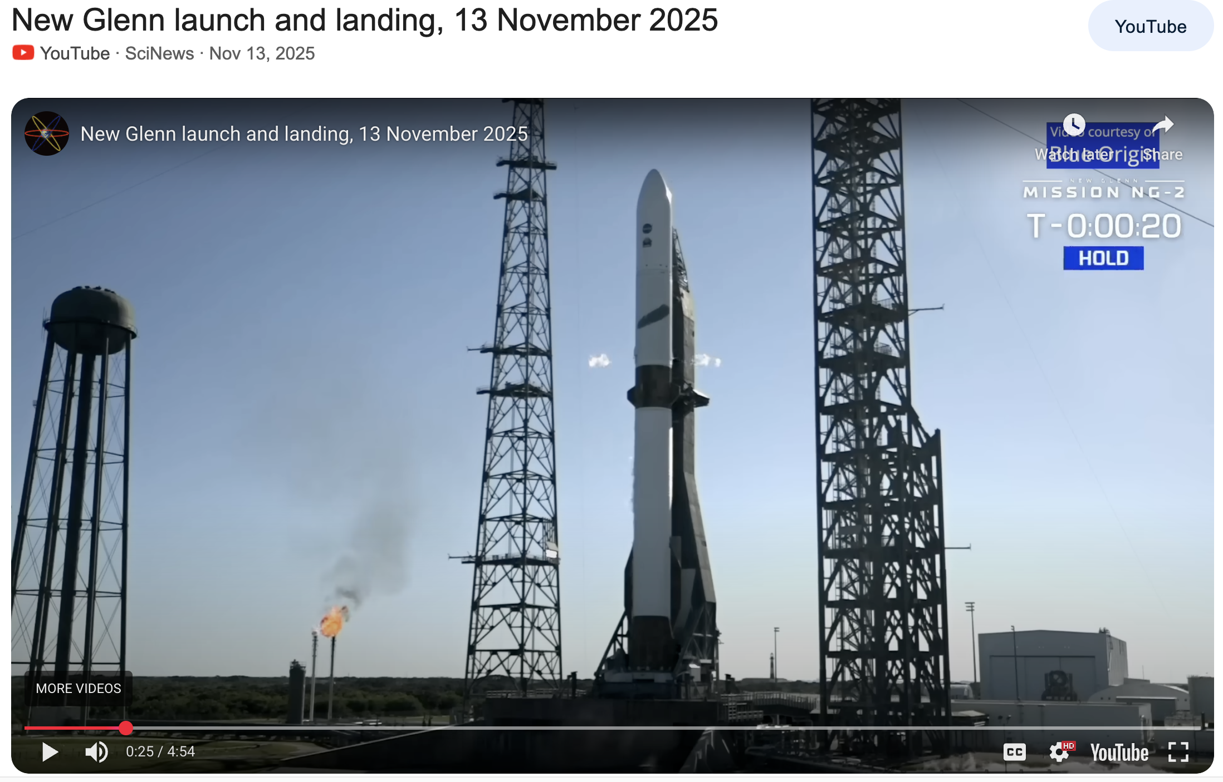
Future Schedule
Daily electronics testing: Smooth running from both Tandem and EBIS.
Last week we had a team from Blue Origin testing. While they were at NSRL, there was a launch of New Glenn-2. Share the excitement with this video clip

