Slide 1
Data courtesy C. Naylor

Slide 2
Data courtesy C. Naylor

Slide 3
Data courtesy C. Naylor

Slide 4
Data courtesy C. Naylor

Slide 5
Data courtesy C. Naylor

Slide 6
Data courtesy C. Naylor

Slide 7
Data courtesy C. Naylor

Slide 8
Data courtesy C. Naylor

Slide 10
Data courtesy C. Naylor

Slide 11
Data courtesy C. Naylor

Slide 12
Data courtesy C. Naylor

Slide 13
Data courtesy C. Naylor

Slide 14
Data courtesy C. Naylor

Slide 15
Data courtesy C. Naylor

Slide 16
Data courtesy C. Naylor

Slide 17
Data courtesy C. Naylor

Slide 18
Data courtesy C. Naylor

Slide 19
Operations for BLIP
No BLIP
this past week
BLIP remains in shutdown.
Linac off since 8 July.
Notes:
BLIP plot from LogView /MCR/PerformanceStats/timeMeetingBLIP.lvdisp
Avail calc on nsrl time Excel sheet

Slide 20
NSRL activity past weeks: 11/4-18/2025 (as of 0800)
NSRL running continues.
Various setup and user beam time through the week.
8 EBIS species (H3/C, Fe, Kr, Ag, Nb, Ta, Au, Bi), Tandem Au logged to NSRL
Run 25-C began 30 June; concluded 31 October.
Run 26-A schedule posted with users up to 19 December.
Availability: 99.7%
Notes:
Graph and avail calc from nsrl time.xlsx

Slide 21
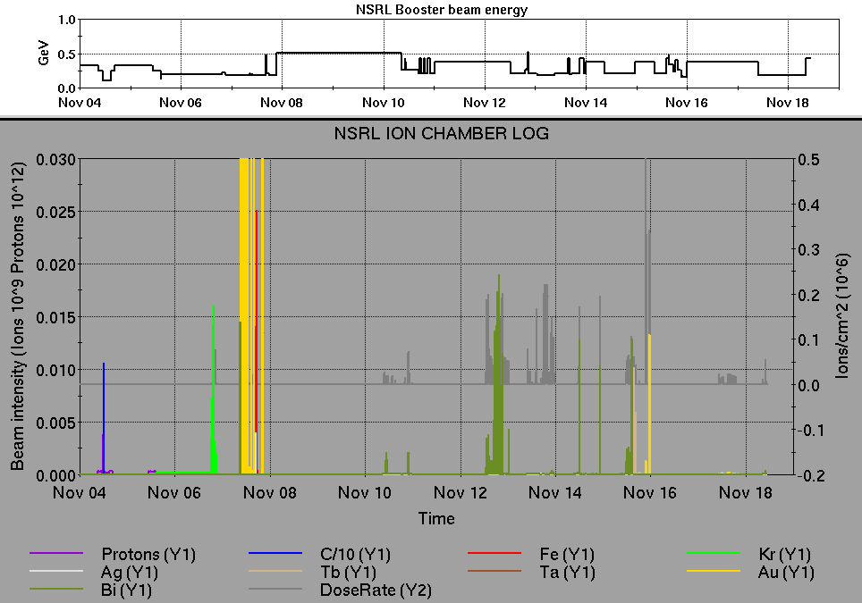
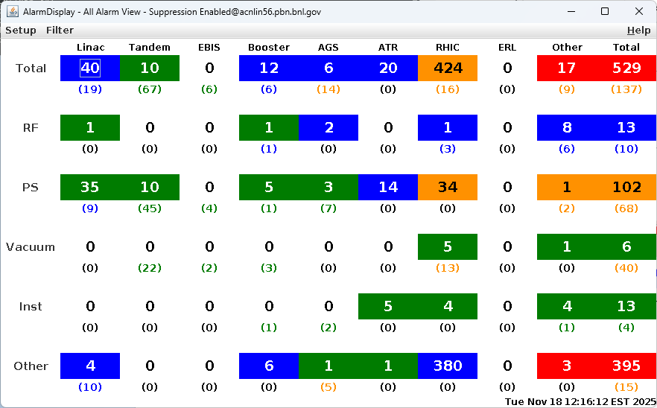
Notes from Operations
Notable failures (>1 hr)
sPHENIX TPC trip following beam abort, beam restoration
delayed
MPS beam abort, 56MHz insulating vacuum failure, roughing
pump replaced
Yellow QLI, quench detector 4b-qd2 comm failure
AGS A5 kicker replacement PS failure, original reinstalled
Blue QLI at injection, failed QPA for bi5-qf1-ps replaced
Beam abort, 1a-ps1 FEC failure due to HVAC failures
Controls failure, access encountered cfe-5c-ps1 UPS failed;
disconnected
Power dip affecting systems across the complex; RHIC BS5
required call-in to replace grid PS.
EBIS linac drift quad PS failure, no spare IGBT; other modules
installed
Other notes
AGS RF station KL failure, grid PS repaired
BLM beam abort at store, undiagnosed
BLM abort at store, gap cleaner setup issues
BLM permit filling yellow, AtR retuned
BLM beam abort on ramp, BBQ lost tune lock
AGS RF station JK crowbar fault, access required
STAR, sPHENIX accesses
NQBPS beam abort, bad voltage readback on yo9-qf2-ps masked
Other various trips, resets, tuning, foil
changes (58 resets logged, in addition to
short failures)
Over 45 hours CeC time logged this week; 189 hours OPPIS to HEBT,
polarized proton setup in AGS.
Notes:
NSRL plot from LogView /MCR/PerformanceStats/timeMeetingNSRL.lvdisp, select Dose Rate and ion species in use
Screenshot of AlarmSummary

Slide 22
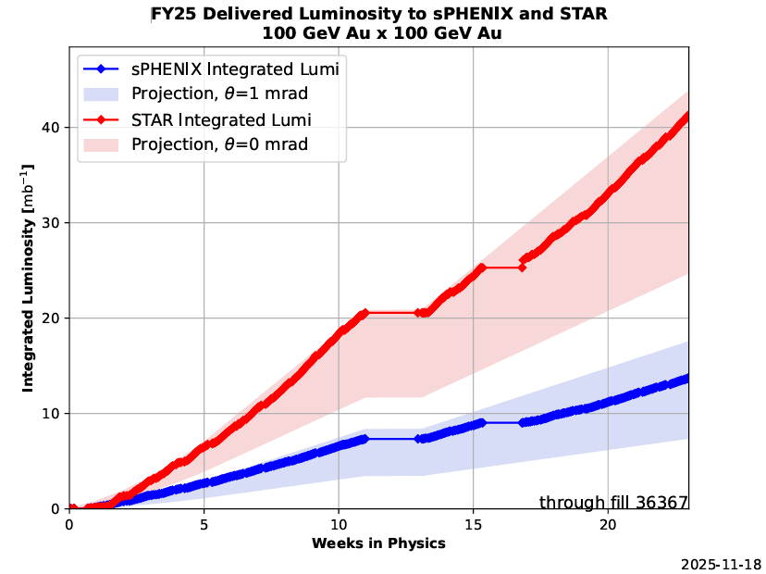
Reminder from Operations
MCR beam operations continue
  RHIC physics continues
    Tandem (MP7) remains sole provider of Au31 for RHIC
  NSRL shifts scheduled for users & MD, 5 days/2 shifts.
    Au31 from Tandem for higher intensity
    Other ion beams from EBIS;
      H₂ intended for H delivery
      H₃ production at source TBD
  BLIP run anticipated 12/19 pending Mod 7 and
  other issues. ORC in progress.
  AGS tuning, pp setup, other studies to continue
  behind stores as time allows.
  MCR shift coverage 24/7.
Data courtesy A. Nicola/C.S. Towle

Slide 23
Keytree notes
Remote keytree systems require a database lookup to validate and authorize distribution of keytokens. The Keytrak system’s database is available for lookup functionality, but can no longer be modified in any way to add or edit qualified personnel.
Personnel affected:
New employees, experimenters arriving after 12/1/2024 could not be enrolled in database
Existing employees & experimenters, not already enrolled, cannot be added or modified in database
Remote keytrees affected:
Iris scan @NSRL
BNLID scan @AGS South gate, North Conjunction Gate
Iris scan @RHIC STAR, sPHENIX, IP12, IP4
Keytrees NOT affected:
BNLID scan @Linac, Booster
BNLID scan @RHIC IP2
MCR keytrees

Slide 24
Keytree notes, continued
Mitigation:
Choose entrants that are currently enrolled to perform the work in the enclosure under Controlled Access (CA).
Obtain CA keys from MCR for remote gate watch
Arrange for local gate watch using other tokens for entrants.
Arrange for Restricted Access, and allow for delays incurred to sweep areas.
CAUTION
Follow procedures. Gate Watch staff will remain vigilant.
  No “piggy-backing” – one key/token per entrant.
  Access keys are not candy! Authenticated entrant retains possession.
Radiological Controls and the Access Controls System are not to be circumvented. This is (has been) enforced with disciplinary action (dismissal).

Slide 26
Notes:
Reliability comparisons to previous runs

Slide 27
Notes:
Reliability comparisons to previous runs

Slide 28
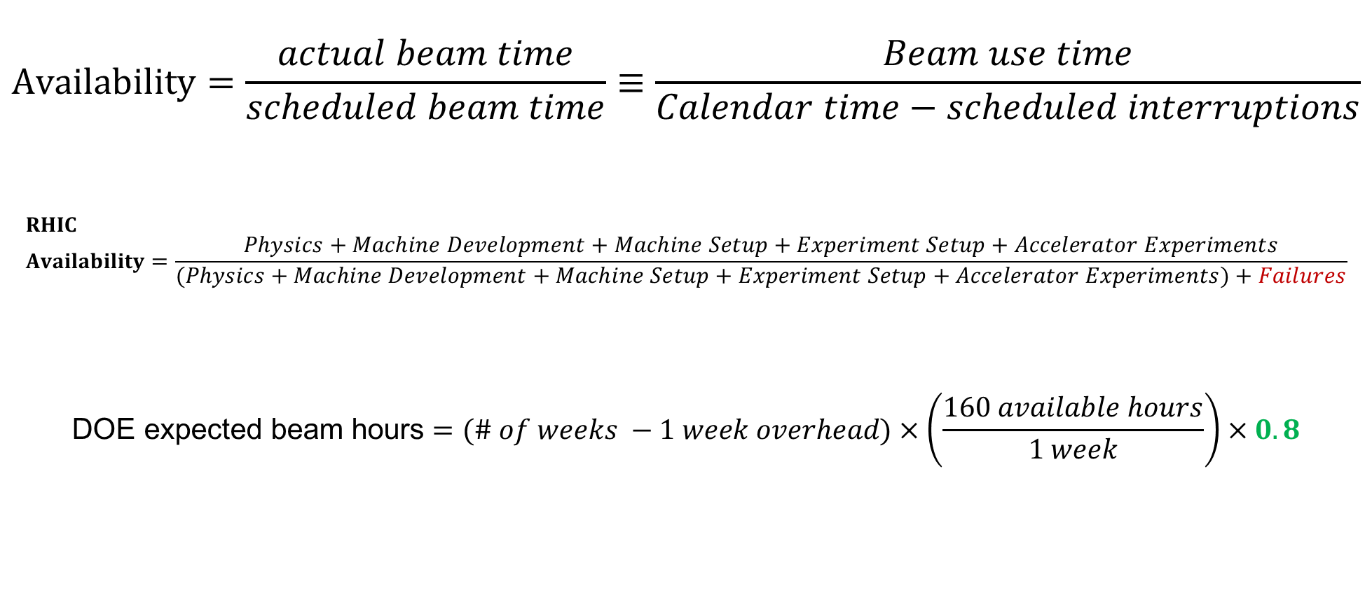
Availability, expected beam hours
$$Availability=\frac{actual beam time}{scheduled beam time}≡\frac{Beam use time}{Calendar time−scheduled interruptions}$$
$$RHIC \\ Availability=\frac{Physics+Machine Development+Machine Setup+Experiment Setup+Accelerator Experiments}{(Physics+Machine Development+Machine Setup+Experiment Setup+Accelerator Experiments)+Failures}$$
$$\text{DOE} \text{expected} \text{beam} \text{hours}=(\# of weeks −1 week overhead)×\left(\frac{160 available hours}{1 week}\right)×0.8$$
Notes:
Normally hidden. Explains how the 85% from DOE comes in to play, & general availability metrics

