Slide 1
APEX Report
Time Meeting, Nov. 18, 2025

Slide 2
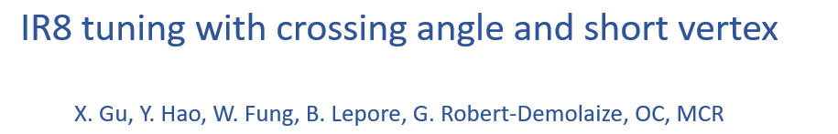
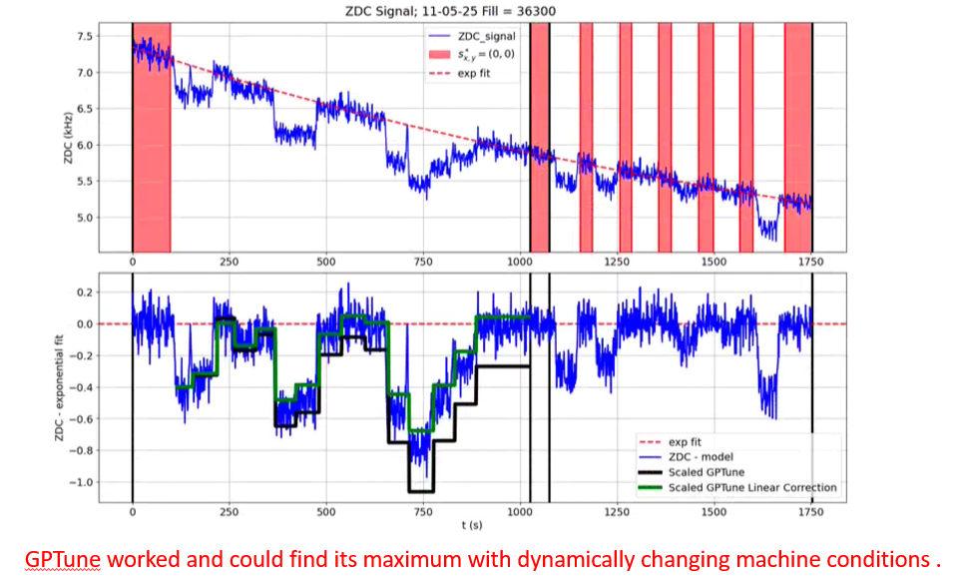
One reason we did not achieve an even higher ZDC rate is simply that the current machine setup is already optimized for maximum ZDC rate.
Another reason is that the ZDC signal is essentially insensitive to the s* shift. The script was originally designed for the sPHENIX vertex signal, which only accepts ±10 cm longitudinal collision region, with the 2 mrad crossing angle and the 56 MHz cavity on.

Slide 3

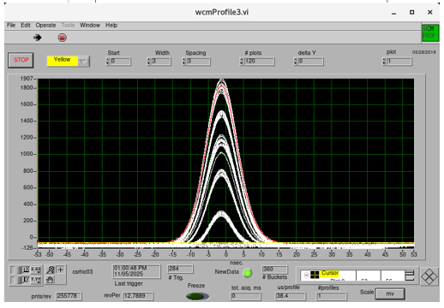
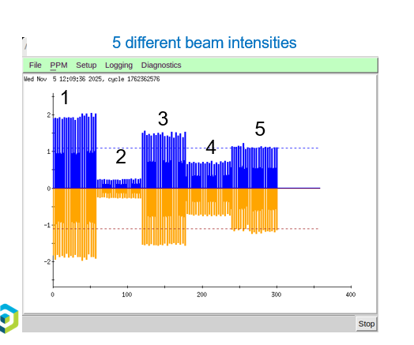
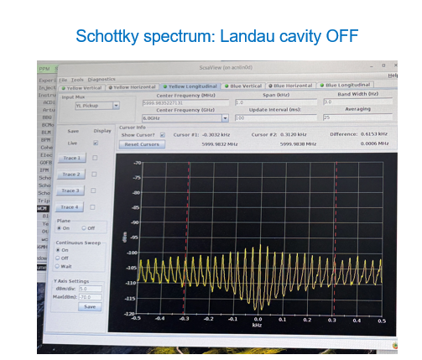
Schottky spectrum taken. Data analysis in progress.

Slide 4
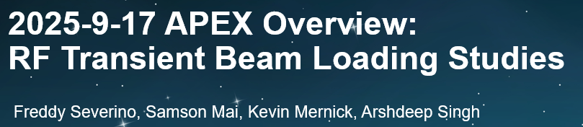
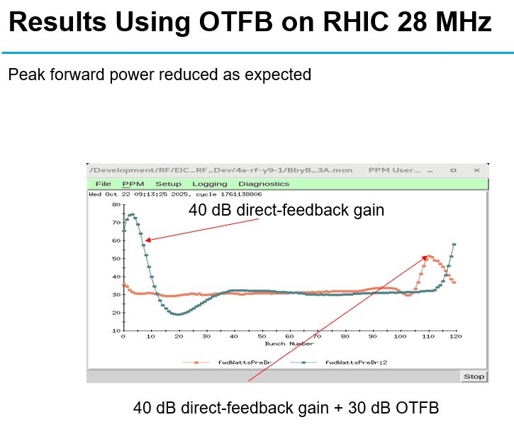
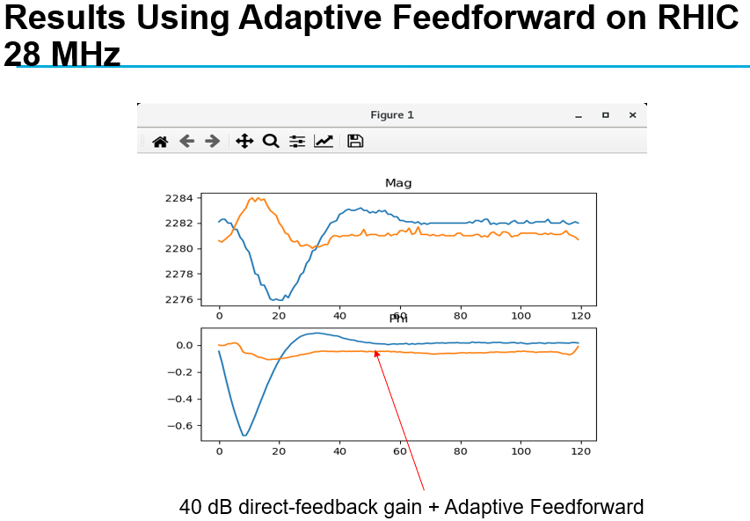
Goal achieved. Good Results!

Slide 5
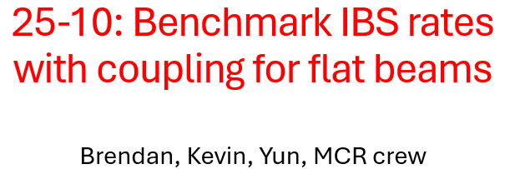
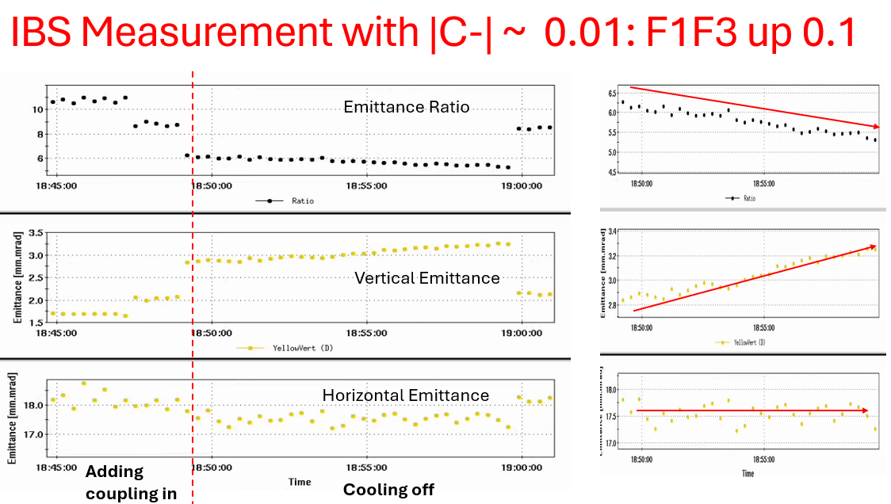
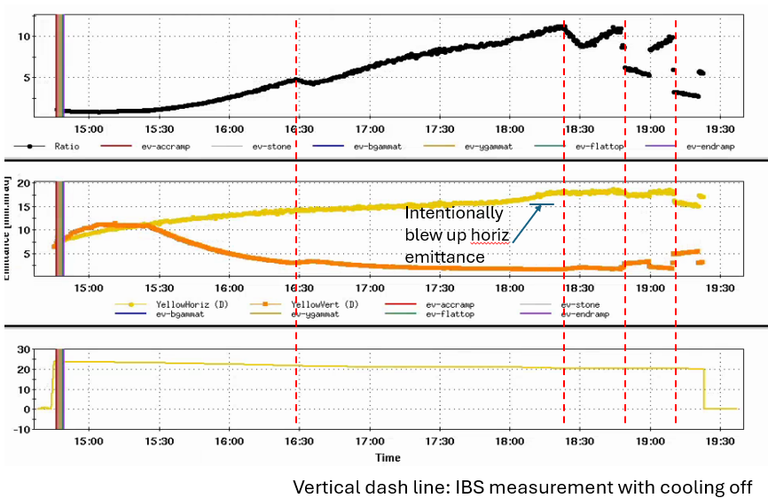
Data were taken. Data analysis and IBS modeling is in progress.

Slide 6
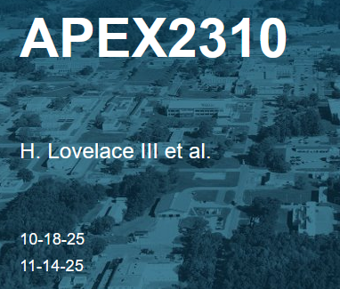
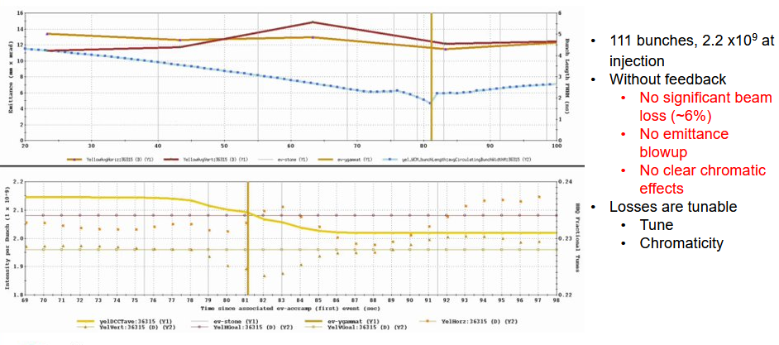
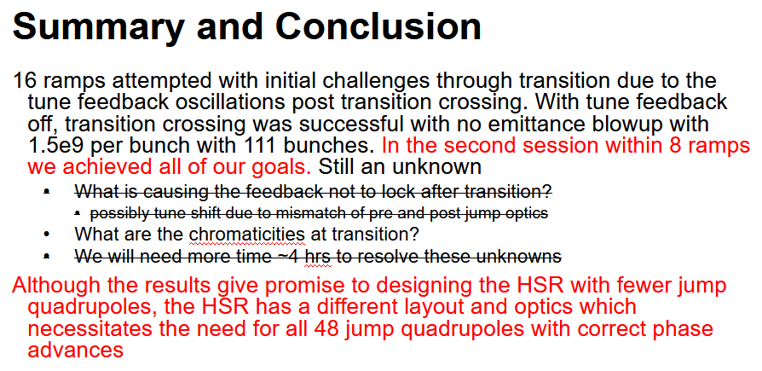

Slide 7
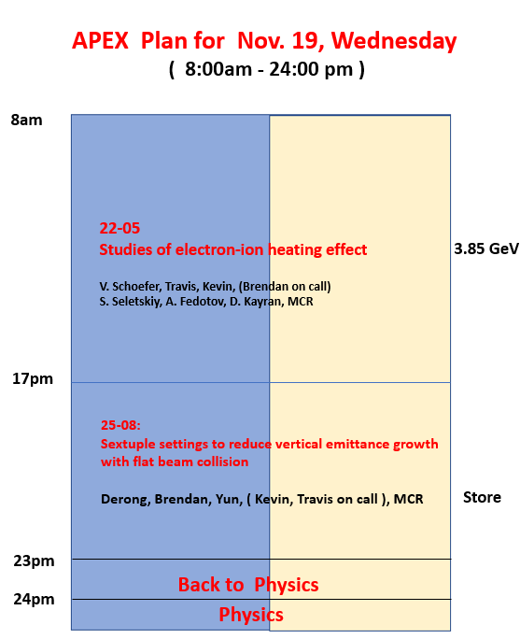
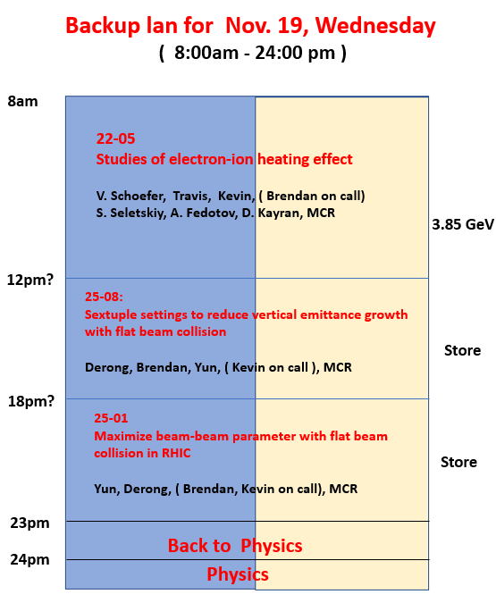

Slide 8
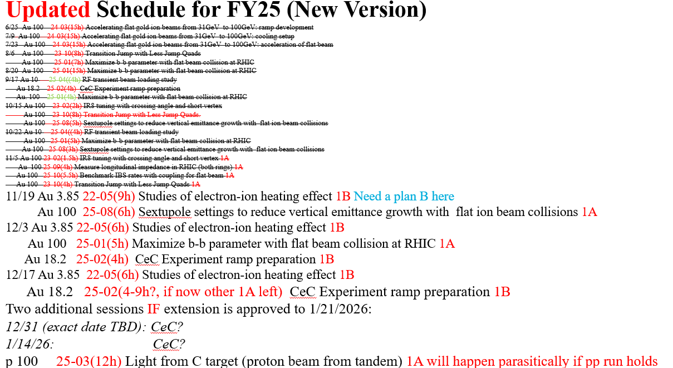
@Haixin

